Slide 1
Labor & Employment Law: 4 Big Headaches Facing Hotels
Presented by:
Art Lambert, Fisher Phillips
Direct: (214) 220-8324
alambert@fisherphillips.com

Slide 2
TIP POOLING AND OTHER WAGE-HOUR HEADACHES

Slide 3
USDOL AUDITS
Continued focus on hotel, restaurant and related industries
Random or complaint?
Notice of Audit
Investigation
Documentation/requested information
Witnesses (supervisory and non-supervisory)

Slide 4
USDOL AUDITS
Determinations
When to Challenge
Back-Pay Statements (WH-56s)
Room for Negotiation?
Liability amount – Liquidated damages?
Time for payment(s)
Know your rights and don’t get strong-armed

Slide 5
TIP CREDITS & POOLS
Tip Credit
Advance written notice
Amount of tip credit claimed
Tipped wage + tips must = applicable M.W.
$30/month in tips
20% rule (prep work/maintenance)
Tips are sole property of employee

Slide 6
TIP CREDITS & POOLS
Tip Pools
Advance written notice
Only employees who customarily & regularly receive tips
Yes: Servers, counter personnel who serve customers, bussers, service bartenders
No: Owners, managers, supervisors, janitors, dishwashers, chefs or cooks, food preparers
USDOL rule from 2011: may not pool tips unless you are taking a tip credit against pool participants’ wages

Slide 7
TIP CREDITS & POOLS
Tip Pools
Closer cases: Hosts, bar backs, expediters (server helpers?), employees who act like supervisors
If you get it wrong . . .
USDOL Fact Sheet #15
https://www.dol.gov/whd/regs/compliance/whdfs15.pdf

Slide 8
TIP CREDITS & POOLS
Recent case-law developments
Cumbie v. Woody Woo Inc. (9th Cir. 2010)
Upheld an Oregon restaurateur's right to run a tip pool that included kitchen employees, as long as the business paid employees who shared in tips at least the minimum wage.
2012 USDOL Rule Regarding Tip Pooling=no no
Rule challenged, upheld in Oregon Rest. & Lodging Assoc. v. Perez (9th Cir. 2016)
On October 24, 2017, Trump DOL submits to OMB proposed regulation rescinding 2011 tip pooling rule
Proposed rule to make such tip pooling lawful, as long as the restaurateur pays waitstaff at least the federal minimum wage ($7.25) and does not claim the "tip credit.“
Probably at least 6 months away
Impact?
SeeSaw

Slide 9
MISCLASSIFYING EMPLOYEES AS EXEMPT
Failure to pay required overtime is the most common claim in litigation
Title and salary alone are insufficient
“White Collar” Exemptions – administrative, executive, professional, computer, outside sales
Duties test
Salary basis test
The new FLSA regulation . . . never mind

Slide 10
ARE THEY REALLY EXEMPT?
Default position: Each employee is non-exempt, that is, each is subject to FLSA's requirements
Exemptions are strictly interpreted
Specific requirements apply
The employer has the legal burden to prove when challenged that each one is met
Otherwise, the employer loses

Slide 11
WHAT’S THE LATEST ON
JOINT EMPLOYER?

Slide 12
How Did We Get Here?
NLRB – Browning-Ferris Industries (2015)
Significant expansion of “joint employer” definition
Can be joint employer even if only exert “indirect control” over another’s employees
“Reserve the right” but do not actually exercise control
Jeopardizes long-standing business models, including some franchise arrangements

Slide 13
How Did We Get Here?
US DOL Administrator’s Guidance (2016)
Expanded who could be held responsible for wage-hour violations
Two scenarios: “horizontal” and “vertical”
Withdrawn June 2017

Slide 14
Where Are We Now?
Save Local Business Act (HR 3441)
Would affect NLRA and FLSA joint employment interpretation
Joint employment could only be found if an entity “directly, actually, and immediately, and not in a limited and routine manner, exercises significant control over essential terms and conditions of employment” of a worker.
Would significantly reduce risk of joint employment claims
Would not affect joint employment standards under other federal laws
Passed House of Representatives November 7, 2017 (242-181)
Moves to Senate

Slide 15
HARASSMENT

Slide 16
EEOC – “A Common Set of Priorities”
Preventing Systemic Harassment
A “jaw-dropping” moment – 30 years of corporate training has had little effect on preventing workplace harassment
New EEOC Task Force
Of 90,000 charges against employers – 1/3 related to harassment
EEOC says 90% of harassment victims never file a legal complaint

Slide 17
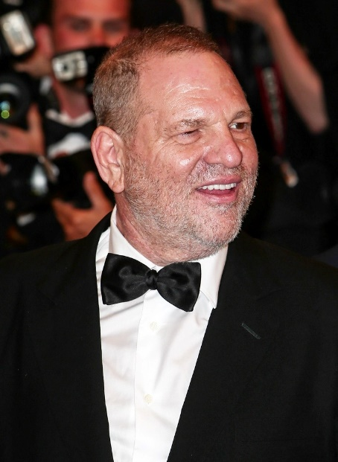
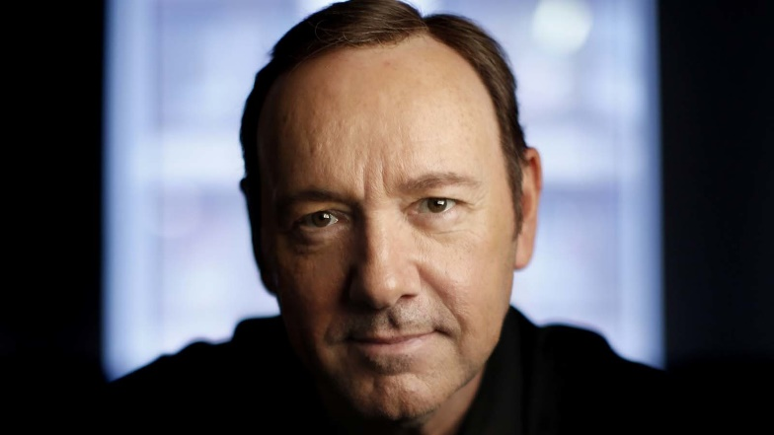
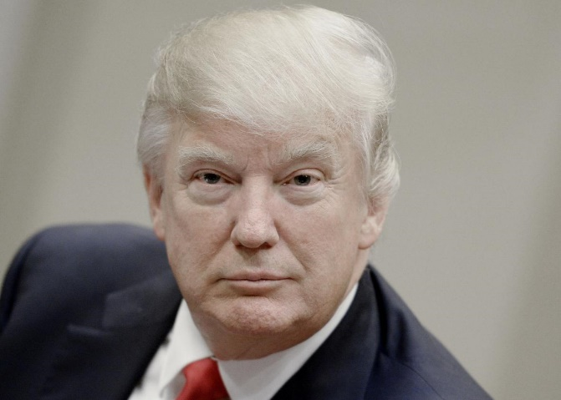
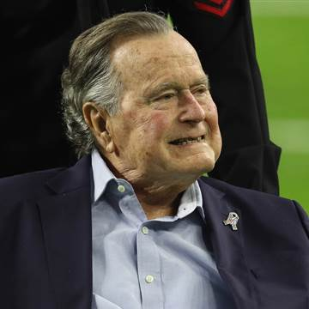
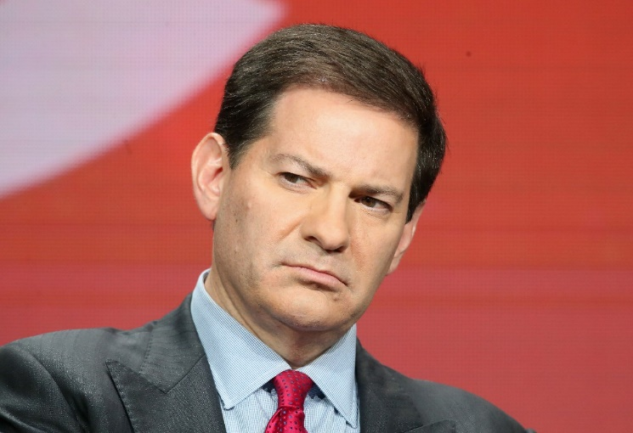
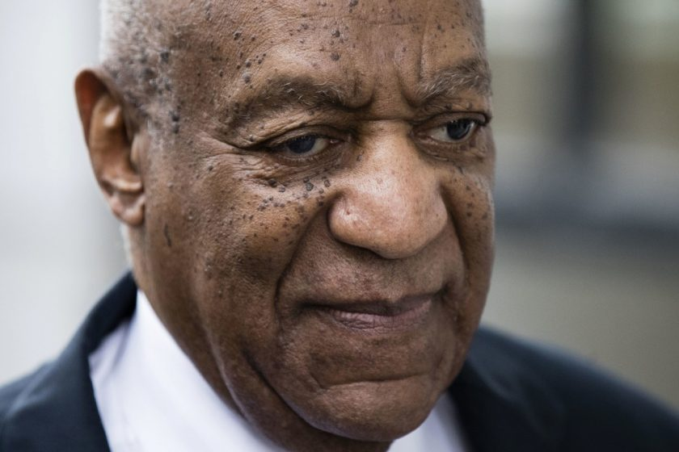
In the Headlines
Harvey Weinstein
Mark Halperin
Kevin Spacey
Bill Cosby
Donald Trump
George H.W. Bush

Slide 18
Harassment in the Hospitality Industry
Government agencies believe industry has serious harassment problems
Employs vulnerable employees
Foreign workers
Young workers

Slide 19
An Effective No Harassment Policy
“Protects” all employees including supervisors and managers
Requires compliance by all employees including supervisors and managers
Sets forth a reporting procedure for complaints, including a by-pass procedure

Slide 20
WORKPLACE VIOLENCE

Slide 21
Best Practices To Prevent Workplace Violence: Before Employment
Screening
Drug testing

Slide 22
Best Practices to Prevent Workplace Violence: During Employment
Policies
Commitment to safe work environment
Physical and non-physical violence
No weapons
Duty to Report
Zero Tolerance

Slide 23
Best Practices to Prevent Workplace Violence: During Employment
Supervisor Training
Identifying threats
Persistent problems
Lying or blaming others
Fascination with weapons
Adverse employment action

Slide 24
Best Practices to Prevent Workplace Violence: During Employment
Employee Training
Workplace Violence Policy
Types of potential emergencies
Reporting procedures
Alarm or alert systems
Evacuation plans/routes

Slide 25
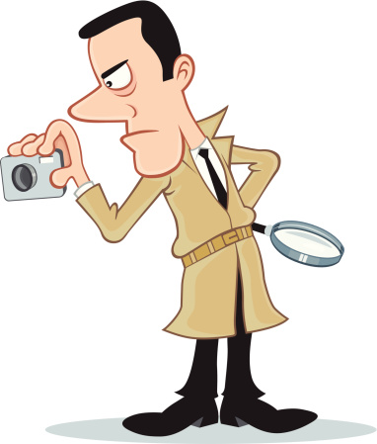
Best Practices to Prevent Workplace Violence: During Employment
Searches
Threat investigation
Employee assistance program

Slide 26
Best Practices to Prevent Workplace Violence: Termination
Witness
Timing
Script
Post-meeting plan

Slide 27
Final Questions
QUESTIONS?

