Slide 1
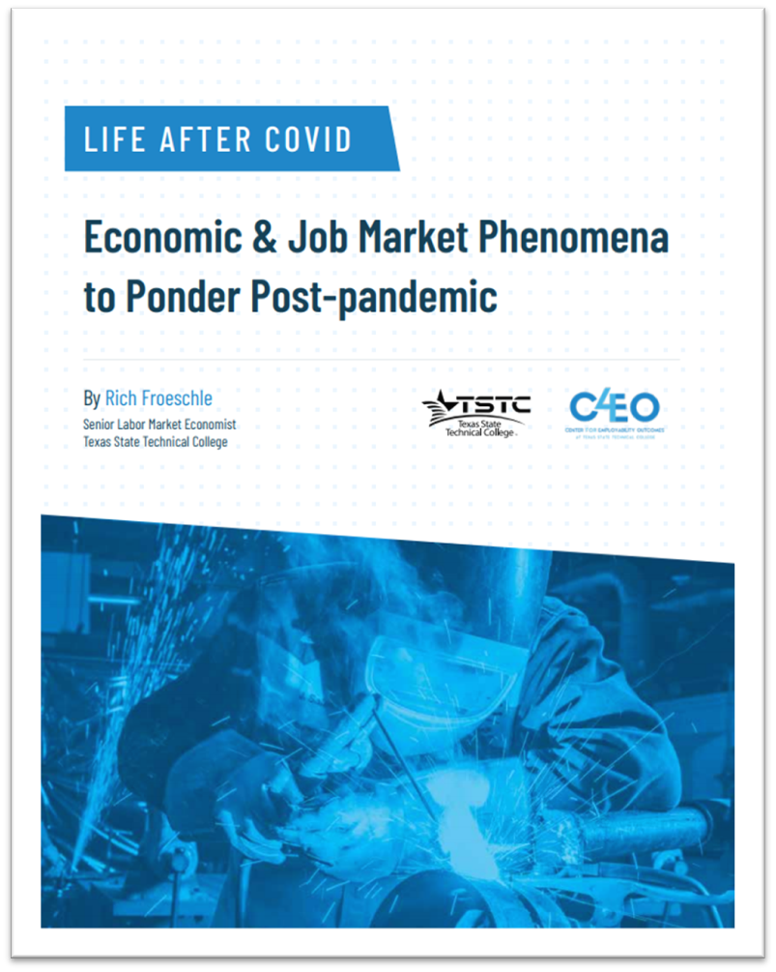

Life After COVID-19:
Labor Shortages and other Trends, Technologies and Practices to Ponder in the Post-pandemic Economy
Hotel Association of Tarrant County May 12, 2022
Richard Froeschle
rich.froeschle@tstc.edu
(512) 585-8231

Slide 2
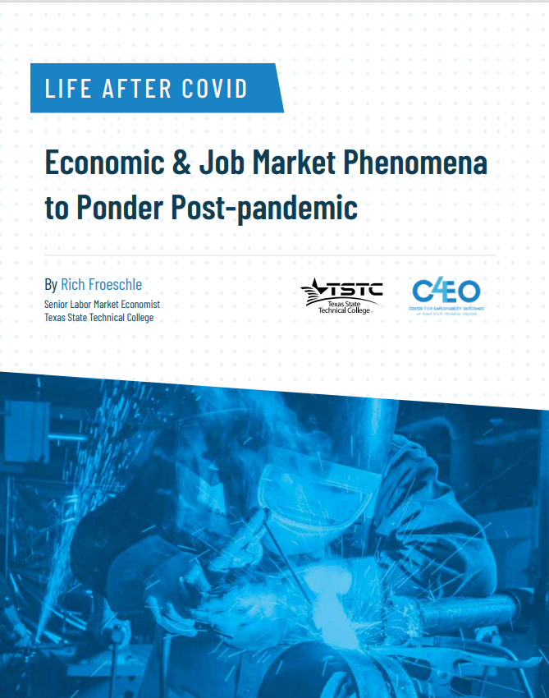

“It’s unrealistic to presume that an economy and a society, which have endured unprecedented structural and psychological hardships, will emerge on the other side unscathed and unchanged”.
Life After COVID source: Andrew Duguay, MarketWatch May 5, 2020

Slide 3
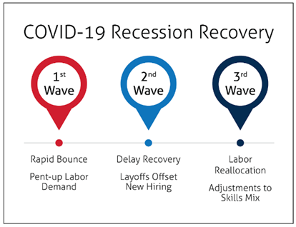
The Hurricane Recession: Three Waves of Job Recovery
the ‘hurricane effect’. Rapid bounce back in jobs (survival)
The downstream or delayed recovery mixed bag of layoffs and hiring (reactive)
the labor reallocation phase what new skills business needs (strategic)
Life After COVID

Slide 4
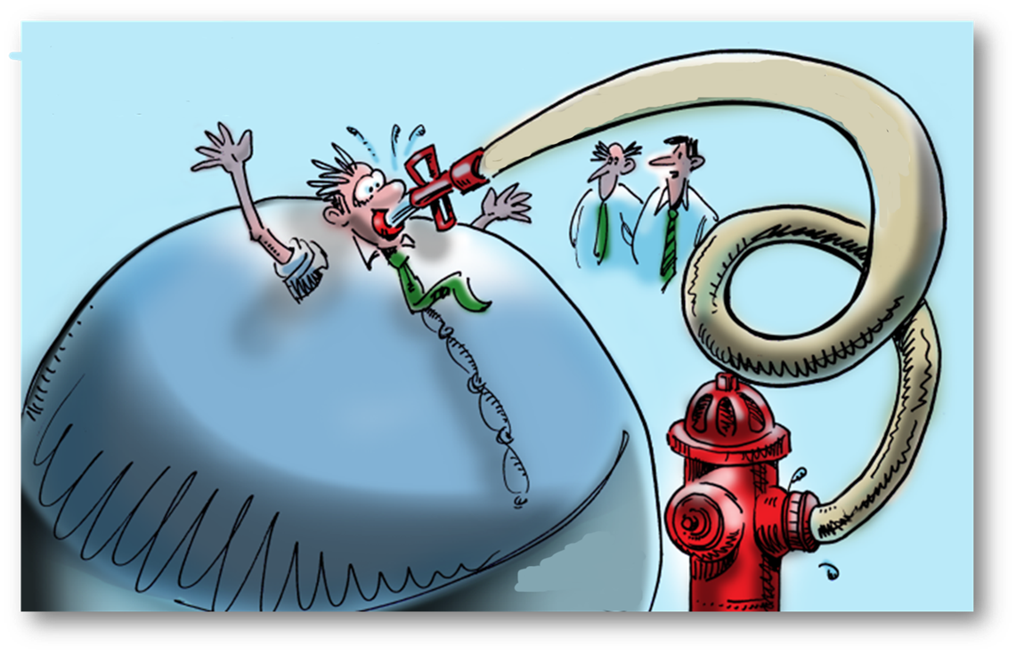
Wage Growth Lags Price Inflation
Inflation CY2021
All Items | 7.5%
Food at Home | 7.4%
Meat, Poultry, Eggs | 12.2%
Food away from Home | 6.4%
Gasoline | 40.0%
Electricity | 10.7%
Utility Gas Service | 23.9%
New Vehicles | 12.2%
Used Cars and Trucks | 40.5%
Apparel | 5.3%
Adult Beverages | 2.7%
Housing (Rent) | 3.8%
Medical Care Services | 2.7%
Motor Vehicle Repair | 4.8%
Airline Fares | 4.9%
Wage Increase | 4.7%
Consumer Demand
Post-COVID
Economic Capacity
Life After COVID source: BLS Consumer Price Index

Slide 5



The Good News… A Recovery in the Money economy is clearly at hand, e.g. GDP, wealth, savings, stocks up
The Bad News…The Money economy and the Job Market are 2 different birds
Life After COVID

Slide 6
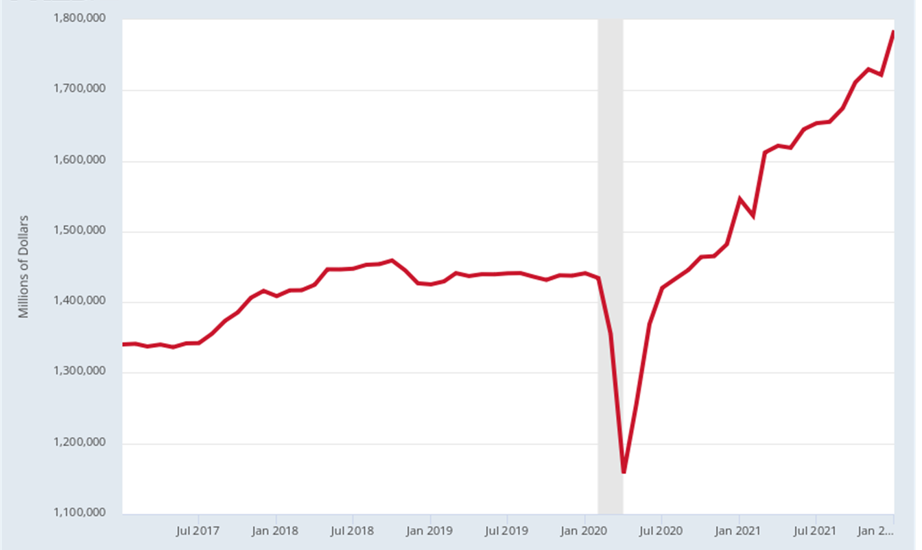
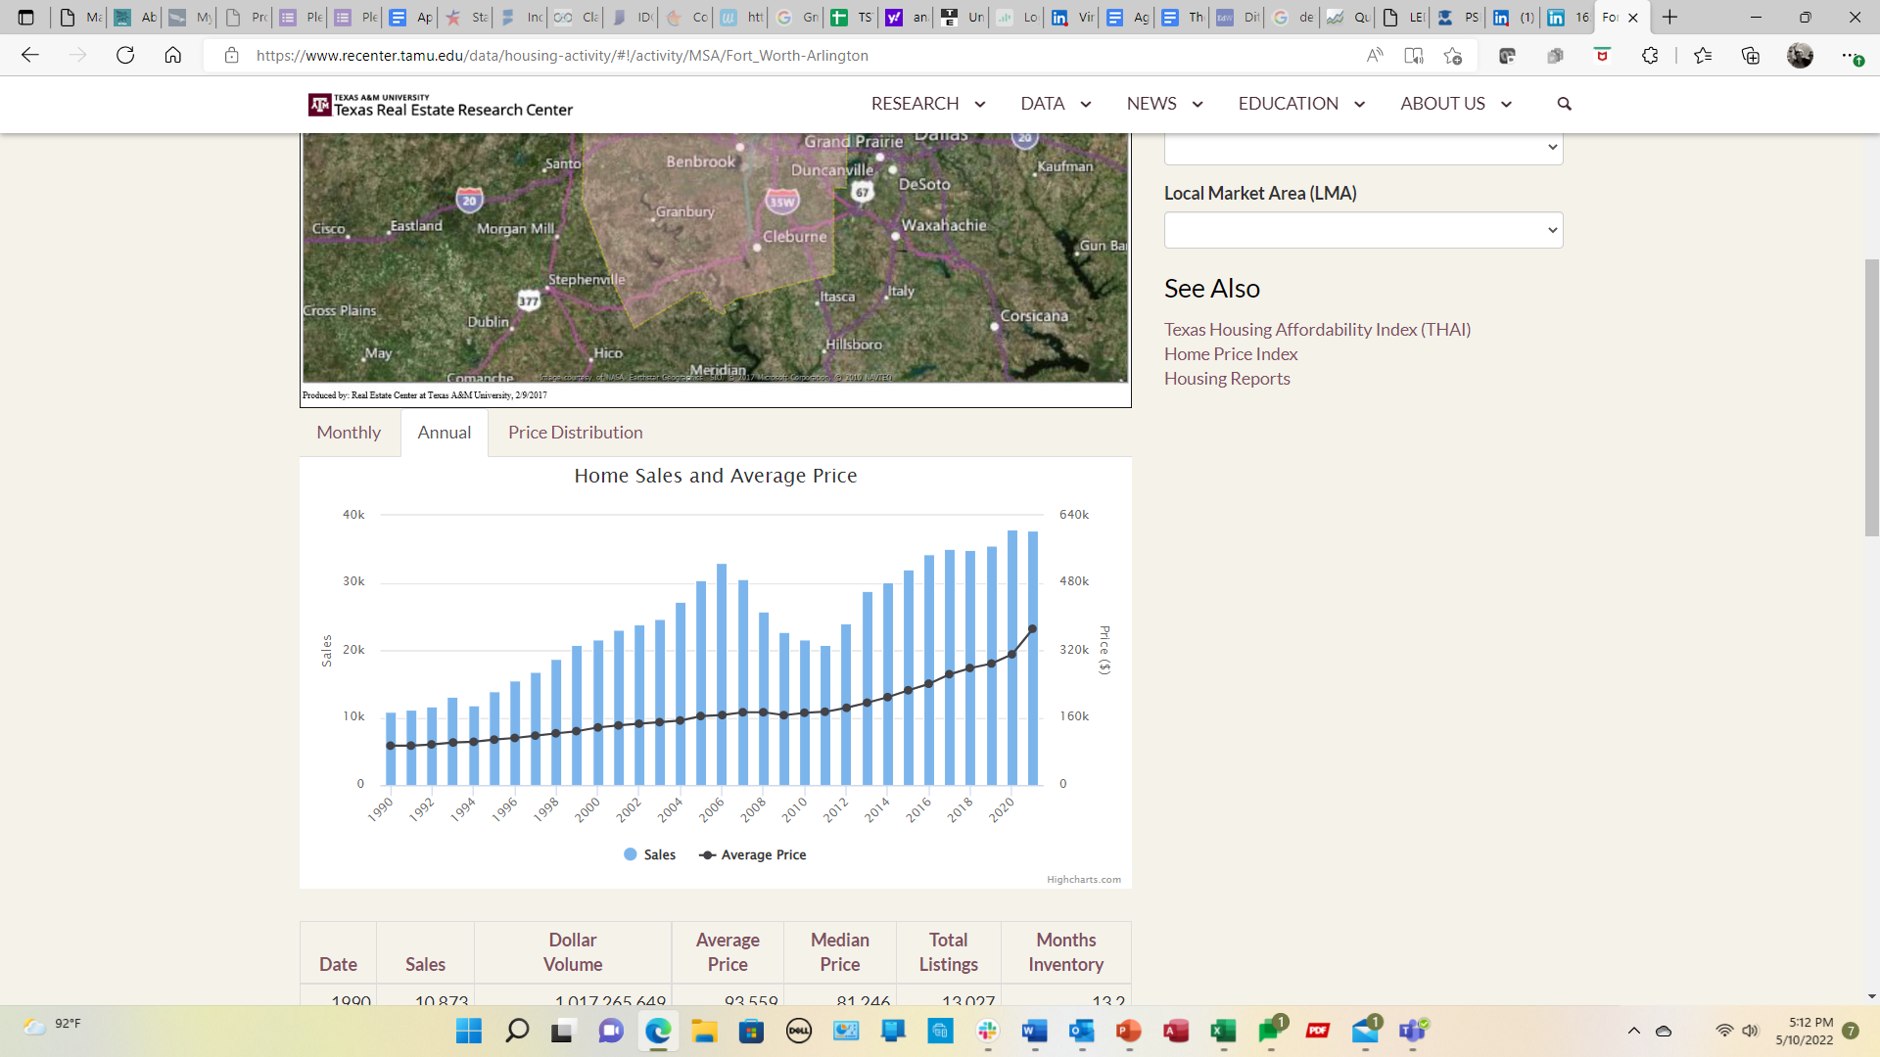
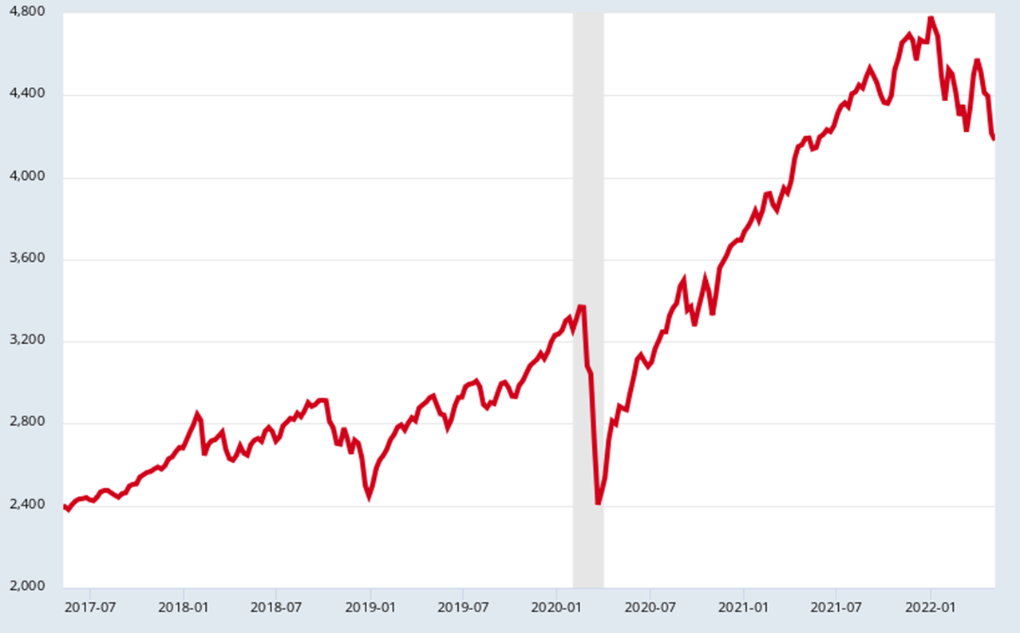
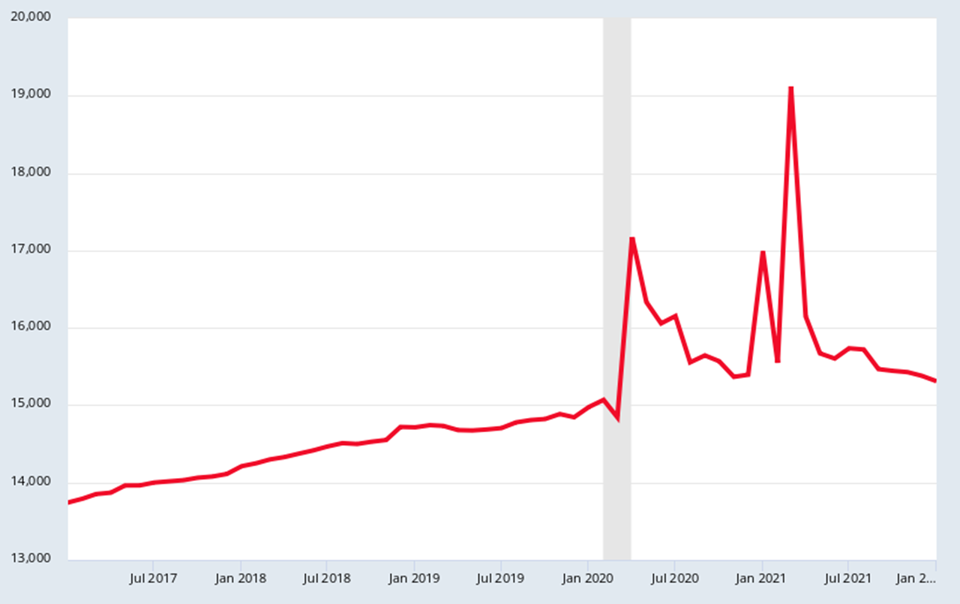

By Most Measures, the Money Economy is Fully Recovered
Ft. Worth/Arlington Home Sales
Business Sales
Disposable Per Capita Income
S&P 500 Stock Index
Life After COVID source: FRED, St Louis Fed Reserve, TAMU Real Estate Ctr.

Slide 7
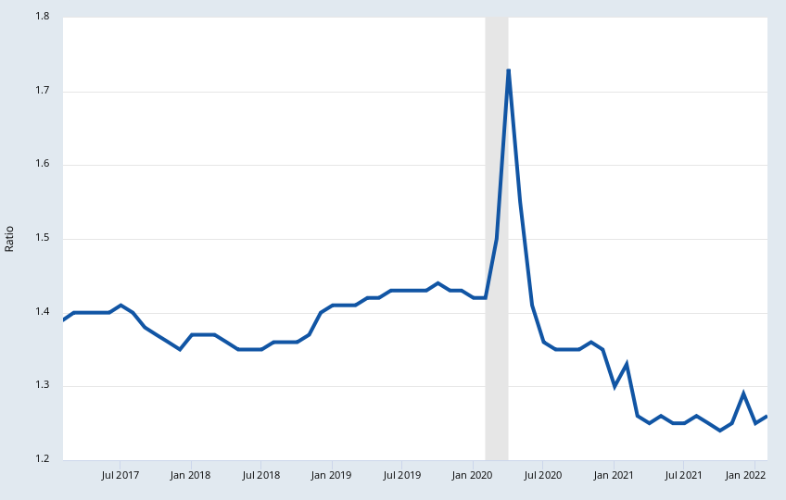
Harbinger of Economic Slowdown?
Inventories Decline Relative to Sales
You can’t sell what you don’t have!
No housekeepers, no rooms!
Life After COVID source: Census, FRED St. Louis Federal Reserve

Slide 8
Mixed Recession Signals:
What consumers say or what they do?
Index
Sales
Life After COVID source: FRED St. Louis Federal Reserve

Slide 9
Life After COVID-19
Both general labor and specific skill shortages are inevitable. Many of the same occupational shortages that existed prior to the pandemic have returned as the economy recovers
Skilled construction trades, manufacturing technicians, and logistics and sales occupations.
It also includes increasing numbers of information technology skills (cloud, robotics, AI, cyber).
Health care occupations, especially nursing and a variety of health technicians, driven by demographic trends that will persist after the pandemic.”
Life After COVID

Slide 10
Hot Jobs: Texas Job Postings Feb 2020 & April 2022
Occupation | 2020 | Occupation | 2022
Total Across All Occupations | 833,500 | Total Across All Occupations | 1,210,819
Registered Nurses | 38,196 | Registered Nurses | 57,835
Software Developers | 33,488 | Software Developers | 40,899
Non-tech Sales Rep, WH & Man | 30,302 | Non-tech Sales Reps, WH & Man | 31,641
Retail Salespersons | 25,196 | Retail Salespersons | 30,356
Customer Service Reps. | 20,192 | Customer Service Reps. | 30,245
Supervisor, Retail Sales Workers | 17,039 | Fast Food & Counter Workers | 24,586
Computer Occupations, MISC | 14,253 | Personal Service/Project Mgrs. | 20,875
Personal Service/Project Mgrs. | 12,932 | Supervisors, Retail Sales Workers | 20,385
Heavy Truck Drivers | 12,826 | Heavy Truck Drivers | 20,113
Fast Food & Counter Workers | 10,889 | Computer Occupations, MISC | 19,071
Maintenance & Repair Workers | 9,885 | Manual Laborers/Freight Movers | 17,584
Accountants and Auditors | 9,780 | Maintenance & Repair Workers | 15,189
Medical Dosimetrists, E-HIT | 9,731 | Waiters and Waitresses | 15,103
Sales Managers | 9,713 | Food Service Managers | 14,166
Secretaries & Admin Assistants | 9,669 | Medical & Health Services Mgrs. | 14,000
Life After COVID source: Economic Modeling Inc.

Slide 11
Hot Jobs: Tarrant Co. Job Postings Feb 2020 & April 2022
Occupation | 2020 | Occupation | 2022
Total Across All Occupations | 76,604 | Total Across All Occupations | 106,252
Retail Salespersons | 2,898 | Registered Nurses | 5,362
Registered Nurses | 2,847 | Retail Salespersons | 3,235
Non-tech Sales Reps, WH & Man | 2,665 | Customer Service Reps. | 3,128
Software Developers | 2,033 | Fast Food and Counter Workers | 3,088
Supervisors, Retail Sales Workers | 1,955 | Non-tech Sales Reps, WH & Man | 2,802
Customer Service Reps. | 1,913 | Manual Laborers/Freight Movers | 2,152
Heavy Truck Drivers | 1,535 | Heavy Truck Drivers | 2,108
Manual Laborers/Freight Movers | 1,210 | Software Developers | 2,082
Fast Food & Counter Workers | 1,205 | Supervisors, Retail Sales Workers | 1,964
Computer Occupations, MISC | 1,159 | Food Service Managers | 1,686
Personal Service/Project Mgrs. | 1,048 | Waiters and Waitresses | 1,641
Food Service Managers | 1,039 | Cooks, Restaurant | 1,630
Maintenance & Repair Workers | 949 | Personal Service/Project Mgrs. | 1,525
Secretaries & Admin Assistants | 895 | Cashiers | 1,328
Life After COVID source: Economic Modeling Inc.

Slide 12
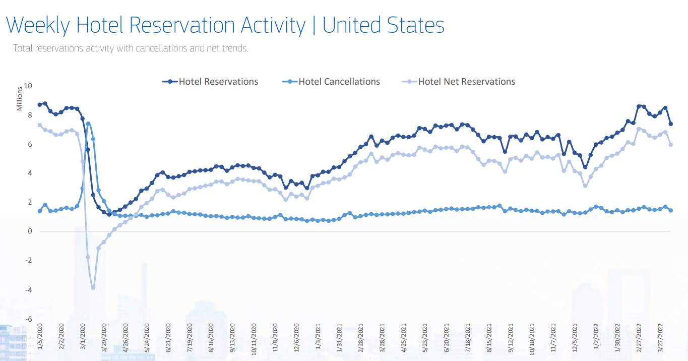
Not Every Industry has Recovered at the Same Pace; Jobs or Revenues
Life After COVID source: Amadeus Demand360

Slide 13
Life After COVID

Slide 14
D/FW Metro Industry Leaders 2020Q1 – 2021Q3
Industry (3D) | EMP | CHG | ANN Wage
Total, All Industries | 3,669,505 | 35,812 | $68,630
Professional, Scientific & Technical Services | 299,504 | 22,767 | $105,248
Warehousing and Storage | 69,764 | 18,699 | $41,184
Administrative & Support Services (Temps) | 279,155 | 14,866 | $53,352
Banking & Other Credit Intermediation | 121,042 | 8,029 | $102,908
Couriers & Messengers (last mile delivery) | 35,276 | 5,717 | $47,268
Ambulatory Health Care Services | 215,494 | 5,158 | $67,080
General Merchandise Stores | 85,815 | 5,014 | $32,292
Securities & Misc. Financial Activities | 35,422 | 4,987 | $140,296
Building Material, Garden Supplies Dealers | 32,400 | 3,632 | $43,784
Electronic Markets & Internet Brokers | 16,048 | 3,368 | $128,960
Non-store Retailers (online retailing) | 15,593 | 3,335 | $110,448
Real Estate | 61,546 | 3,066 | $80,496
Insurance Carriers | 84,242 | 2,517 | $87,048
Amusement, Gambling, and Recreation | 36,454 | 2,040 | $28,704
Life After COVID source: TWC QCEW

Slide 15
D/FW Metro Industry Laggards 2020Q1 – 2021Q3
Industry (3D NAICS) | EMP | CHG | ANN Wages
Total, All Industries | 3,669,505 | 35,812 | $68,630
Educational Services | 288,396 | -22,247 | $57,200
Accommodation (hotels/motels) | 26,803 | -8,645 | $37,544
Food Services and Drinking Places | 300,057 | -5,855 | $24,596
Nursing and Residential Care Facilities | 44,904 | -4,949 | $41,184
Clothing & Clothing Accessories Stores | 30,483 | -4,278 | $27,196
Social Assistance & Childcare | 51,158 | -4,162 | $32,656
Transit & Ground Passenger Transportation | 9,121 | -2,934 | $50,024
Performing Arts & Spectator Sports | 9,496 | -2,782 | $100,932
Movie Theatres & Sound Recording Studios | 5,515 | -2,042 | $39,676
Rental and Leasing Services | 15,537 | -1,956 | $67,652
Support Activities for Transportation | 28,849 | -1,954 | $78,208
Religious, Civic & Non-profit Organizations | 15,164 | -1,737 | $58,188
Machinery Manufacturing | 15,683 | -1,601 | $69,992
Motor Vehicle and Parts Dealers | 51,409 | -1,547 | $77,376
Life After COVID source: TWC QCEW

Slide 16
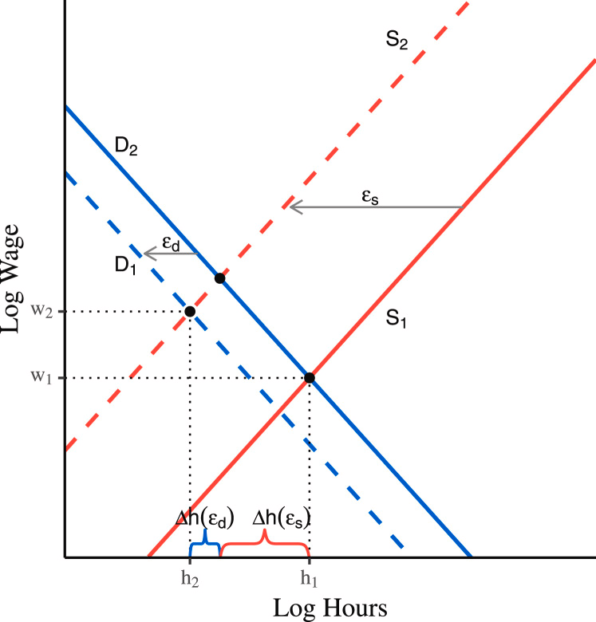
The Labor Shortage Explained: Any Questions?
Life After COVID

Slide 17

“There are eight million stories in the naked city, you are about to see one of them”
Life After COVID

Slide 18

The Current Labor Shortage: Driver Impacts for Slow Hiring
1. Govt. incentives remove urgency – expanded UI, student debt relief, rent postponement, other subsidies
2. Minding the kids: in-home schooling, childcare!, eldercare
3. Declining Labor Force Participation Rates (esp. Mothers)
4. Demographics: baby boomer retirement, low birth rates
5. Reduction of foreign workers: fewer student & work visas
6. Workplace safety issues (lost hours out sick, virus-based hesitancy)
7. Change in cultural values: Millennials/Gen Z have different work/life ($$$/flexibility) balance priorities, value of work
8. The Great Reshuffle: Career reflection & ‘Burnout’, quits/job hopping to increase pay, self-employment, Reservation Wage
9. Small business can’t compete on wages (Amazon effect, chains)
10. Measurement Challenges: Not in the CLF to Employed. Gig work?
11. Skill mismatch: Worker skills don’t match job openings, student choice doesn't match high demand jobs
Life After COVID

Slide 19
Life After COVID source: Census ACS PUMS, authors calculations

Slide 20
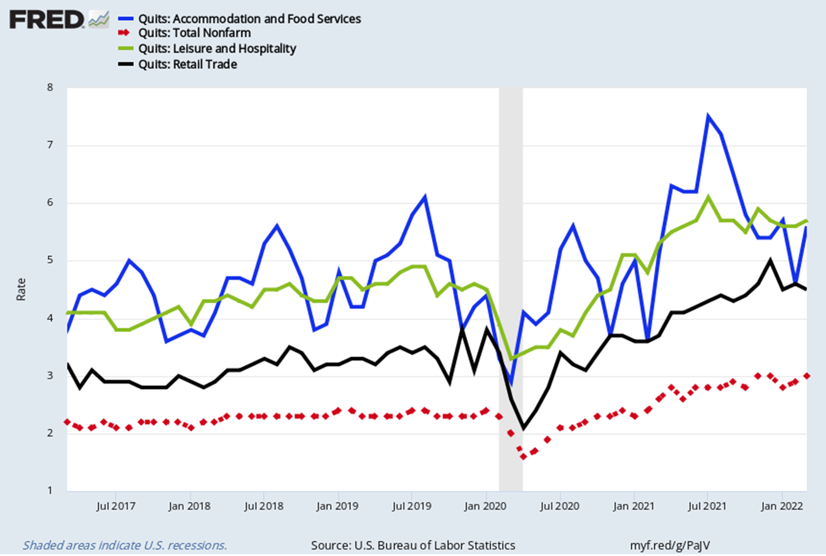
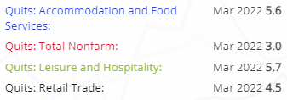
Are more people really quitting than ever before?
Research suggests the quit rate is the best indicator of future wage inflation
Life After COVID source: BLS JOLTS/FRED St. Louis Fed

Slide 21
Labor Shortage Dynamics: Quits, Hires, Openings
11.55 mil
6.74 mil
Life After COVID source: BLS JOLTS

Slide 22
Tarrant Co. Labor Force Pandemic Peak to Trough to Today
 | CLF** | EMP** | Postings* | UnEMP** | Urate
Feb 2020 (peak) | 1,079,821 | 1,046,438 | 76,604 | 33,383 | 3.1%
April 2020 (trough) | 1,012,343 | 885,935 | 70,707 | 126,408 | 12.5%
March 2022 (today) | 1,128,211 | 1,089,219 | 106,252 | 38,992 | 3.5%
CHG Trough (April 2020) to Today | 115,868 | 203,284 | 35,545 | -87,416
PCT CHG | 11.4% | 22.9% | 50.3% | -69.2%
CHG Pre-pandemic Peak to Today | 48,390 | 42,781 | 29,648 | 5,609
PCT CHG | 4.5% | 4.1% | 38.7% | 16.8%
* Job Openings (Openings) from EMSI/Burning Glass Online Postings
**Civilian Labor Force (CLF), Unemployed (UnEMP), Employed Persons (EMP) from BLS LAUS/TWC (unadjusted)
Life After COVID source: TWC/LMCI, EMSI/Burning Glass

Slide 23
Tarrant Co. Labor Shortage: Postings Outstrip Unemployed
106,252/38,992 = 2.7 jobs per unemployed person
106,252
38,992
Life After COVID source: TWC/CES & LAUS – EMSI job postings

Slide 24
Labor Competition in the D/FW Hotel Sector
Occupation (77%) | Hotel Staff % | Mar 2022 Postings | Advertised Salary | D/FW AVG Salary
Maids/Housekeepers | 25.9% | 874 | $23,872 | $23,971
Hotel & Motel Desk Clerks | 19.4% | 907 | $24,000 | $24,368
Waiters and Waitresses | 6.3% | 1,641 | $25,024 | $18,541
Maintenance & Repair Workers | 5.0% | 1,283 | $37,504 | $41,420
Lodging Managers | 3.7% | 103 | $44,928 | $53,192
Cooks, Restaurant | 3.3% | 1,630 | $26,048 | $27,221
Dining Room Attendant/Bartender Helper | 2.6% | 565 | $22,464 | $19,991
Supervisors, Office/Admin Support | 2.1% | 567 | $44,416 | $60,437
Janitors & Cleaners, Ex. Maids | 1.4% | 1,140 | $25,792 | $27,608
Supervisors, Housekeeping | 1.4% | 123 | $32,128 | $44,563
Laundry & Dry-Cleaning Workers | 1.4% | 157 | $21,824 | $23,326
Services Sales Representatives | 1.4% | 308 | $44,416 | $58,067
Supervisor, Food Prep Workers | 1.2% | 1,072 | $27,008 | $32,822
General and Operations Managers | 1.2% | 1,009 | $54,912 | $105,396
Bookkeeping & Accounting Clerks | 1.1% | 933 | $37,504 | $42,896
Bartenders | 1.1% | 411 | $26,560 | $18,770
Security Guards | 1.0% | 734 | $28,032 | $28,674
Life After COVID source: EMSI/Burning Glass, Texaswages.com

Slide 25
A Dozen Trends to Ponder in the Post-pandemic Economy
#1 - The less-than-full economy: Fewer workers (labor supply) and social-distancing takes productive capacity out of the economy.
#2 - Supply chains have been seriously disrupted. They will be reoriented with greater emphasis on local markets
#3 - Online retailing will accelerate: Decline in retail store jobs. E-commerce capturing a growing share of the market. Logistics!
#4 - School may never be the same: back to campus or cyberspace? Hybrid Learning? Questions about college costs/value proposition?
#5 - Teleworking or work from home arrangements become more common: Fewer commuters and a virtual workplace
#6 - It’s all about skills! - Degrees still matter, but skills are the new metric. Hard & soft, socioemotional & digital skills, transferable!
Life After COVID

Slide 26
Competition & Upskilling: Transferable Skills for Hotel Staffing Pattern
Occupation | OCCs with Similar Skills
Maids/Housekeepers | Private home housekeeper, Fast food counter clerk
Hotel & Motel Desk Clerks | Customer service rep, Bookkeeper, Med. Records HIT
Waiters and Waitresses | Host(ess), Cashier, Dining room attendant
Maintenance/Repair Workers | HVAC Tech, RV service tech, Roustabout (oil & gas)
Lodging Managers | Food service Mgr, Admin Services Mgr, Logistics Mgr
Cooks, Restaurant | Baker, Institutional cook, Butcher/Meatcutter
Dining Room Attendant | Waiter(ess), Host(ess), Barista
Supervisor, Office/Admin | HR Mgr/Specialist, Admin services Mgr, Exec.support
Janitors & Cleaners, Ex. Maids | Landscaper/groundskeeper, Construction helper
Supervisors, Housekeeping | Food Service Supr., Retail Supr., Production Supr.
Laundry/Dry-Cleaning Worker | Food prep wkr., Manuf. packager/packer, Maid
Services Sales Representatives | Real estate agent, Customer service rep., Sales rep.
Supervisor, Food Prep Workers | Food Service Supr., Retail Supr., Lodging Mgr.
General and Operations Mgr. | Business ops specialist, Finance Mgr., Health care Mgr.
Bookkeeping/Accounting Clerk | Office Clerk/Admin Support, Payroll clerk, Info Clerk
Bartenders | Dining room attendant, Barista, Waiter(ess)
Security Guards | Correctional officer, TSA screener, Private investigator
Life After COVID

Slide 27
#7 – The world has been in recession too! – Limited business travel, fewer exports hurts Texas, oil & food shortages, Ukraine
#8. The end of paper? Speeding up digital transformation – the move to cloud technology accelerates digitization (AI, Cyber, Blockchain)
#9. Building the new infrastructure: Rethinking transportation needs. Investments in physical infrastructure. Includes Telecomm!
#10 - Are Robots the Answer? Human frailty, technology progress, labor shortages increase demand for robotic solutions/personnel
#11 - Small business suffers while the gig economy grows – Big Tech and Big Box stores flourished. Will the little guys survive?
#12 – As Labor Markets Evolve, So Must Education and Training Strategies: Upskilling and reskilling become most important approach to addressing worker shortages
Life After COVID

Slide 28
Organizational Strategies for Staffing in the New Economy
1. Companies must diversify recruiting and go beyond looking just for purple unicorns to hire. Marginalized groups
2. Companies must get serious about internal mobility. Upskilling existing talent is an imperative to fill key positions
3. Refocus on “people strategies” i.e. retention (signing bonus paid out over time), company culture/brand, and engagement. More pay does not fix all retention problems!
4. Companies grow new sources of talent & create candidates: Google Certifications, Kaiser Nursing Academy
5. Focus is on a ‘portfolio model’ for talent: adjust to full & part-time employees, temp/contract workers, outsourcing
6. Embrace computerization & automation! Redesign how your hotel operates based on new technology options
Life After COVID source: Josh Bernsin

Slide 29
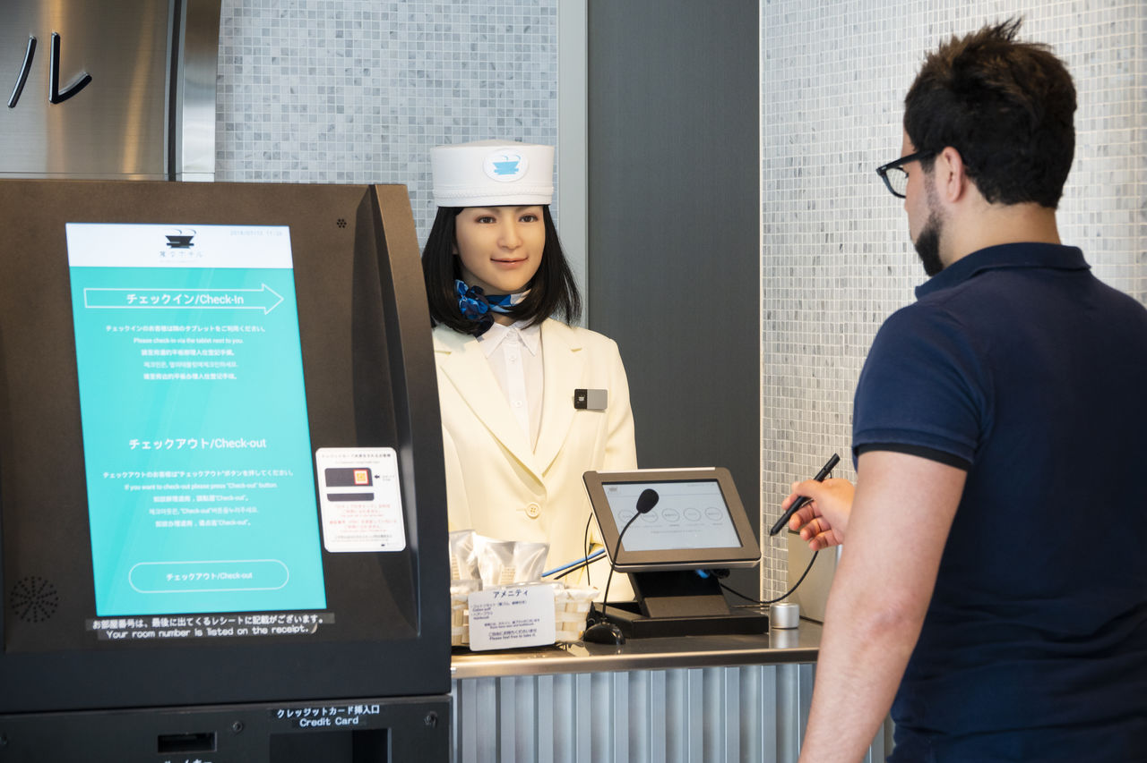
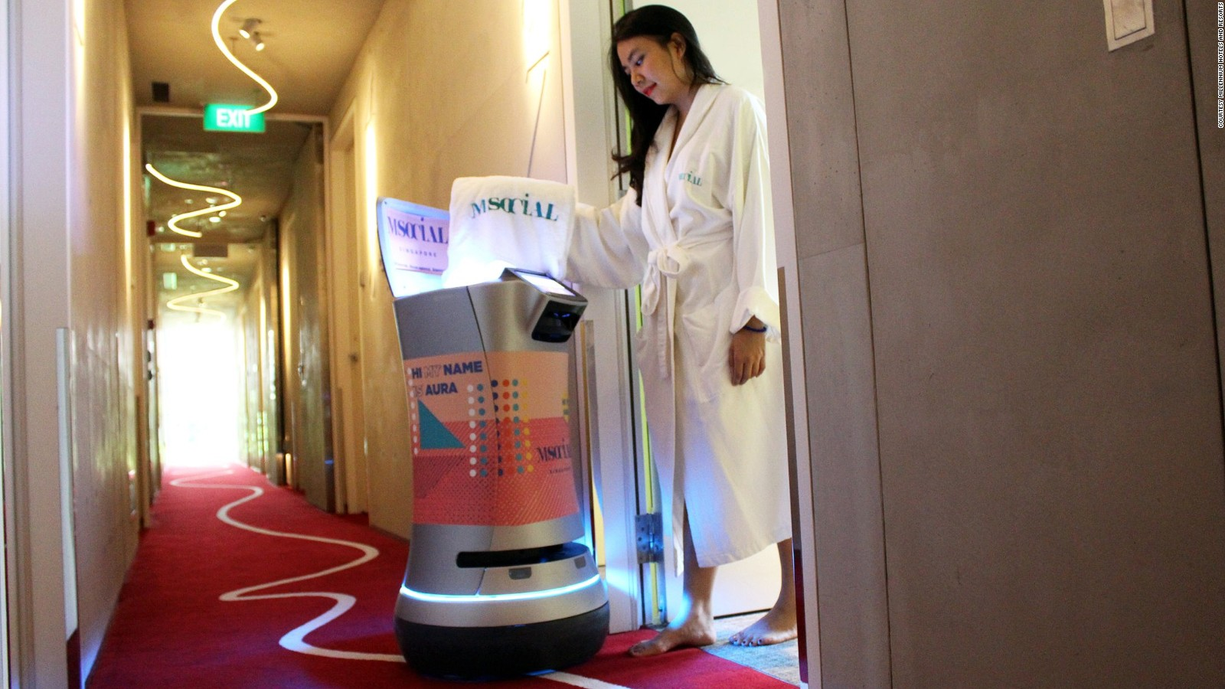
Rethinking Robot Tasks in Hotels?
On automation and technology…
“The pandemic displaced more workers in automatable occupations, putting them at a greater risk of being permanently automated”.
Philadelphia Federal Reserve
Life After COVID

Slide 30

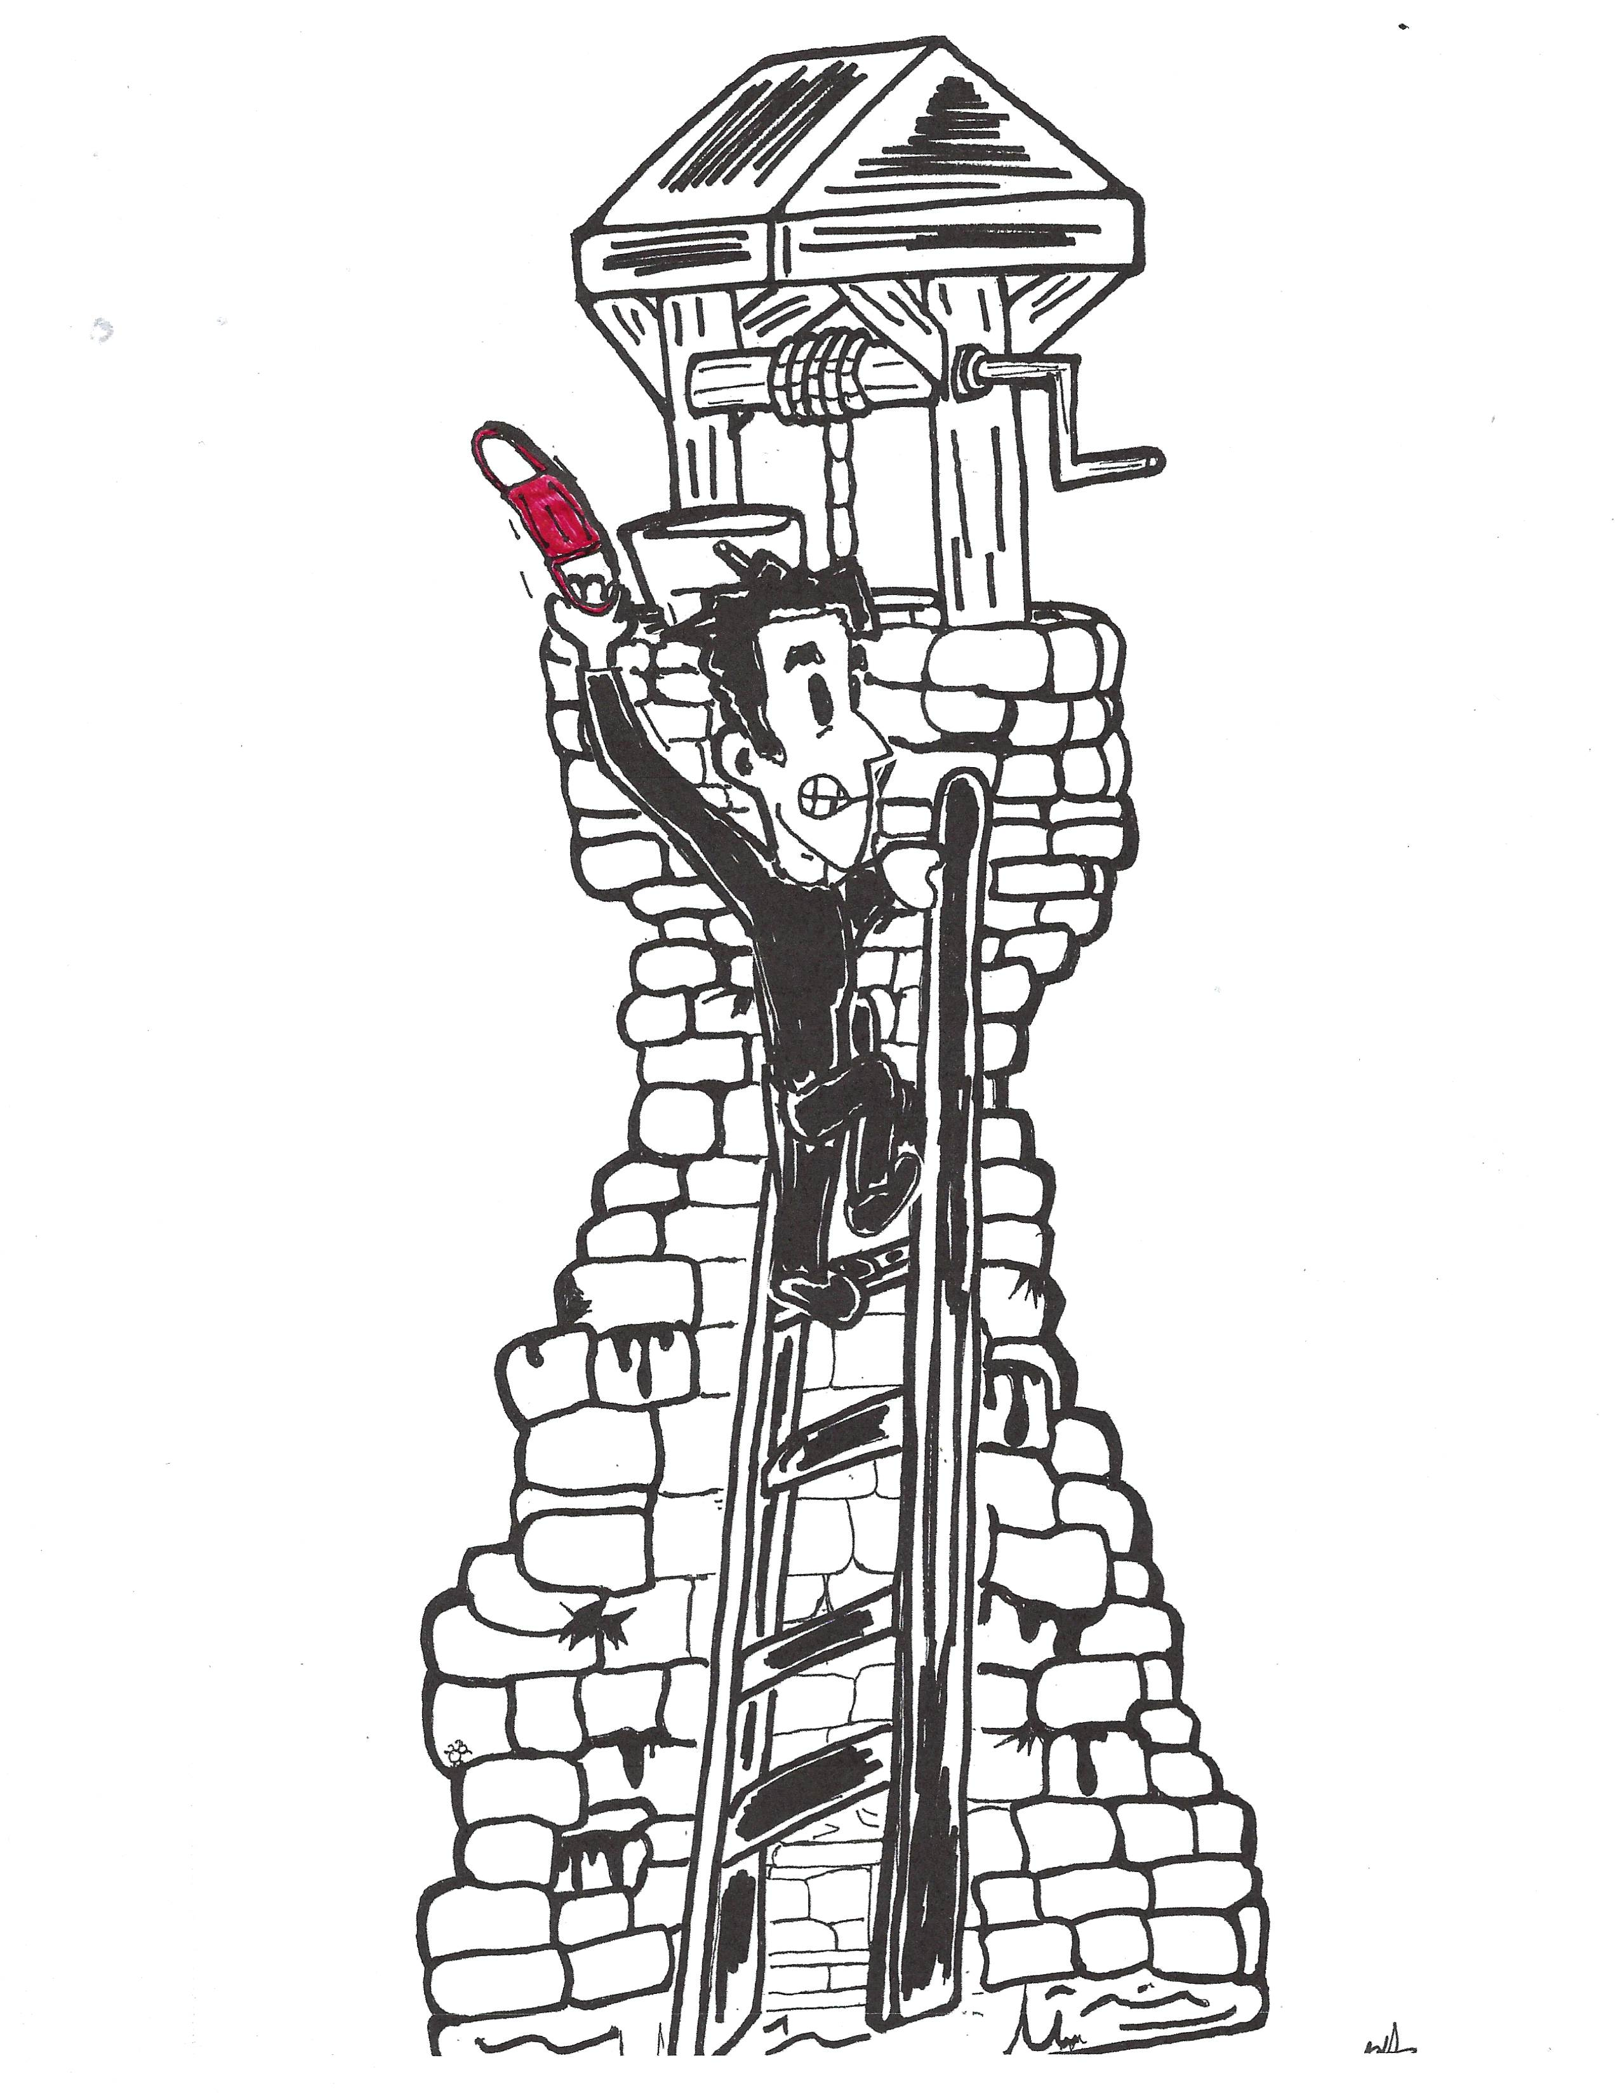
May 2022
April 2020
Life After COVID

Slide 31


Thank you!
There is much more labor market story to tell, but this version is over!
Life After COVID

