Slide 1


Slide 2


Slide 3


Slide 4


Slide 5


Slide 7


Slide 8

About SICO

Slide 9

About SICO
We are a Global Company
Asia
Europe
South Pacific
Japan
Middle East
Spain
With Manufacturing in the US for the North America
Minneapolis MN
Belleville, WI
Conway, AR

Slide 10
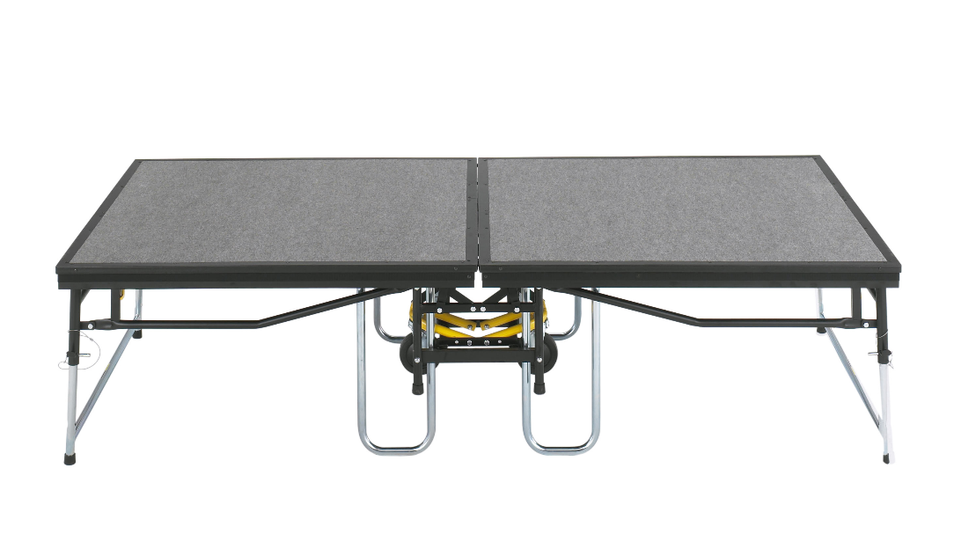
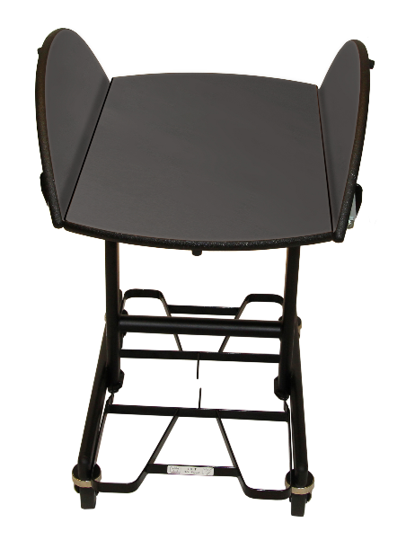

About SICO
Legacy Products

Slide 11
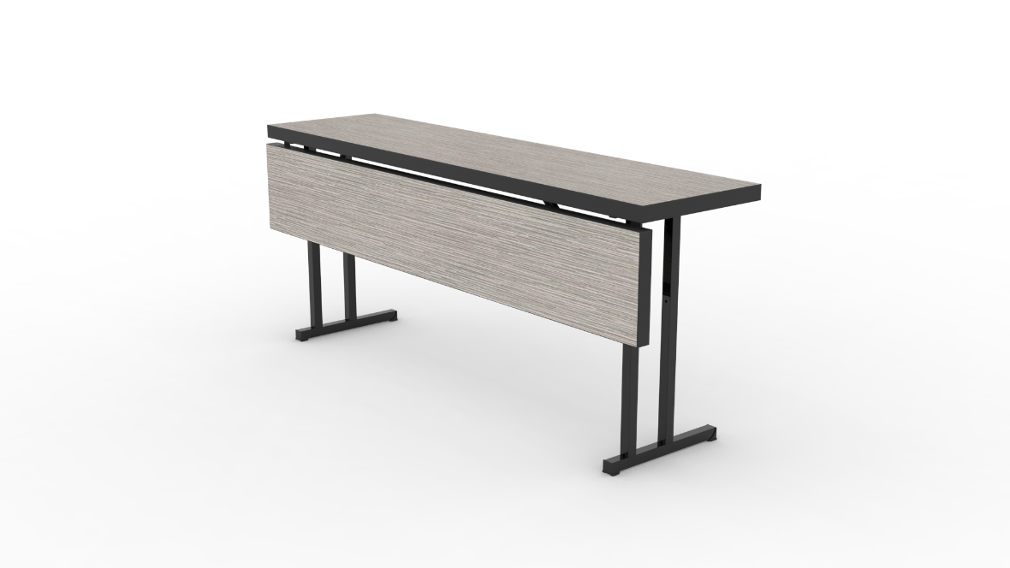
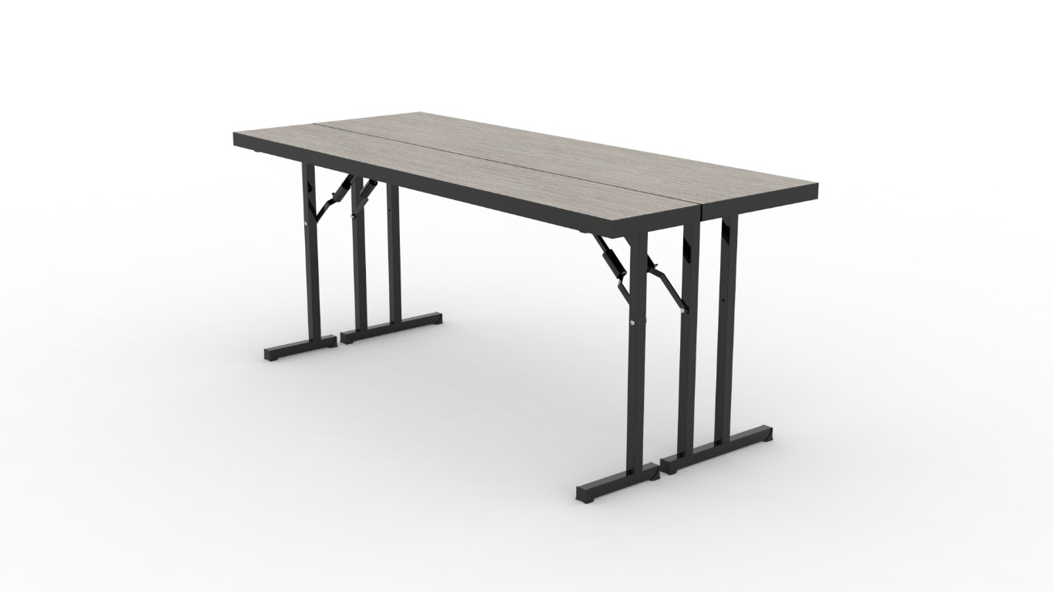
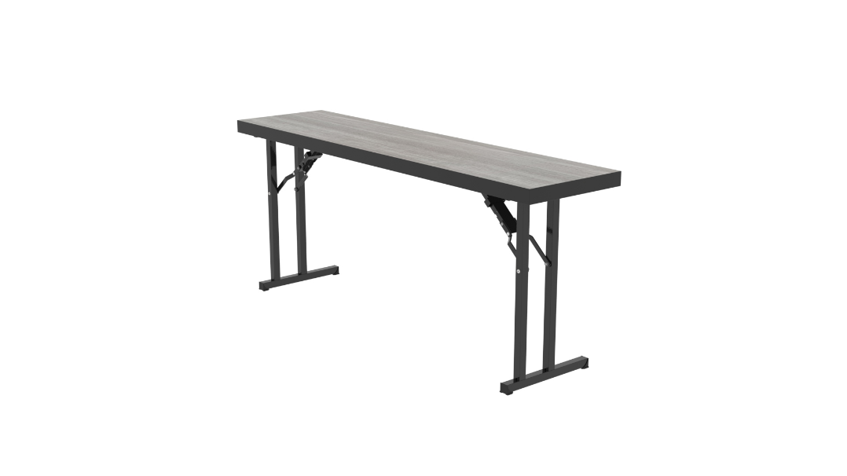
About SICFO
FLEXTable – 40% less storage space

Slide 12
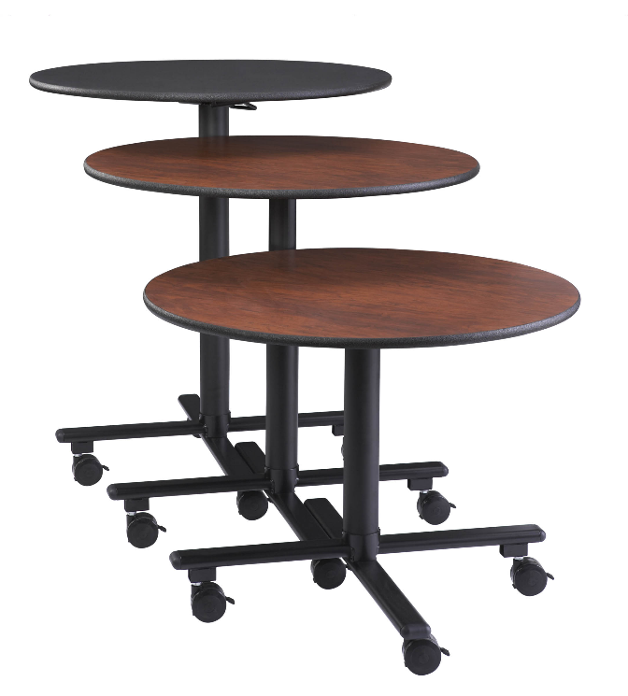
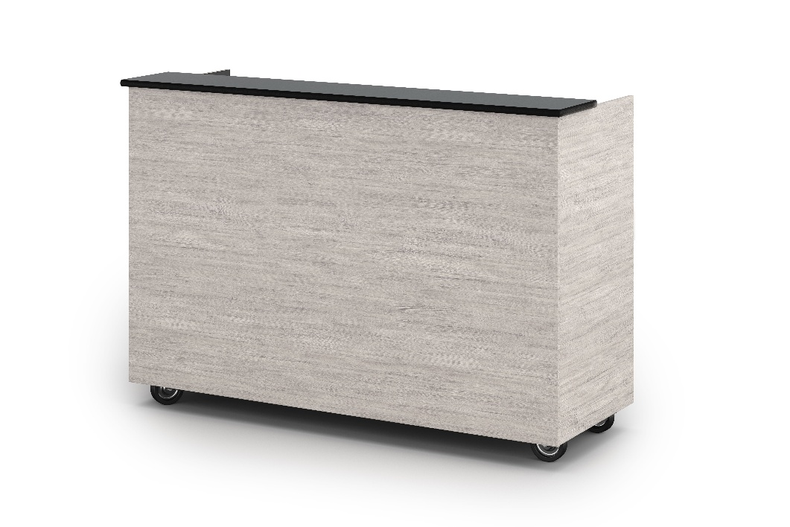
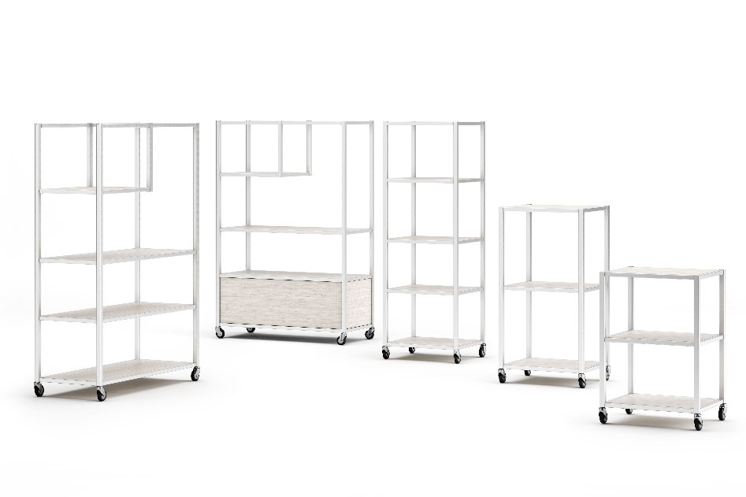
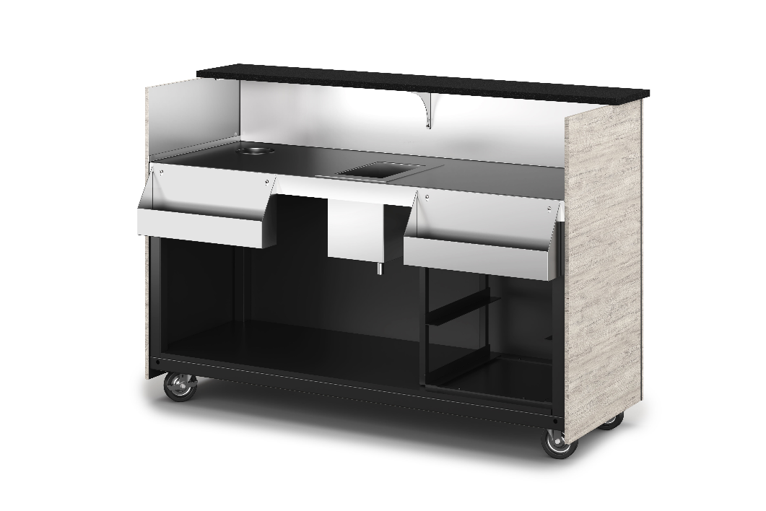
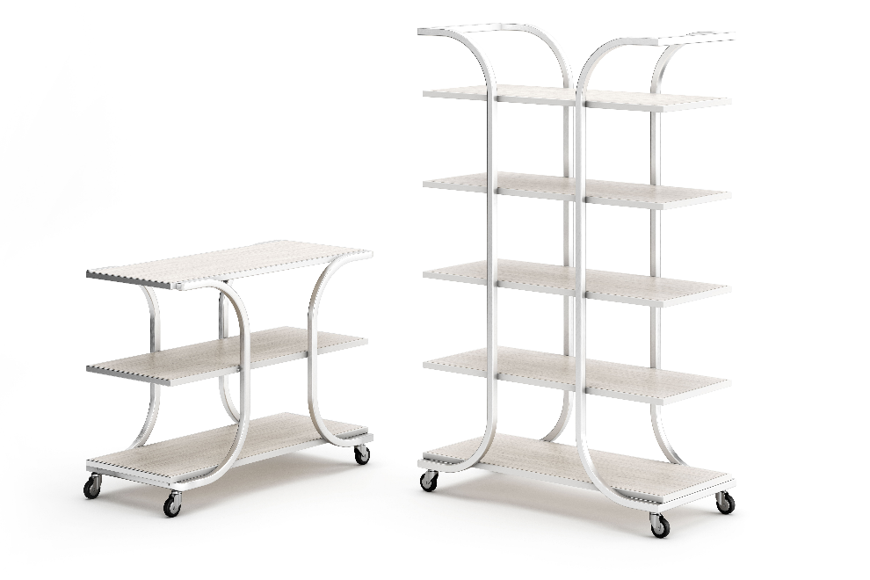
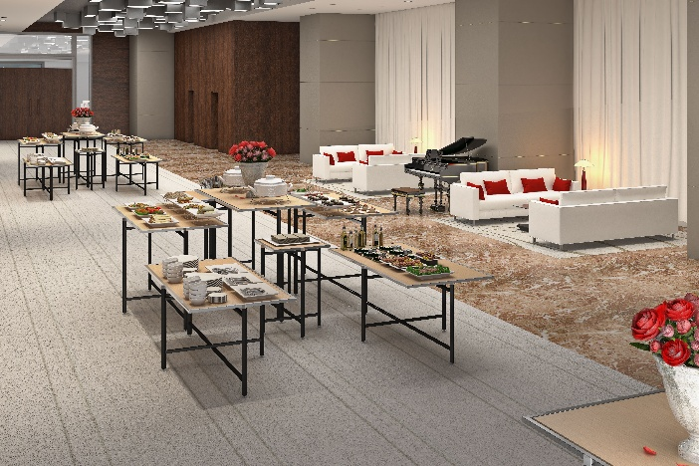
Socializer
Display Towers
Mobile Bars
About SICO
Diamond Cross Tables

Slide 13
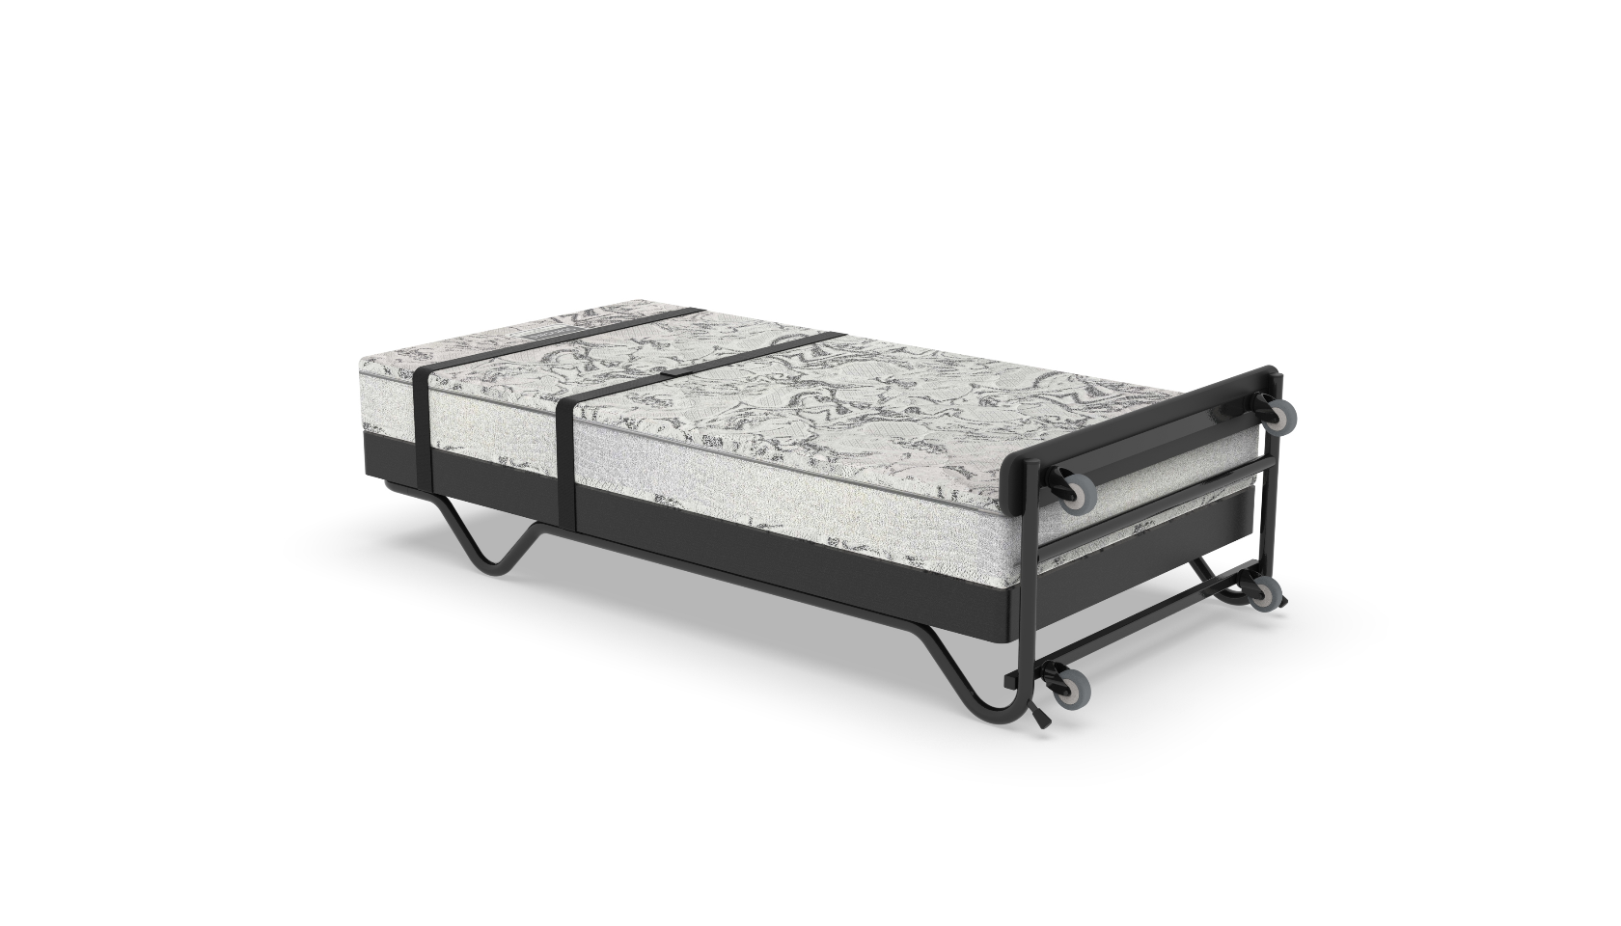
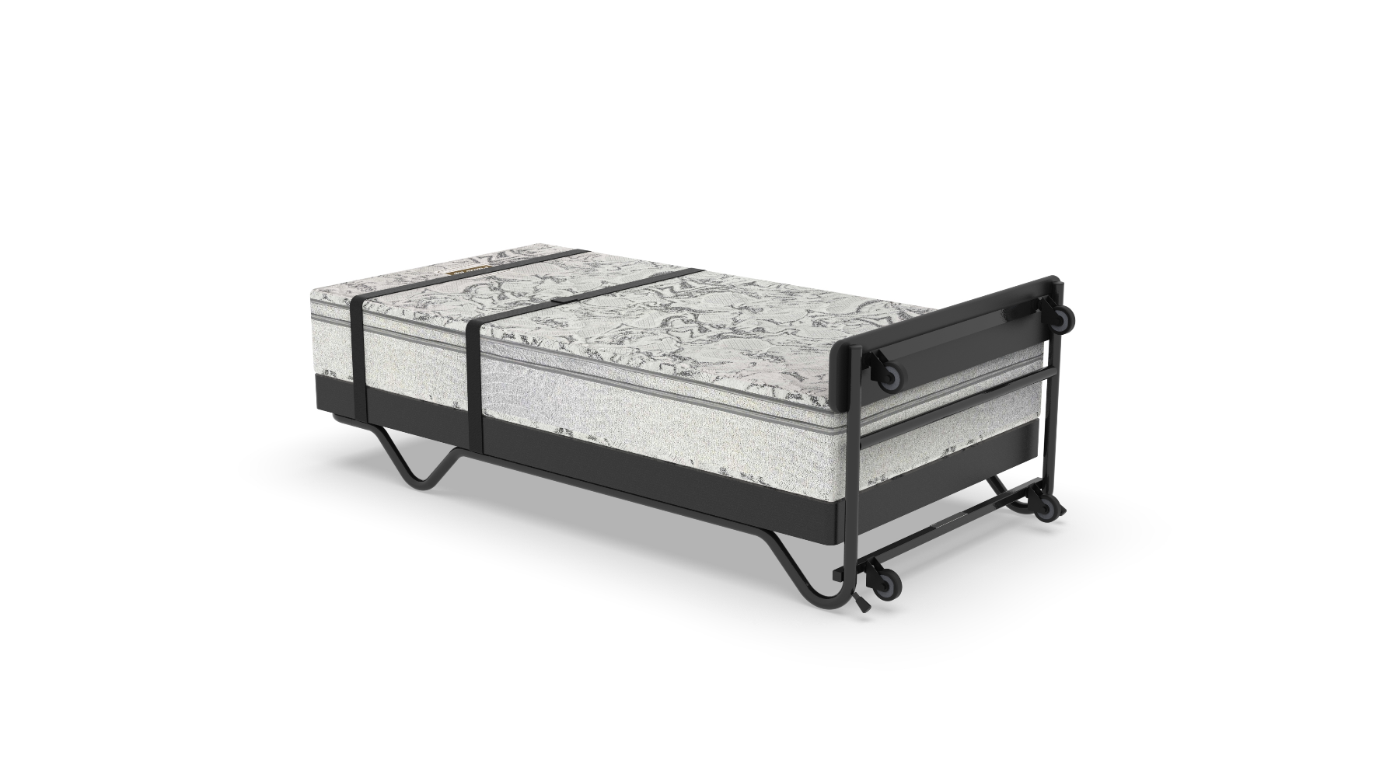
About SICO
FIFA Special - Mobile Sleepers – Buy 5 get 1 FREE
Standard Twin
Pillow Top Twin

Slide 14
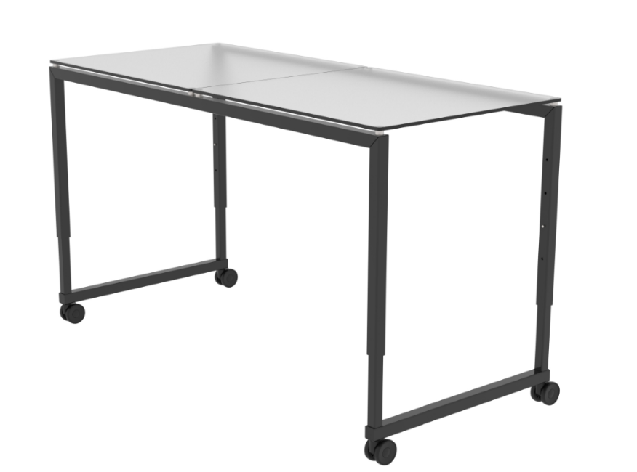
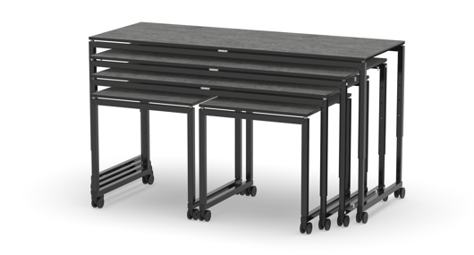
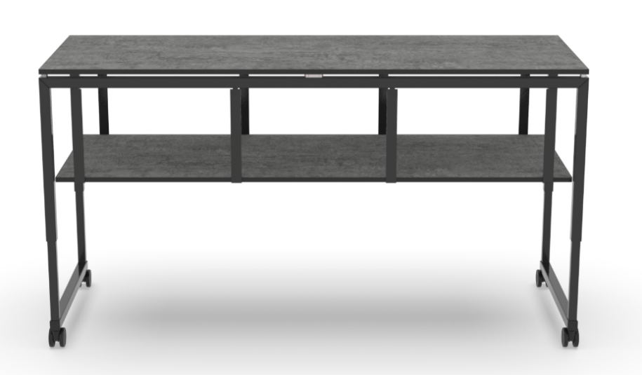
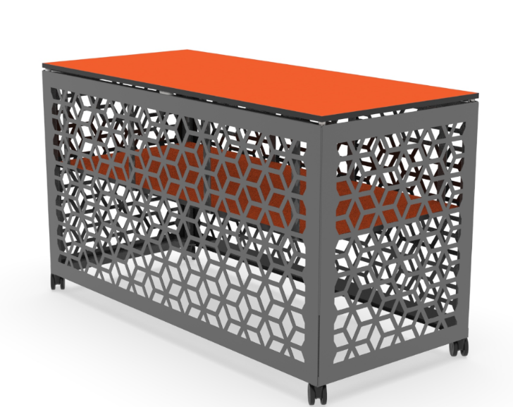
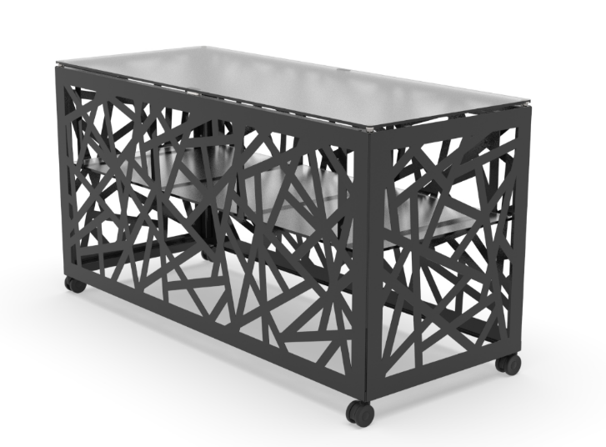
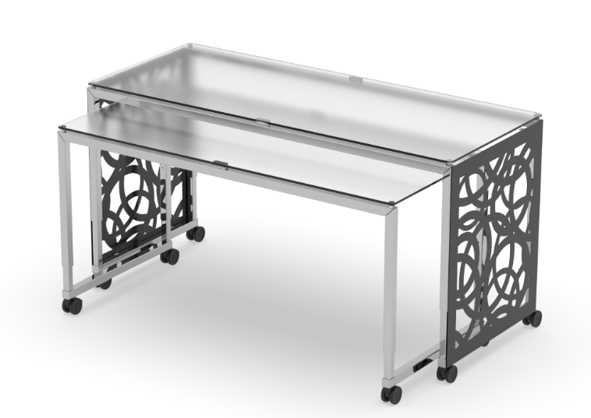
About SICO
NEWEST PRODUCT - MOSAIC

Slide 15
About SICO
Please drop off your business card for me to send you our Catalog Electronically.
THANK YOU

Slide 17




Bridging the Gap
Four Generations
One Workplace
Zero Friction
April 15, 2026

Slide 18

The Research Foundation
WHAT 2025 – 2026 GLOBAL DATA TELLS US ABOUT GEN Z AND THE WORKFORCE

Slide 19
US Bureau of Labor Statistics | 2024-2025 Baseline
CURRENT WORKFORCE COMPOSITION AND GROWTH TRENDS
Millennials: Largest Segment
Gen Z: Fastest Growing
Millennials remain the single largest workforce segment, and their expectations for leadership quality are well-established.
Gen Z is the fastest-growing workforce segment. Their influence on culture and expectations will only increase.
Baby Boomers: Still Active
Three Generations at Once
Boomers are declining but remain present. Leaders are managing three dominant generations simultaneously right now.
Hospitality leaders must speak to diverse modifications, communication styles, and career expectations across all three groups.
The leadership challenge is generational complexity – not just Gen Z alone.
Notes:
Click for Items 2, 3, 4 to appear
Click for summary statement at the end

Slide 20
Deloitte | 2025 Gen Z & Millennial Survey
20,000 RESPONDENTS ACROSS 44 COUNTRIES
Only 6% of Gen Z
Money, Meaning, & Well-Being
say their primary career goal is to reach a leadership position. Work/life balance and growth rank higher.
Gen Z pursues a trifecta of financial security, purposeful work, and personal well-being, not just pay.
Learning = Why They Choose You
74% of the Global Workforce by 2030
Learning and development is a top reason Gen Z selects an employer. Make growth visible or lose them.
Gen Z and Millennials will dominate workforce composition within this decade. This is not emerging; it is now.
Career success has fundamentally shifted from title to balance, growth, and purpose.
Notes:
Click for Quadrants 2, 3, 4 to appear
Click for summary statement at the end

Slide 21
Gallup | State of the Global Workplace 2025
ANNUAL GLOBAL ENGAGEMENT RESEARCH
Only 20 - 30% Engaged Globally
Manager Quality is the #1 Driver
Employee engagement remains critically low worldwide. Younger workers report the lowest engagement of any generation.
The single biggest predictor of engagement is manager quality – this is Gallup’s most consistent annual finding.
Less Than 25% Want Fully Remote
Loneliness Drives Return
Gen Z is least interested in fully remote work. They want mentorship, visibility, and social connection.
Many Gen Z employees are returning to in-person work not for policy, but due to loneliness and desire for development.
This is not about remote vs. office – it is about connection, development, and leadership.
Notes:
Click for Items 2, 3, 4 to appear
Click for summary statement at the end

Slide 22
McKinsey & Company | 2025 Workforce Research
GEN Z ENGAGEMENT AND SATISFACTION DRIVERS
Lower Satisfaction Across Drivers
Mental Health is a Top Concern
Gen Z reports lower satisfaction on clarity, development, recognition, and purpose compared to older generations.
Mental health continues to rank as a primary workplace concern for younger workers, and leaders must respond.
The Great Attrition Continues
Skills Gaps are the Barrier
Employees are still leaving due to lack of development, poor leadership, and absence of meaningful work.
63% of employers cite skills gaps as the biggest obstacle to business transformation. Reskilling is now urgent.
The path forward: stronger manager capability, clearer development,
and more sustainable employee experiences.
Notes:
Click for Items 2, 3, 4 to appear
Click for summary statement at the end

Slide 23
World Economic Forum | 2025 Workforce Projections
FUTURE OF JOBS REPORT – GLOBAL WORKFORCE COMPOSITION
Gen Z = 27%
of Global Workforce
Millennials + Gen Z Are Dominant
Resilience and Agility Rising
This is Already Happening
● ● ● ● ● ● ● ● ● ● ● ● ● ●
● ● ● ● ● ● ● ● ● ● ● ● ● ●
● ● ● ● ● ● ● ● ● ● ● ● ● ●
● ● ● ● ● ● ● ● ● ● ● ● ● ●
By 2025, Gen Z already represents roughly 27% of the global workforce. Their expectations are shaping operations now.
Together, these two generations now make up the majority of workers globally, and leadership must adapt accordingly.
Employers rank resilience, flexibility, and agility as increasingly critical skills – not just technical expertise.
The generational shift is not a future trend to prepare for; it is the present reality leaders are managing today.
Organizations must build environments where high expectations
and human-centered leadership co-exist.
Notes:
Click for Items 2, 3, 4 to appear
Click for summary statement at the end

Slide 24
2025 – 2026 Emerging Workforce Trends
WHAT HAS SHIFTED, AND WHAT IT MEANS FOR HOSPITALITY LEADERS
Career Portfolio Over
Career Ladder
Work-Life Balance Surpassed Pay
Burnout & Mental Health Rising
Learning = Loyalty
Gen Z prioritizes skill-building, flexibility, and optionality over climbing a traditional hierarchy. Growth ambition is high even when leadership ambition is low.
For the first time, work-life balance ranks as the top global priority, above compensation, for younger workers.
Younger workers report higher burnout rates than older generations. Well-being is now an operating concern, not an HR concern.
Continuous learning is now the top retention driver. Employees stay where they grow, feel supported, and see future opportunity.
Employees stay where they grow. Make development visible, or they will find it elsewhere.
Notes:
Click for Items 2, 3, 4 to appear
Click for summary statement at the end

Slide 25

This is not about “kids these days.”
IT IS ABOUT HOW WORK IS CHANGING.
Notes:
Click for Items 2, 3, 4 to appear
Click for summary statement at the end

Slide 26
Why Hospitality Leaders Should Care
The talent shortage is also a leadership challenge.
65%
of surveyed hotels reported staffing shortages.
Still below 2019
AHLA projected 2025 hotel employment would rise, but it remains well below pre-pandemic staffing levels in most states.

Slide 27

What This Means
Operations need people who stay and grow.
Frontline experience rises or falls with manager quality.
Schedule design, development, and leadership habits now affect retention.

Slide 28
What Gen Z Wants from Work
Predictable schedules
Recovery time
Boundaries that feel sustainable
Work that matters
Values alignment
A reason to care beyond the paycheck
Balance
Meaning
Learning and development
Clear next steps
Coaching that builds capability
Fair pay
Financial stability
Confidence in the future
Growth
Security
Bottom line: younger talent is not lowering expectations for work – they are raising expectations for leadership, learning, and sustainability.
Notes:
This one is set up so the 4 qualities are there on start-up. Click for the subpoints for each to appear. 1 Balance, 2 Growth, 3 Meaning, 4 Security
Click for summary statement at the end

Slide 29

How Gen Z Feels About Work
They want managers who guide, inspire and mentor – not just oversee daily tasks.
They respond to timely, authentic feedback more than delayed annual judgments.
They still want human connection: visibility, belonging, and real coaching.
Well-being matters. Stress, clarity, and feeling cared about all shape whether they stay.
Work is part of life, not the whole of life – so loyalty must be earned through experience.
Leadership Implication: Technology may shape how they communicate,
but people will still determine whether feel developed, connected, and valued.
Notes:
Click for Items 2, 3, 4 to appear
Click for summary statement at the end

Slide 30

The Tension Hospitality Leaders Feel
“They don’t want to work.”
What Gen Z is often saying instead:
“WE DON’T WANT TO WORK LIKE THAT.”
Notes:
Click for summary statement at the end

Slide 31
Five Leadership Shifts for Gen Z
HOW HOSPITALITY CAN ATTRACT, DEVELOP, AND RETAIN
DIGITAL-NATIVE TALENT

Slide 32

Shift | From control to flexibility with accountability
1
SCHEDULING IS LEADERSHIP
Flexibility in hospitality
rarely means
“work from home.”
It means
more control
over time.
Post schedules earlier so people can plan their lives.
LEADERSHIP LINE
Flexibility is not about lowering the bar. It is about giving people more control over how they meet the bar.
Use transparent shift-wrap rules instead of formal exceptions.
Clarify standards and outcomes so flexibility does not feel like chaos.
“
Respect recovery time – sustainable energy is a performance issue.
Notes:
Click for items to appear in the middle. Final blue box (Leadership Line or other statement) appears on final click.

Slide 33
Shift | From telling to coaching
2
MANAGER QUALITY MATTERS
Coaching looks like:
Brief daily check-ins, not just corrective conversations.
WHY IT MATTERS
Employees are more engaged when feedback is frequent, valuable, timely, and authentic. Recognition strengthens the impact of feedback.
Real-time feedback that is specific and useful.
Recognition when people handle a guest issue well.
Questions that help employees think, not just comply.
Visible managers who are present in the operation.
Notes:
Click for items to appear in the middle. Final blue box (Leadership Line or other statement) appears on final click.

Slide 34
Shift | From tenure to growth
3
VISIBLE DEVELOPMENT DRIVES RETENTION
If they cannot
see a path,
they assume
there is not one.
Cross-training across front desk, events, F&B, housekeeping, or operations.
LEADERSHIP LINE
They are not job-hopping because they lack loyalty.
Often they are growth-hunting because the path is invisible.
Short development plans with one next skill to build.
Supervisor shadowing and stretch assignments.
“
Transparent internal mobility and promotion criteria.
Notes:
Click for items to appear in the middle. Final blue box (Leadership Line or other statement) appears on final click.

Slide 35
Shift | From transaction to purpose
4
CONNECT THE ROLE TO IMPACT
In hospitality, purpose is not abstract.
We create experiences that people remember.
WHAT LEADERS SHOULD DO
Connect daily tasks to guest impact, team impact, and personal growth.
Purpose does not replace pay.
It strengthens commitment when people can see why the work matters.
We help guests feel welcomed, safe, and cared for.
We solve problems in real-time.
We create moments that affect loyalty and reputation.
Notes:
Click for items to appear in the middle. Final blue box (Leadership Line or other statement) appears on final click.

Slide 36
Shift | From managing work to leading humans
5
EMOTIONAL INTELLIGENCE IS NOW AN OPERATING SKILL
People stay longer and perform better when leaders combine standards with humanity.
Notice: Pay attention to energy, stress, confidence, and who is starting to disengage.
THE MANAGER EXPERIENCE MATTERS, TOO
Gallup shows managers themselves are under strain, so organizations must support the people leading the frontline.
Normalize: Make it safe to ask questions, admit mistakes, and talk about pressure before people shut down.
Develop: Treat each person as a future contributor, not just a pair of hands for today’s shift.
Notes:
Click for items to appear in the middle. Final blue box (Leadership Line or other statement) appears on final click.
Click for summary statement at the end

Slide 37
What Leaders Can Do in the Next 90 Days
1
2
3
Audit Schedules
Upgrade Manager Habits
Make Growth Visible
Where are we creating avoidable stress through unpredictability
or unfairness?
What would frequent coaching and recognition look like in our operation?
Can a new employee see clearly the next skill, role, or pathway available here?
ONE GOOD SHIFT IN MANAGER BEHAVIOR CAN IMPROVE RETENTION FASTER THAN ONE MORE POSTER ABOUT CULTURE.
Notes:
Click for 3 points, and then click again for summary statement.

Slide 38

How Will We Evolve Our Leadership to Meet This Moment?
Thank You
Notes:
Click for Thank You and logo.
Executive Briefing updated with 2025-2026 research

Slide 40
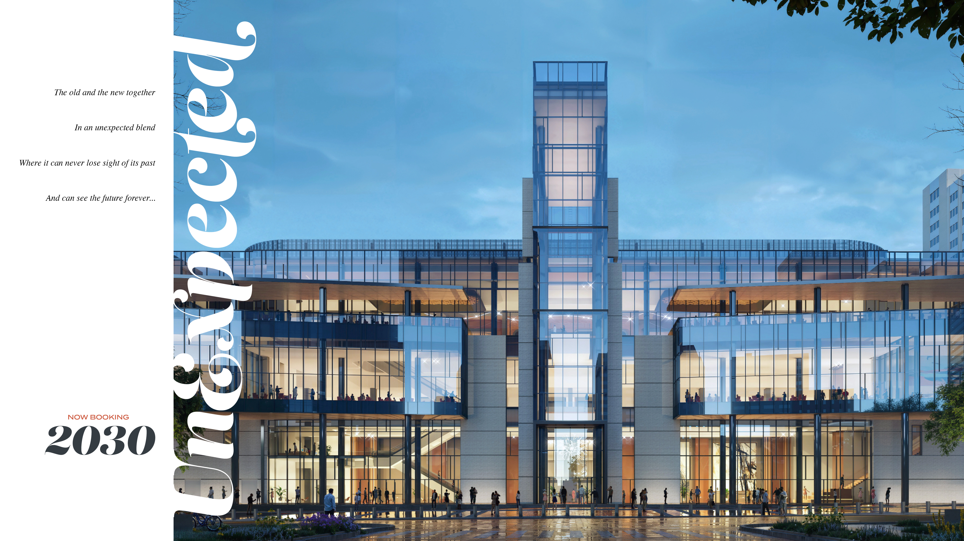

Slide 41
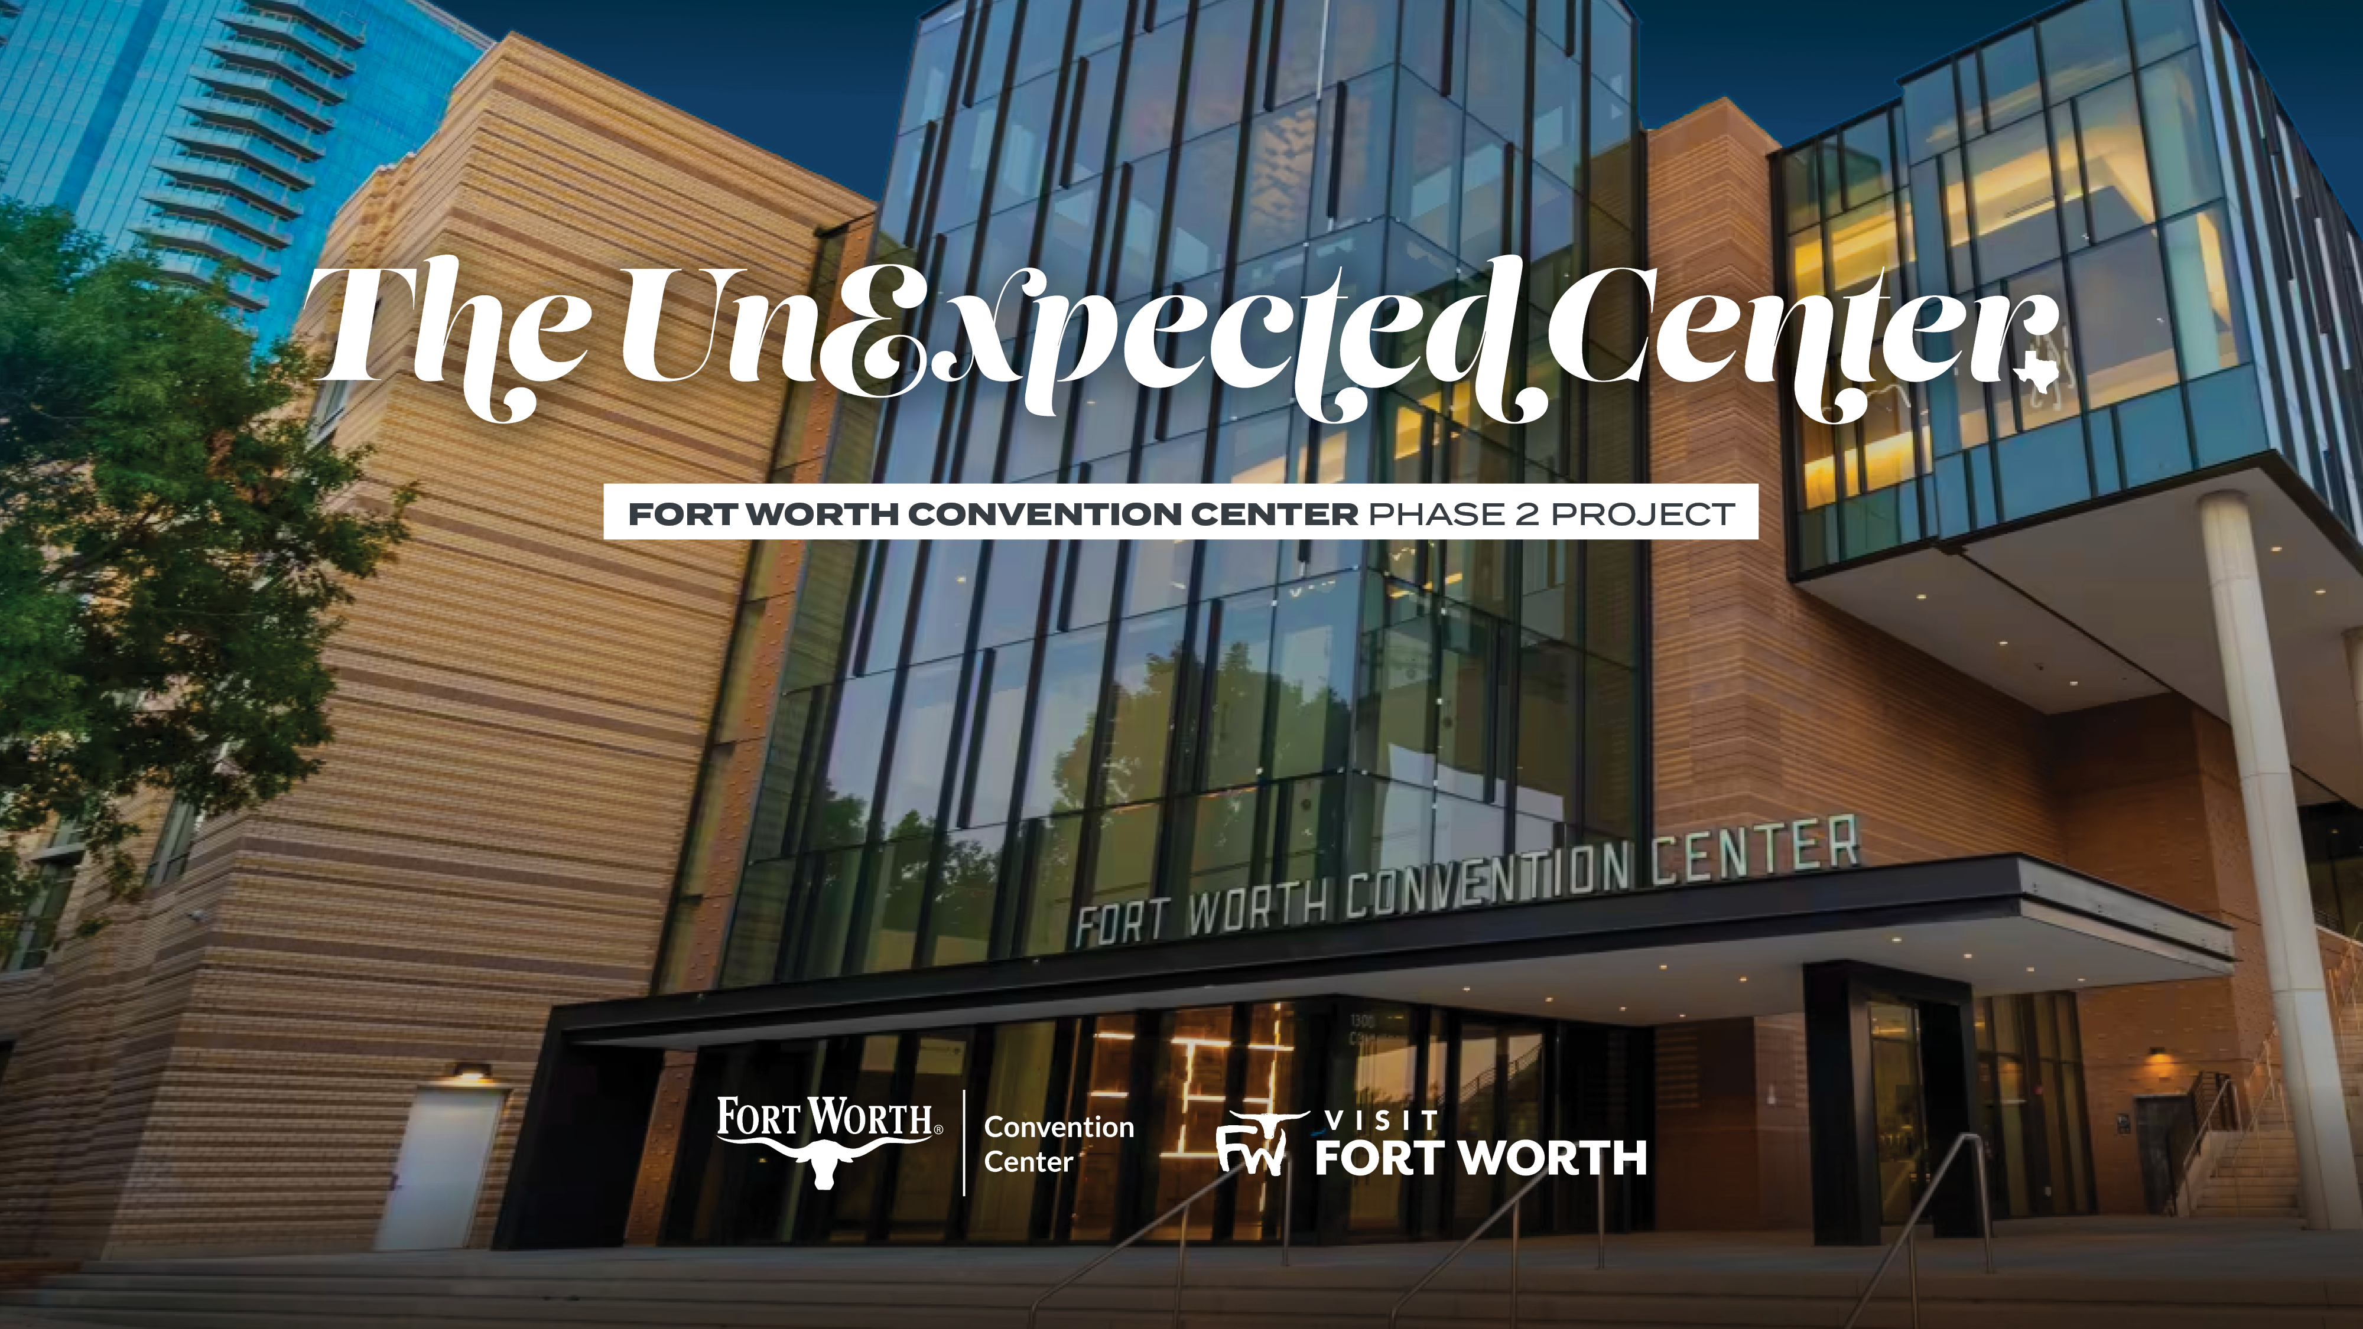

Slide 42
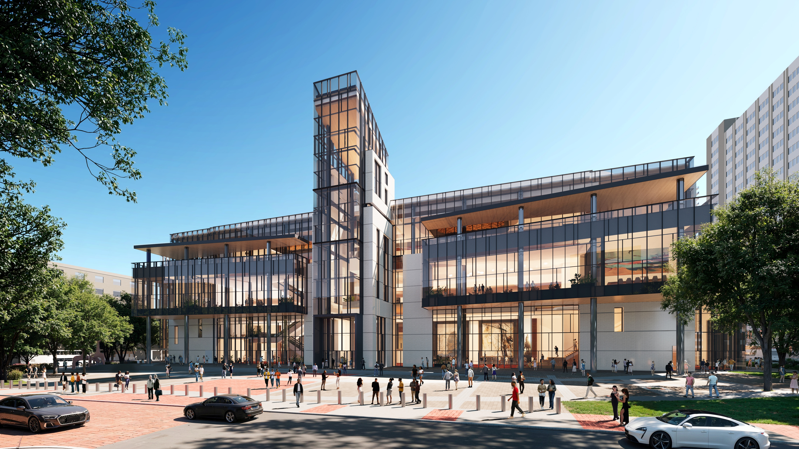
NORTH FACADE & PLAZA

Slide 43
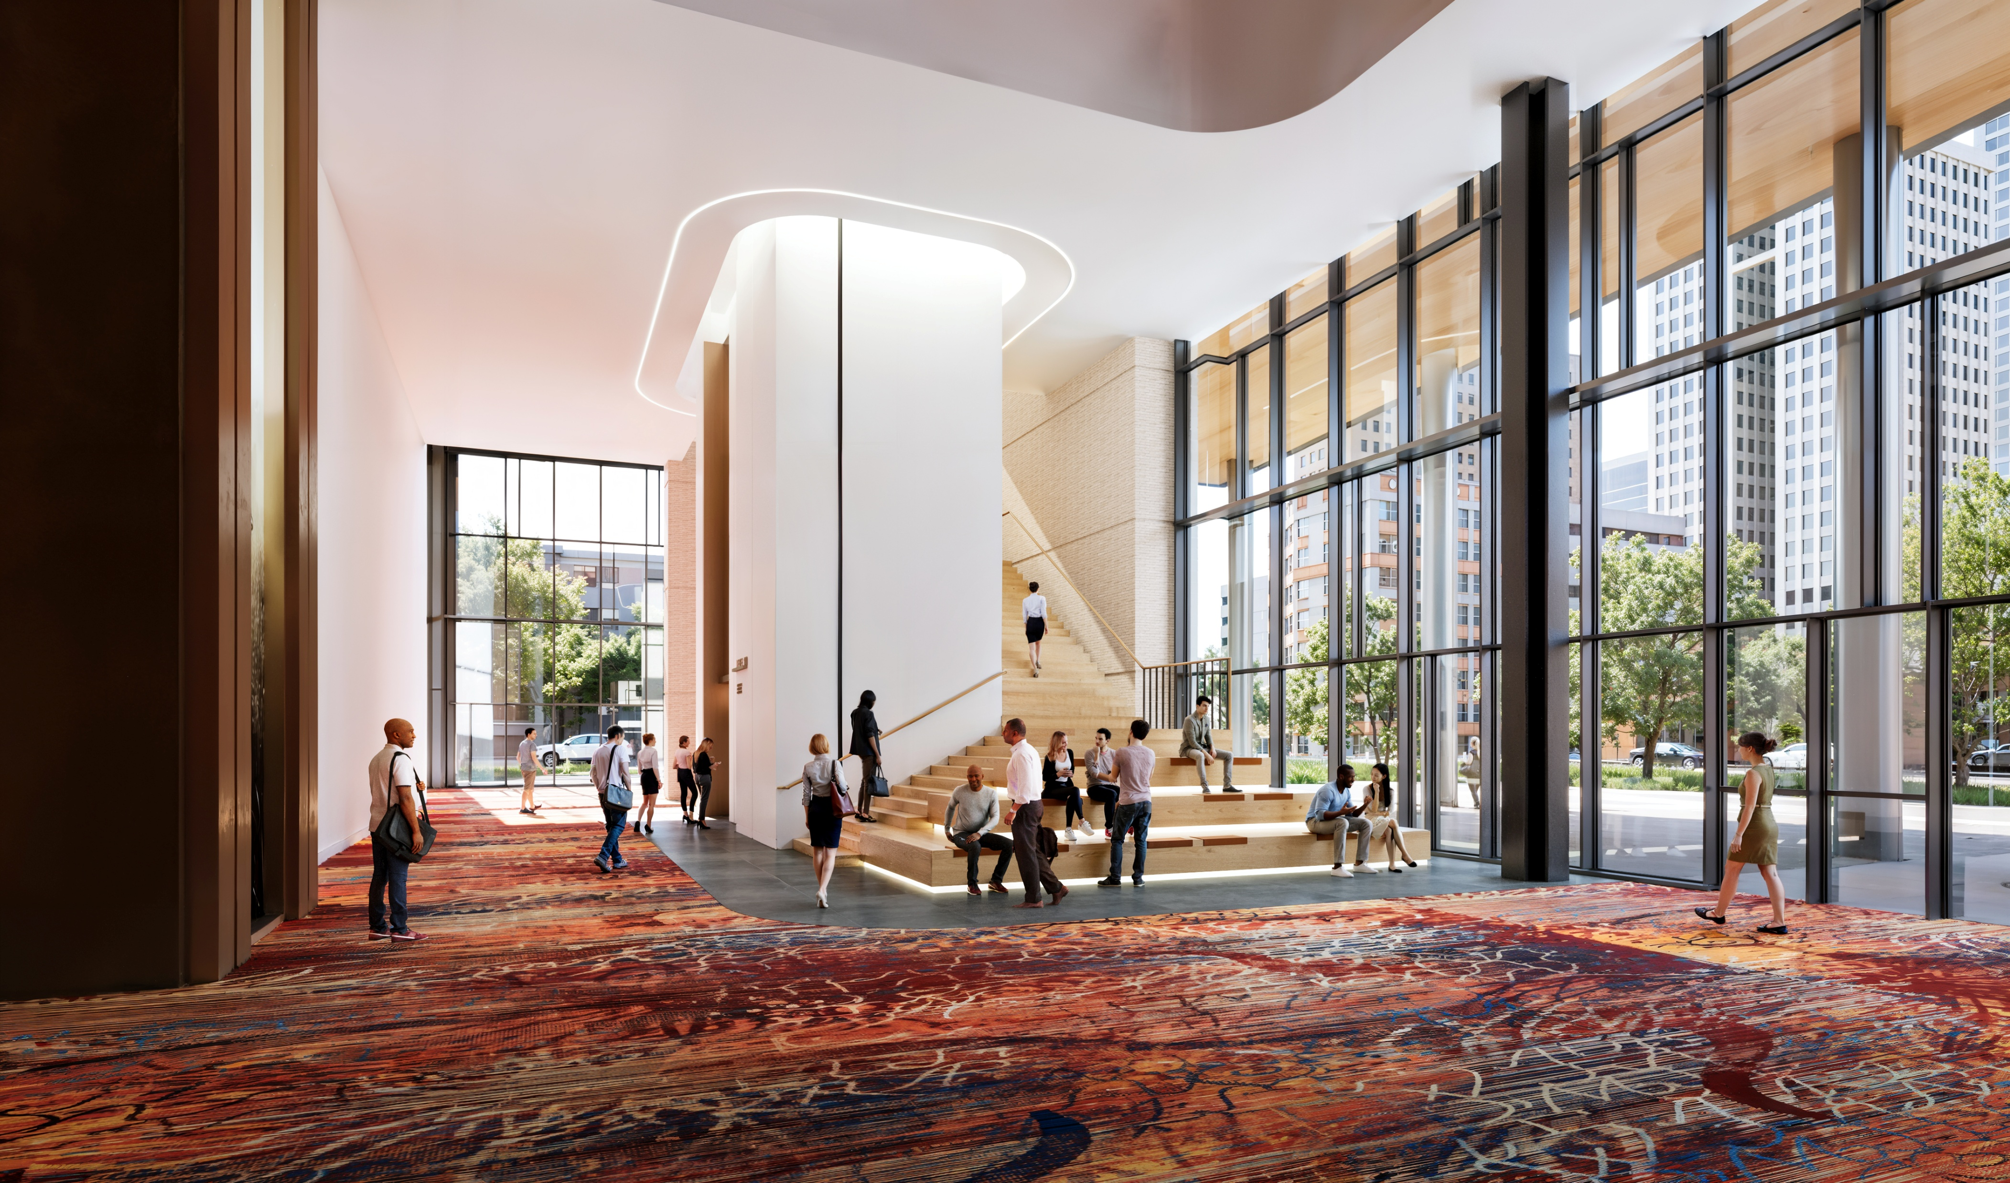
NORTH CONCOURSE – STREET LEVEL

Slide 44
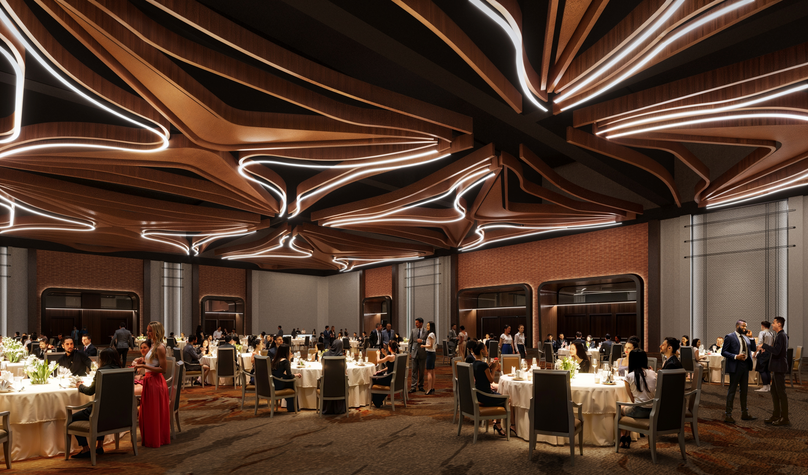
BALLROOM INTERIOR– LEVEL 400

Slide 45
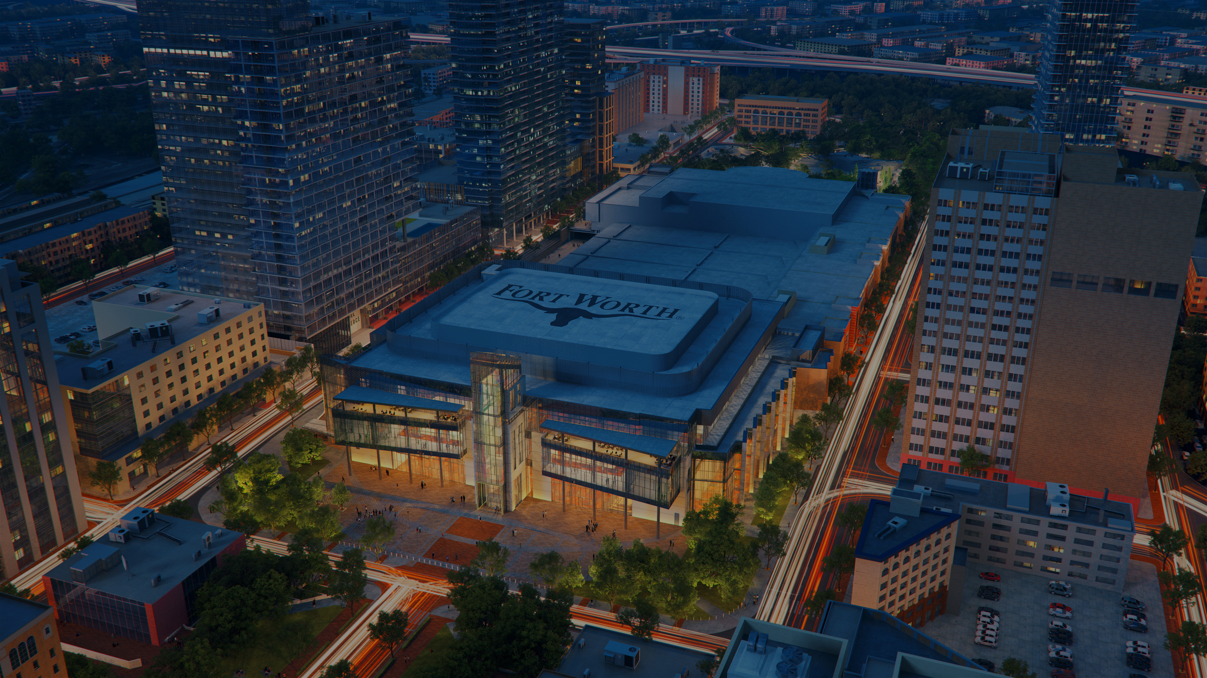
PHASE 2 SCHEDULE
Design Completion: Targeted by end of 2026
Final Event in Arena: September 2026
Arena Abatement Begins: October 2026
Arena Demolition Starts: Q1 2027
Construction Completion: Q4 2029

