Slide 1

Hotel Association of Tarrant County

Slide 2
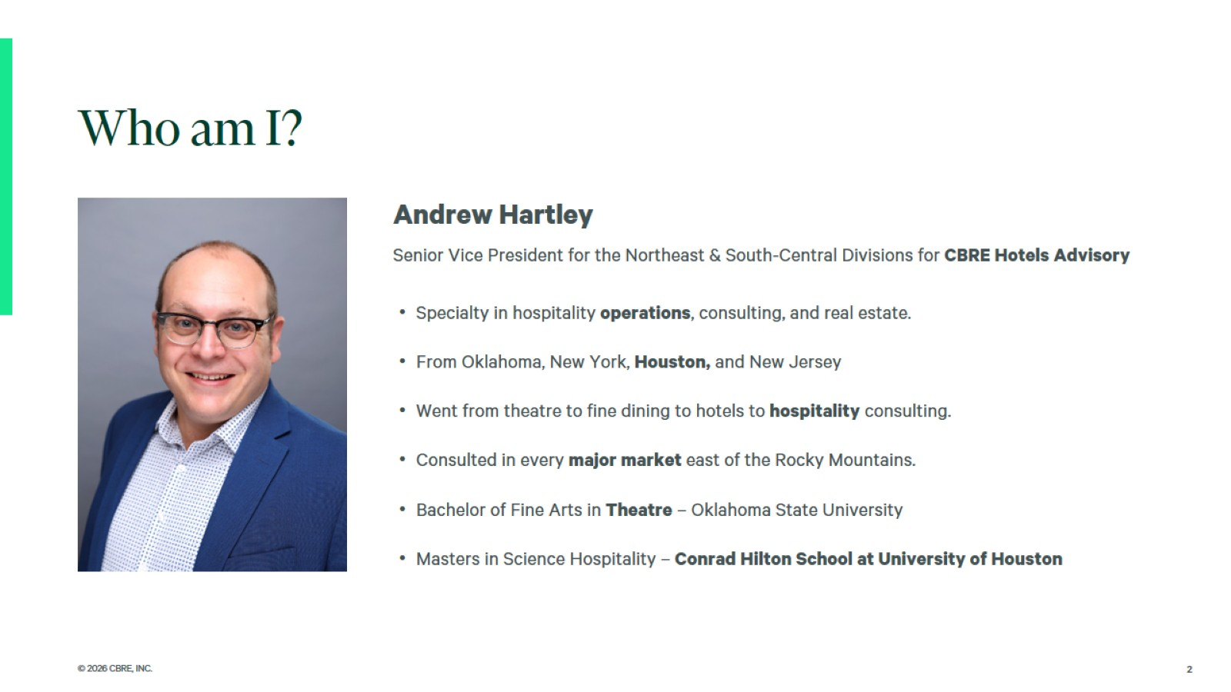

Slide 3

The National
Economy

Slide 4
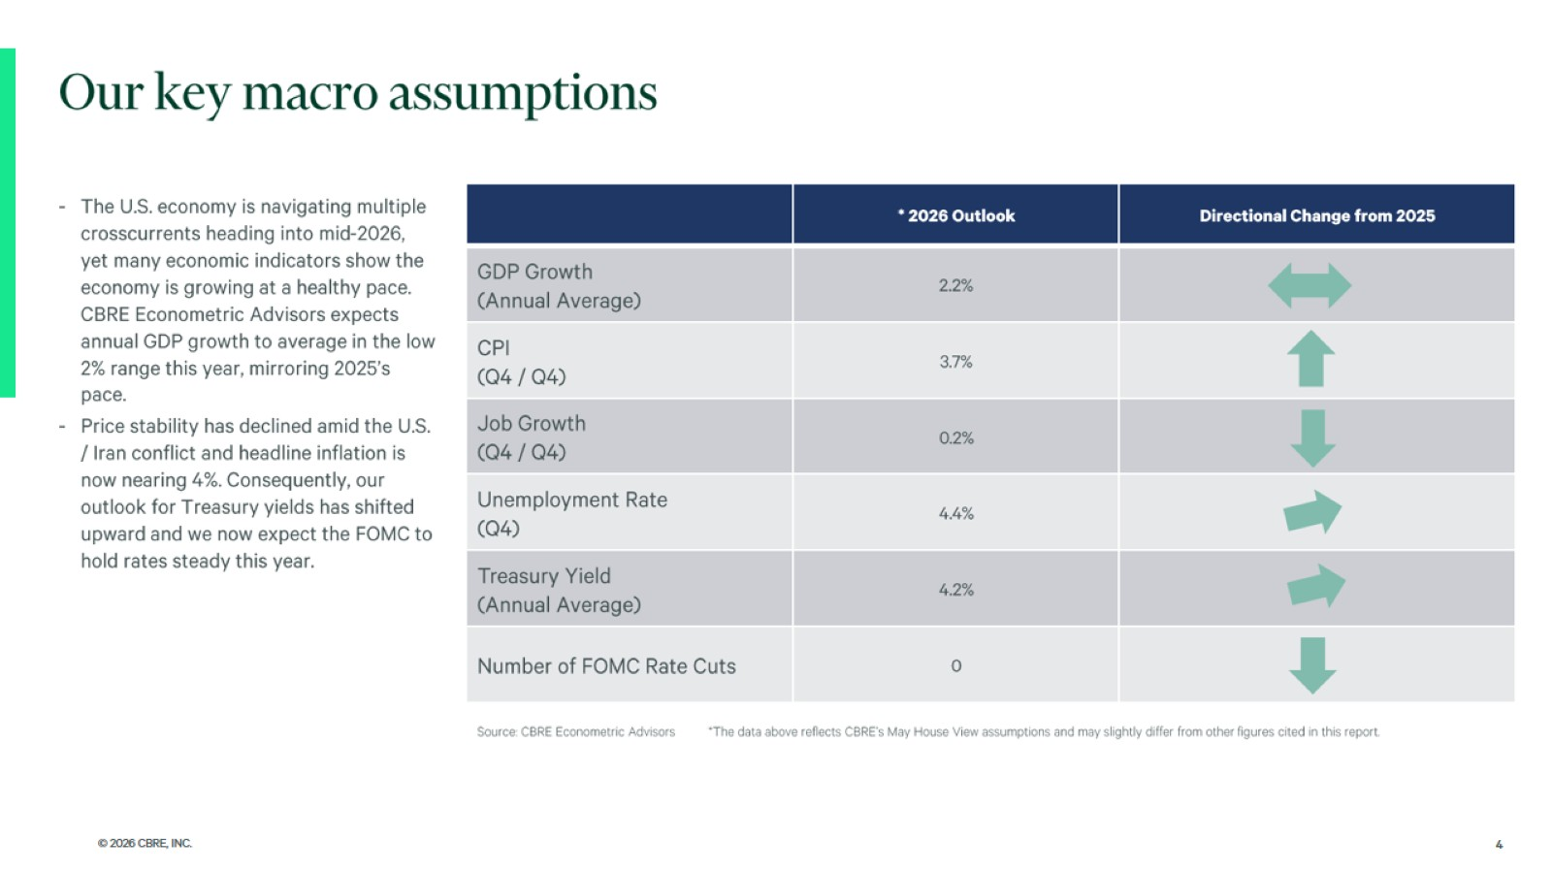

Slide 5
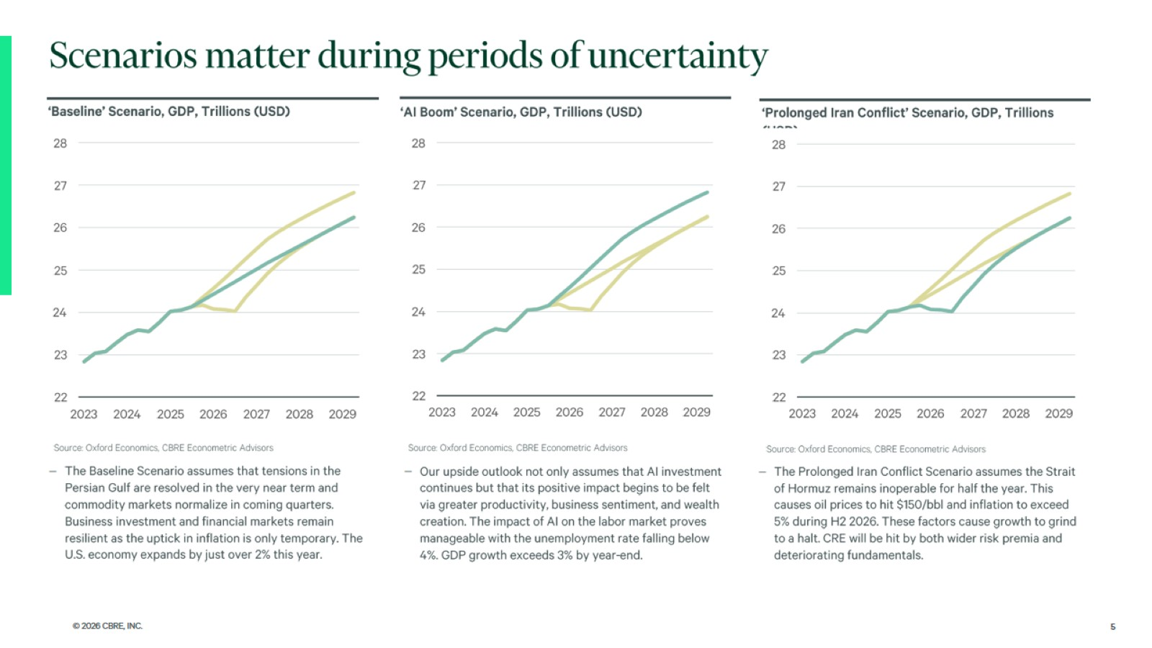

Slide 6
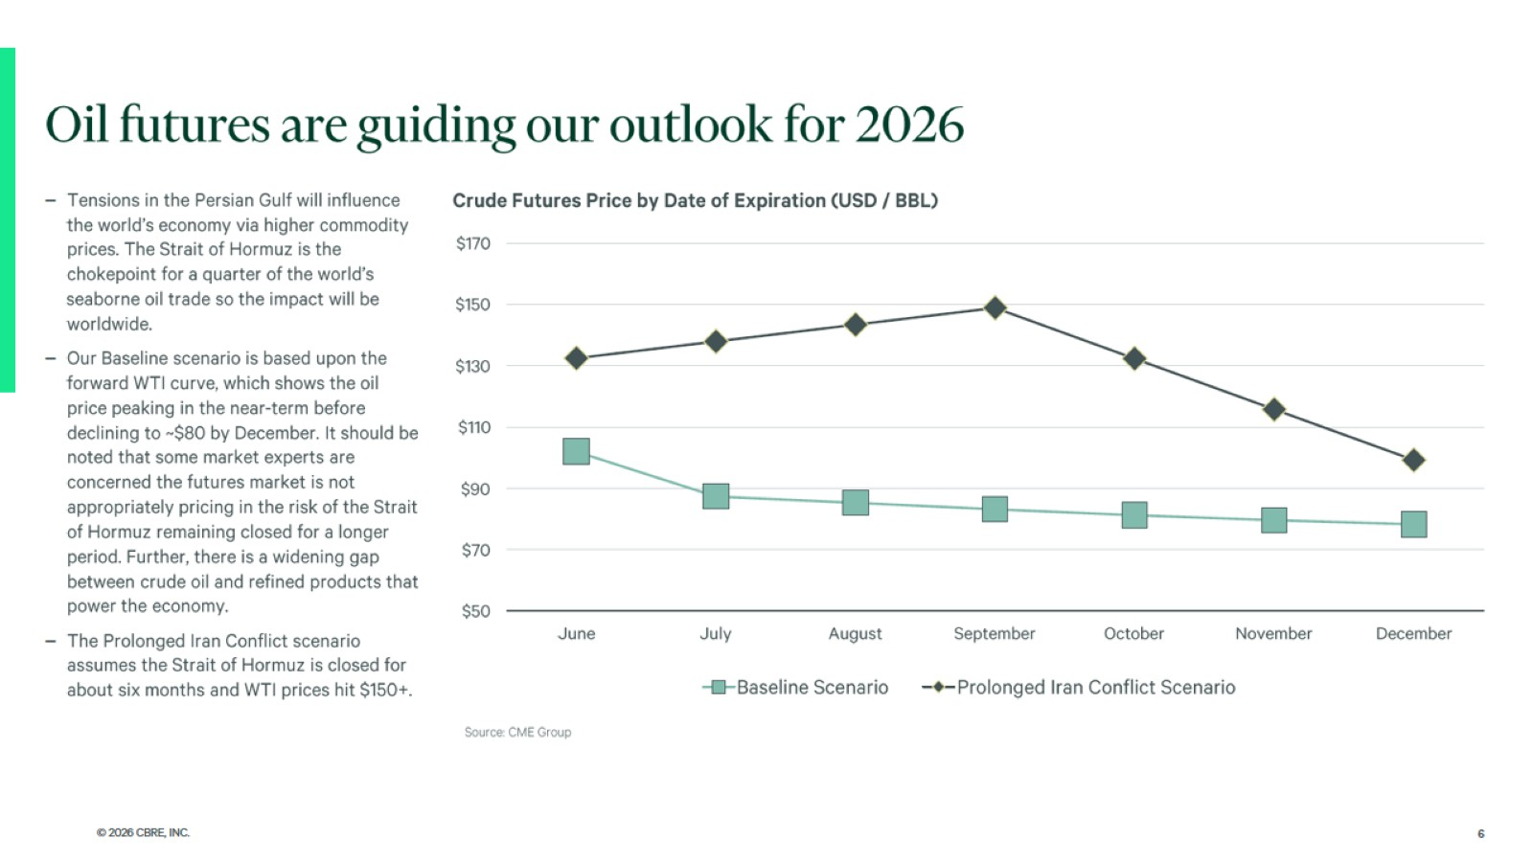

Slide 7
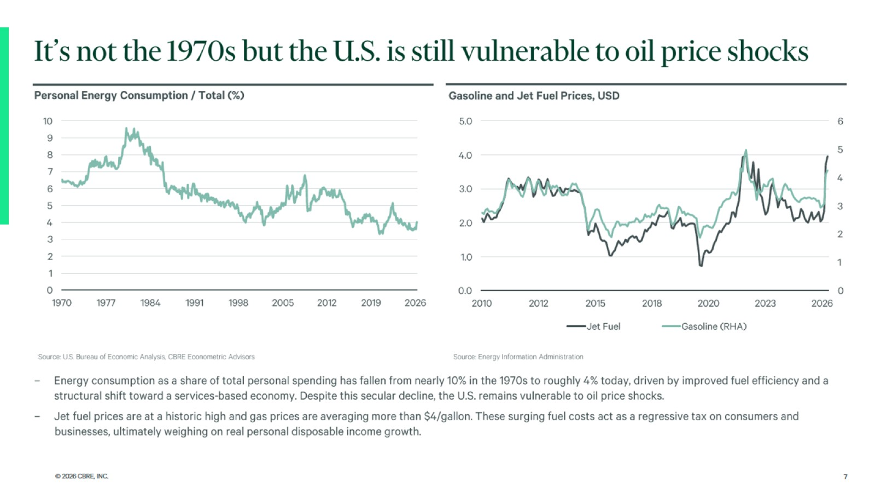

Slide 8
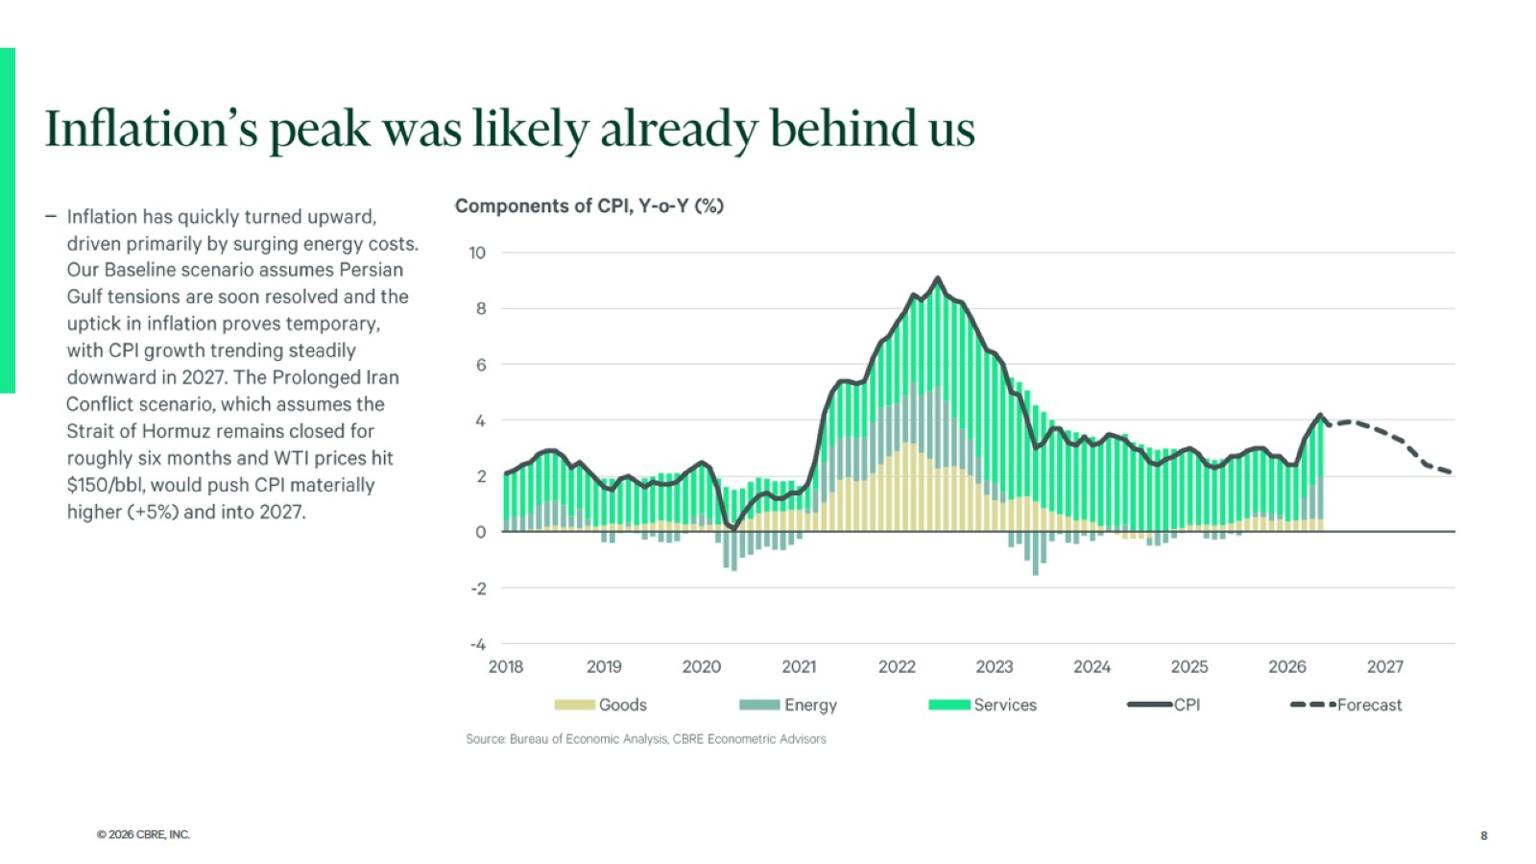

Slide 9
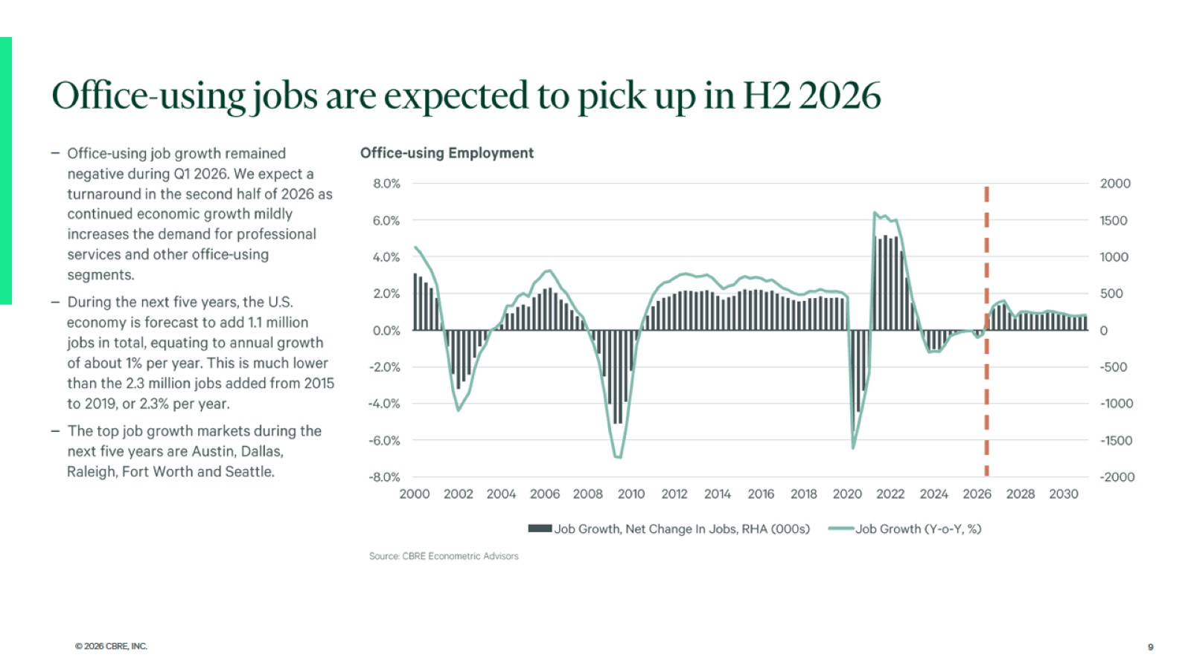

Slide 10
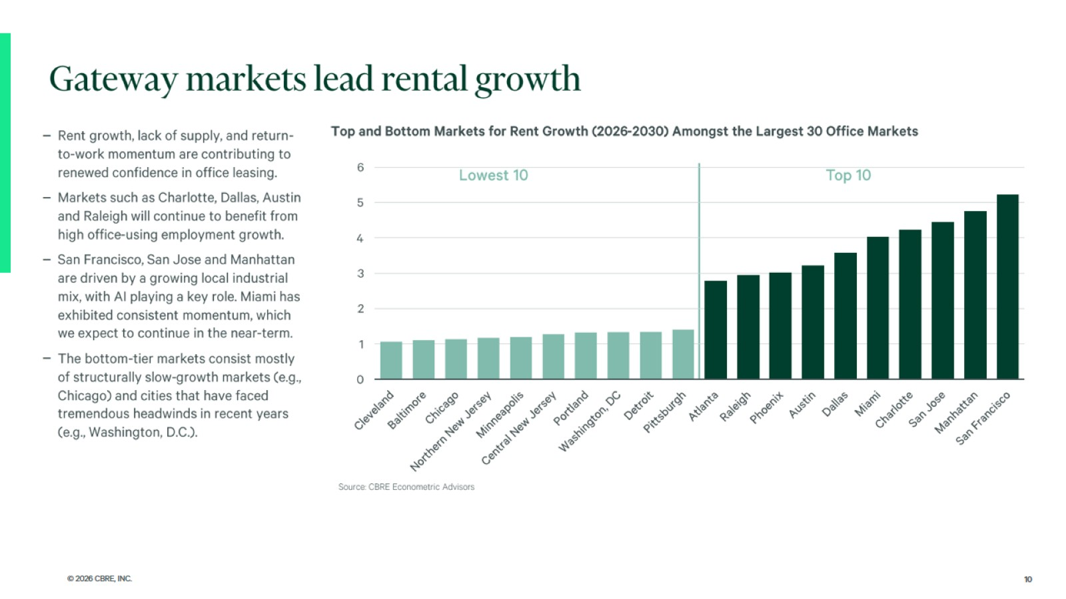

Slide 11

National Hotel Market

Slide 12
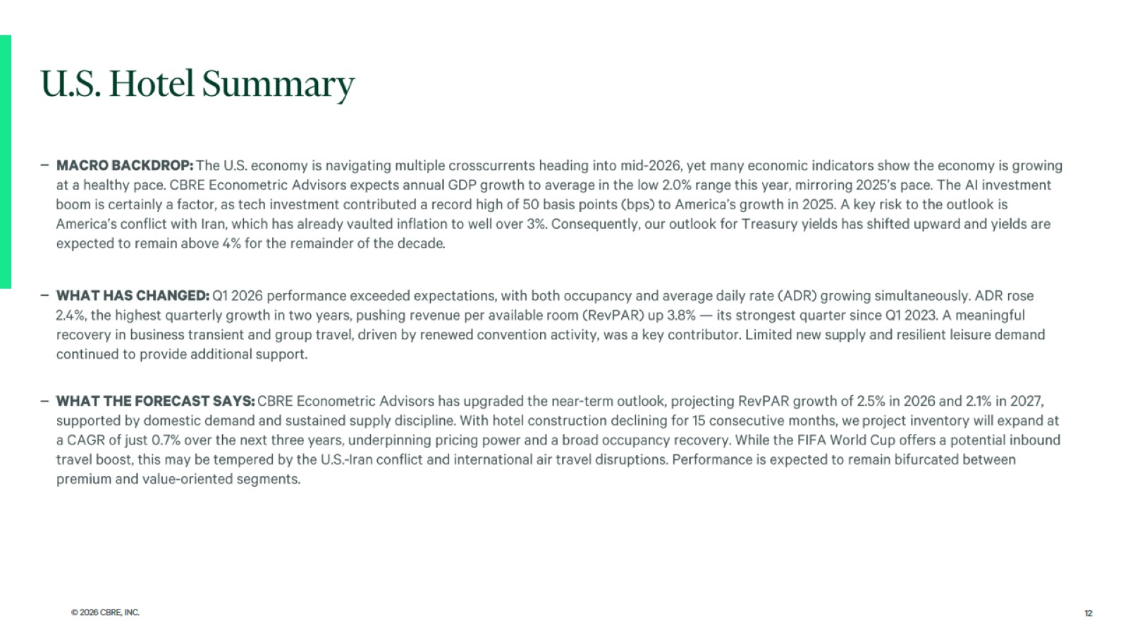

Slide 13
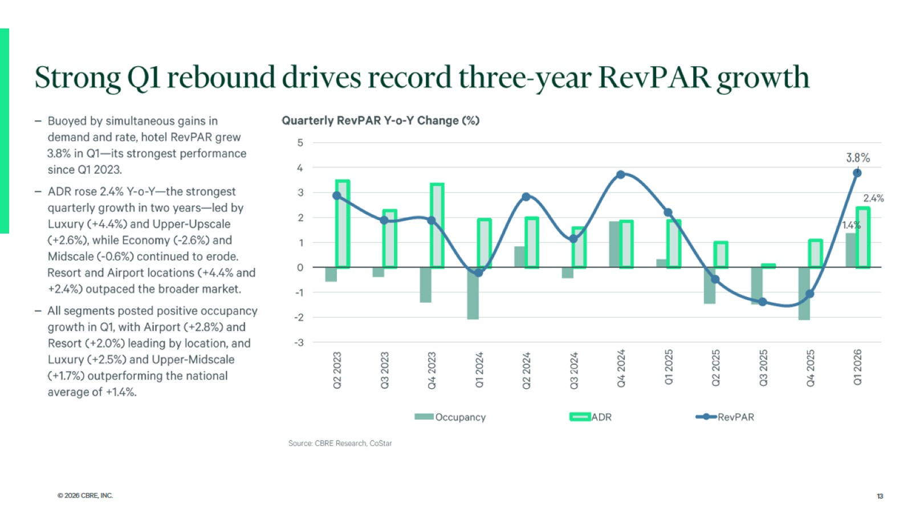

Slide 14
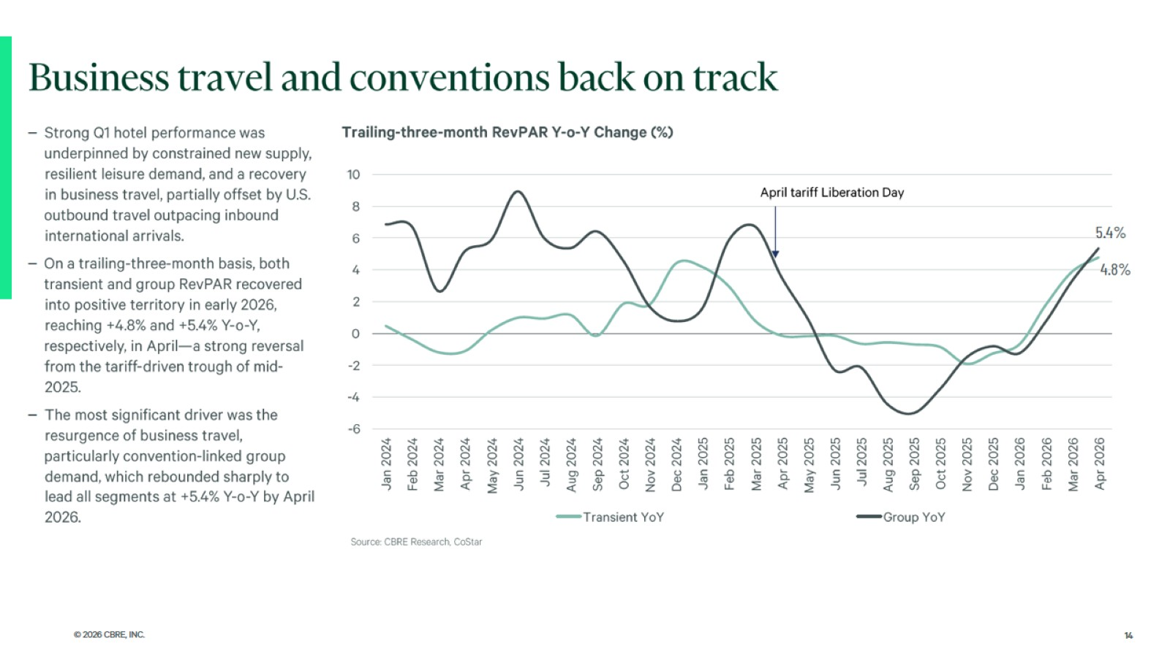

Slide 15
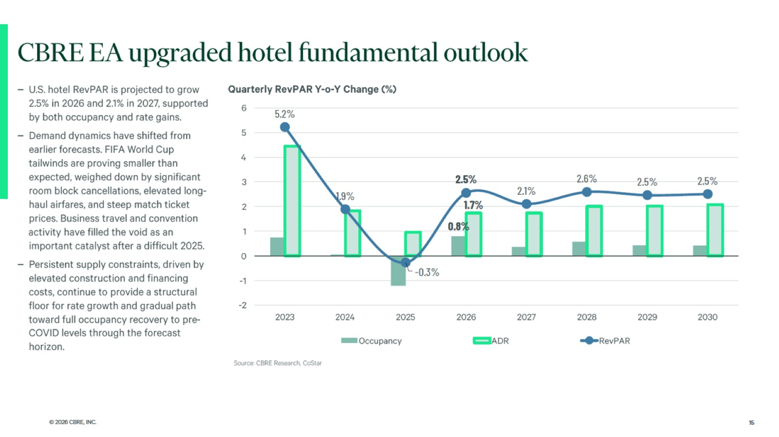

Slide 16
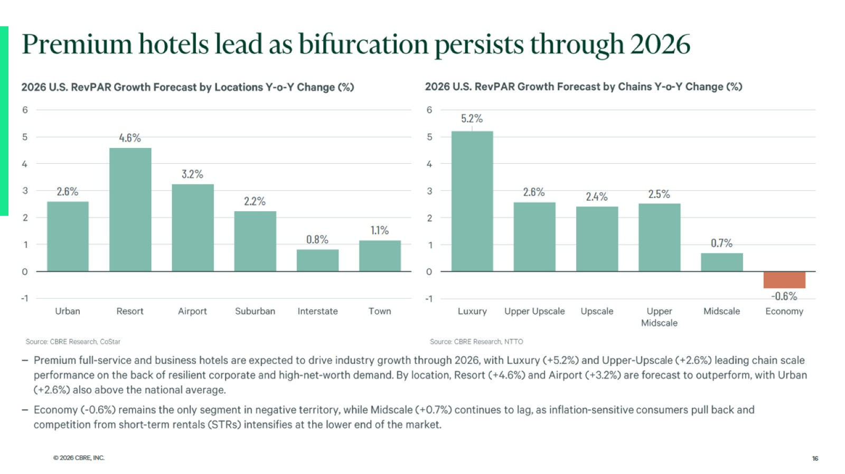

Slide 17
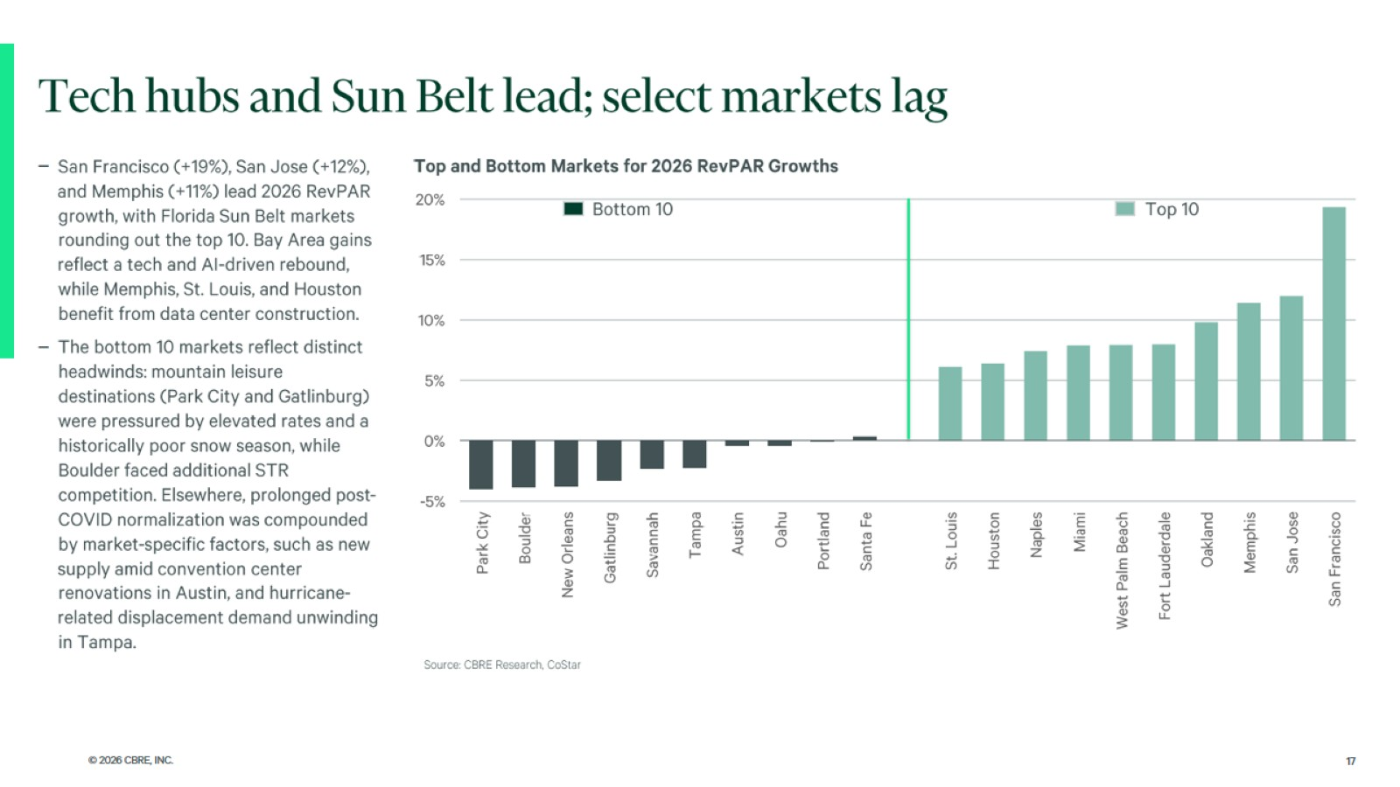

Slide 18

Fort Worth Office Market

Slide 19
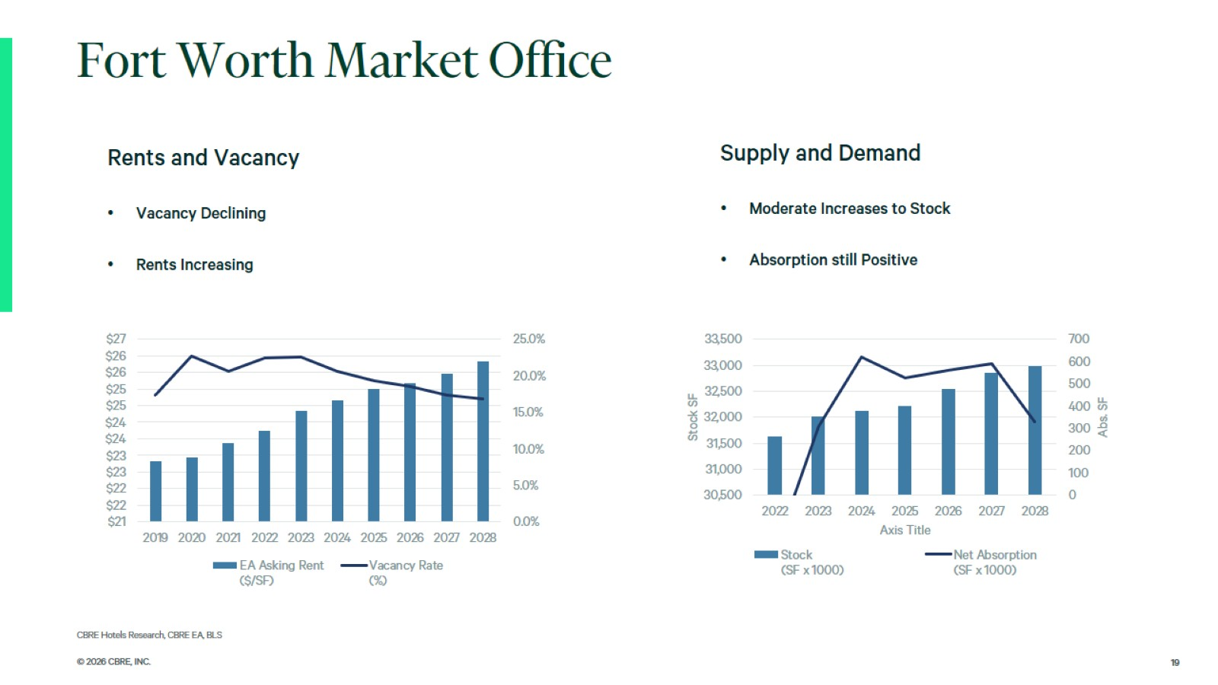

Slide 20
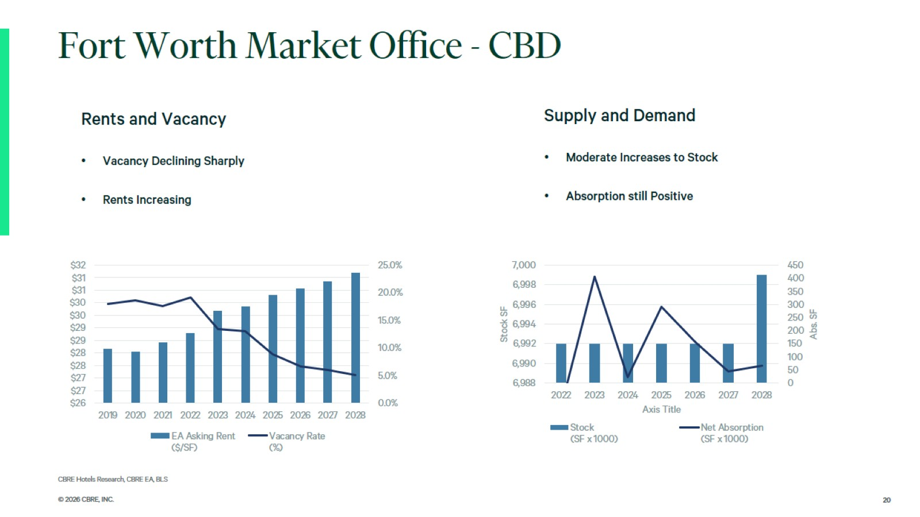

Slide 21
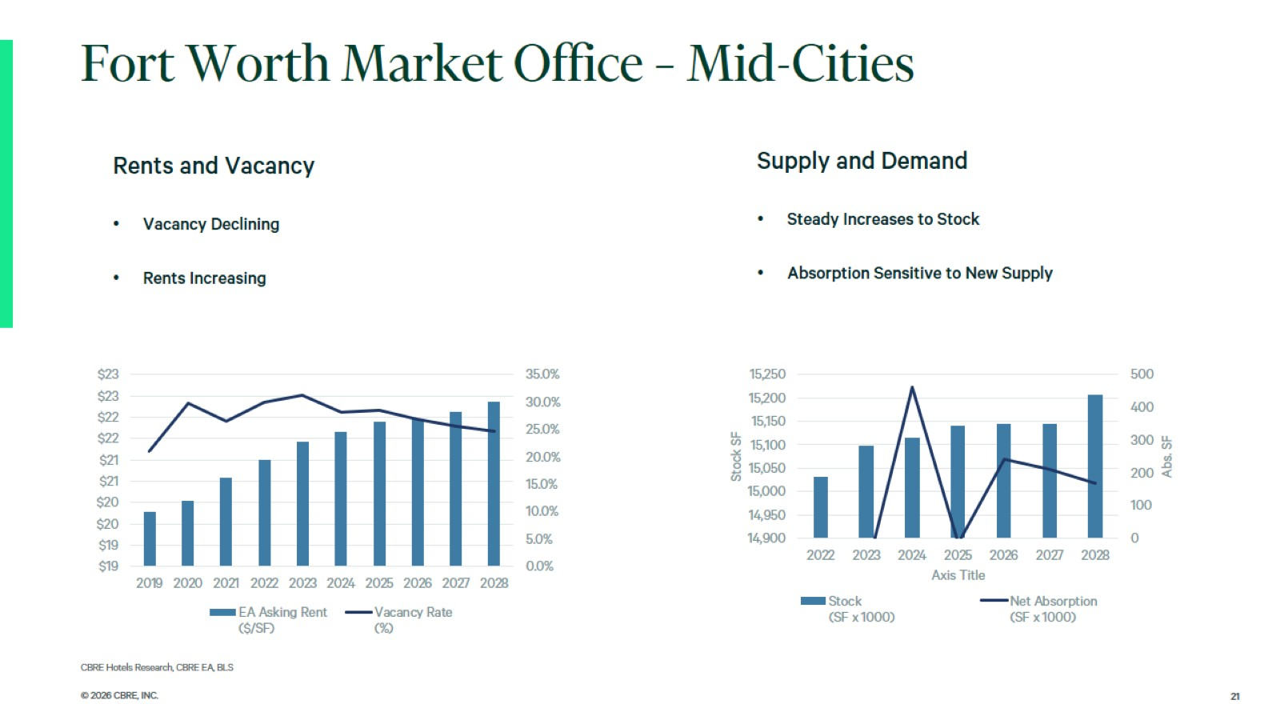

Slide 22
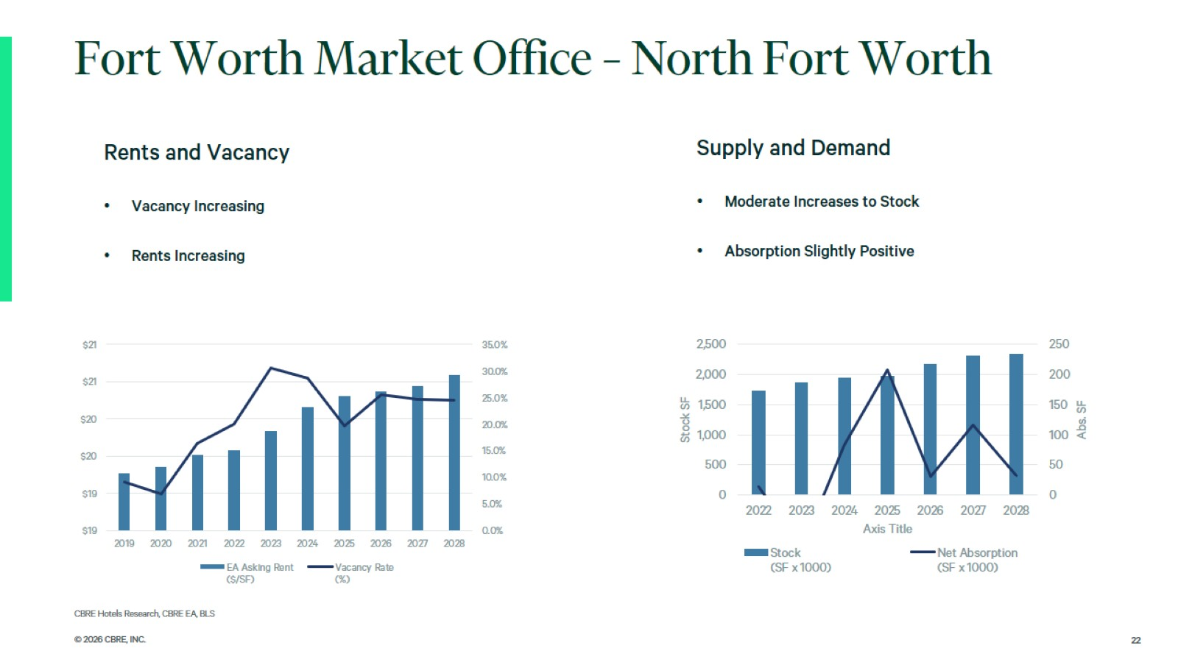

Slide 23
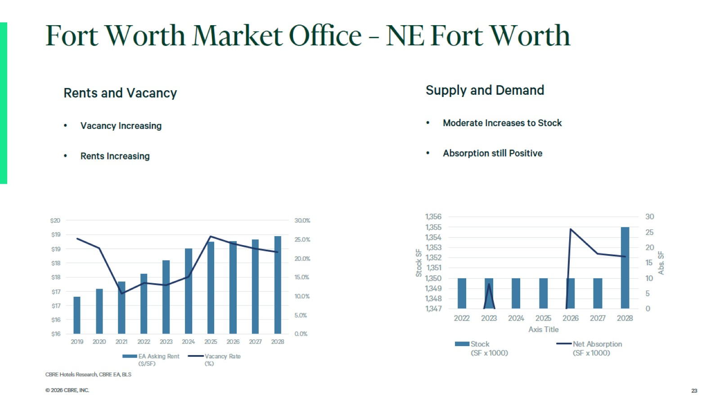

Slide 24
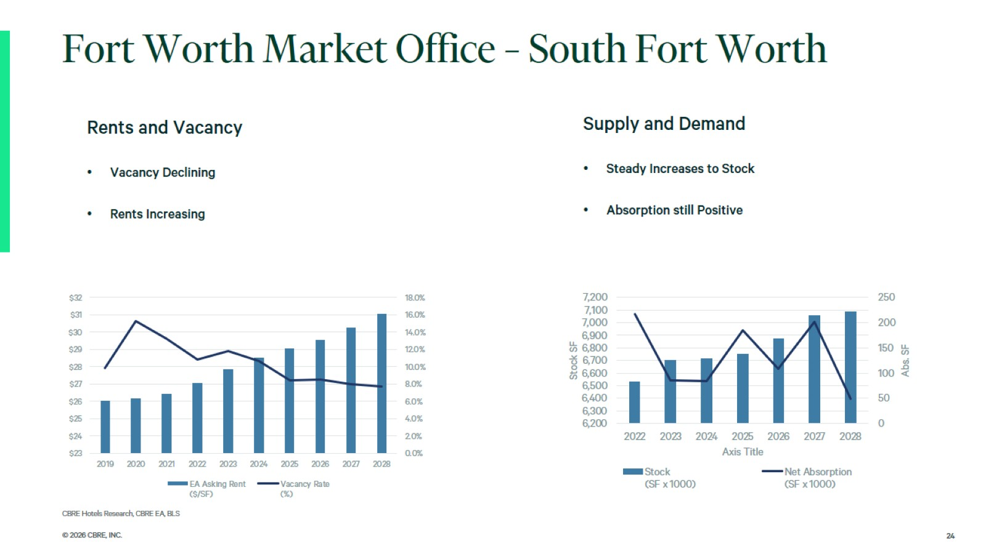

Slide 25

Fort Worth Forecast

Slide 26
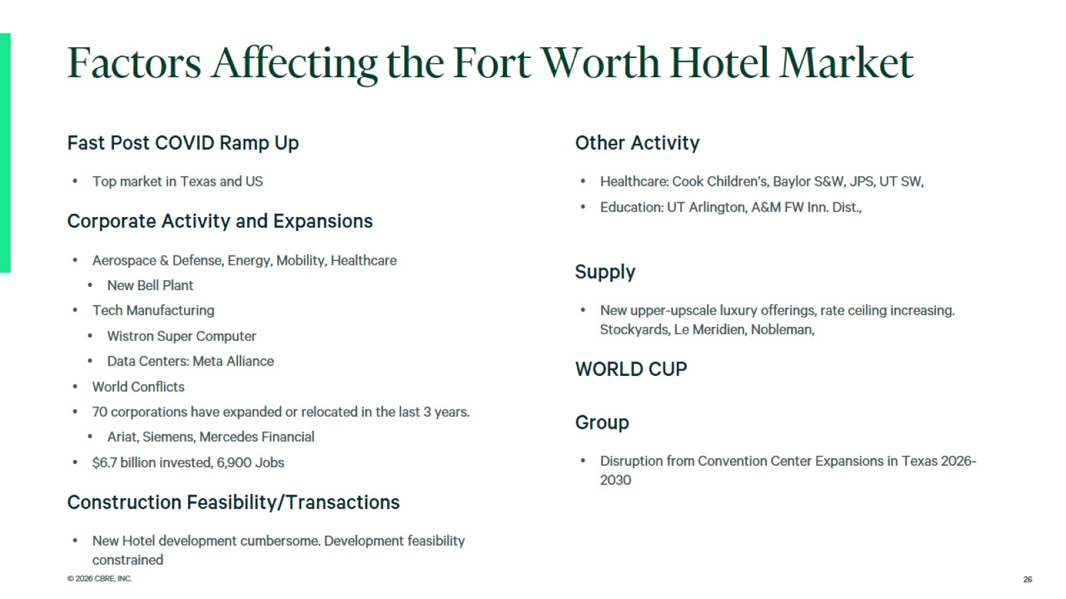

Slide 27
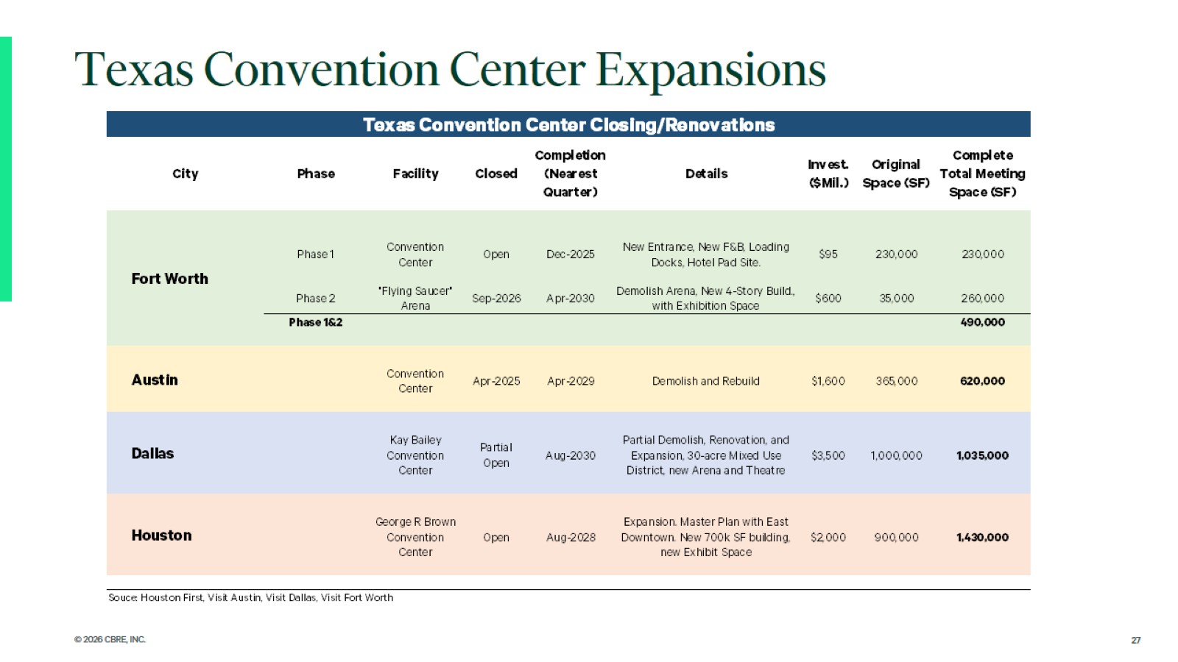

Slide 28
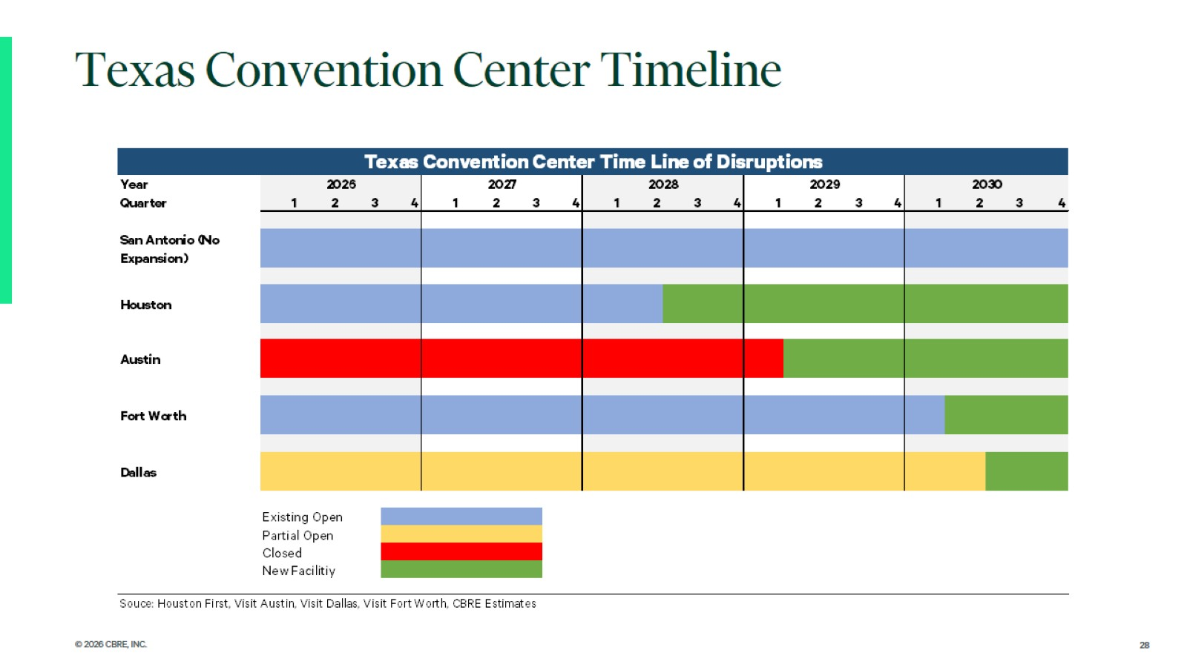

Slide 29
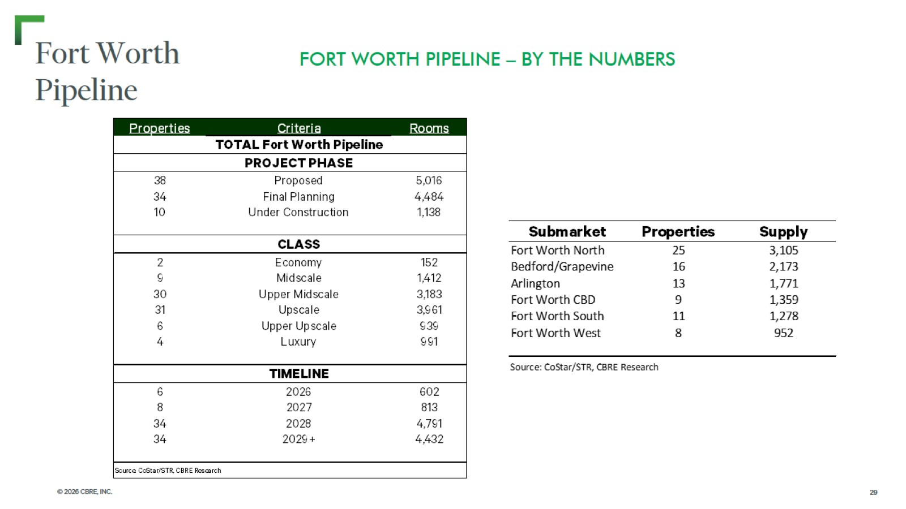
Fort Worth
Pipeline

Slide 30
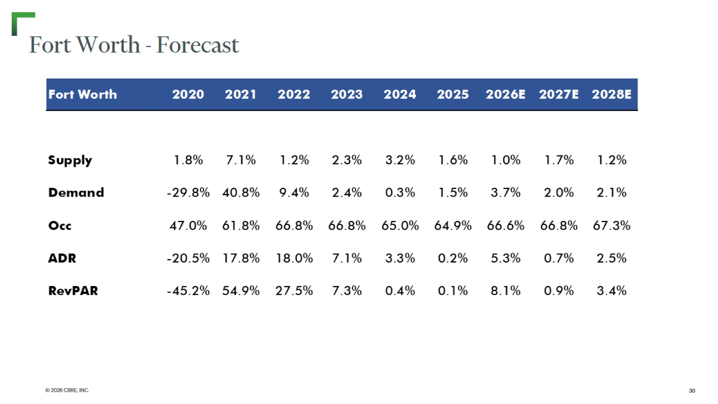
Fort Worth - Forecast

Slide 31
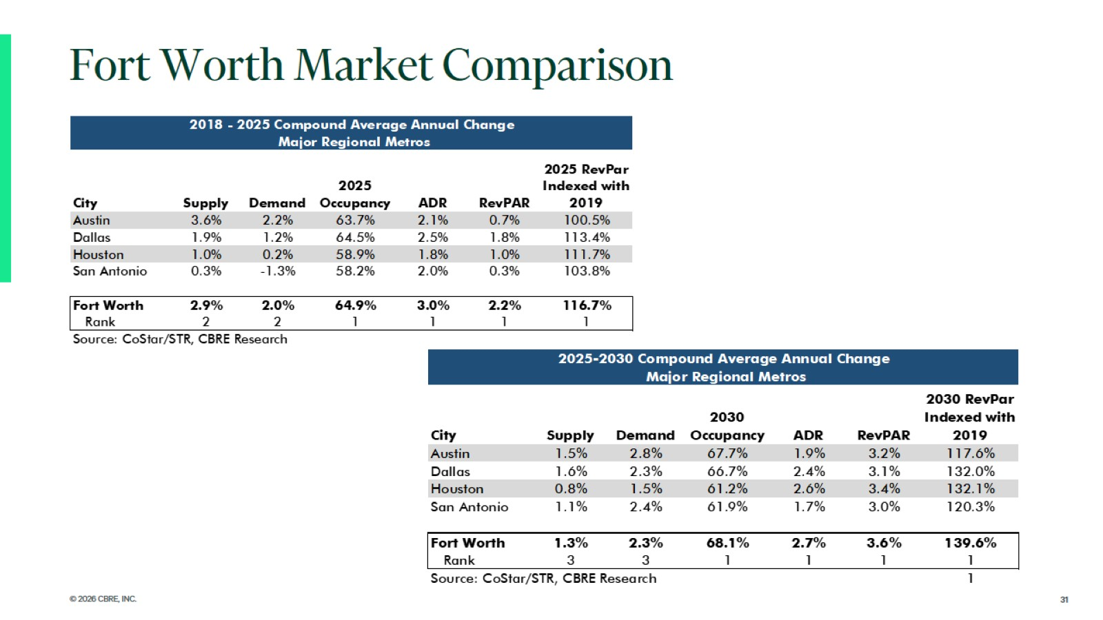

Slide 32
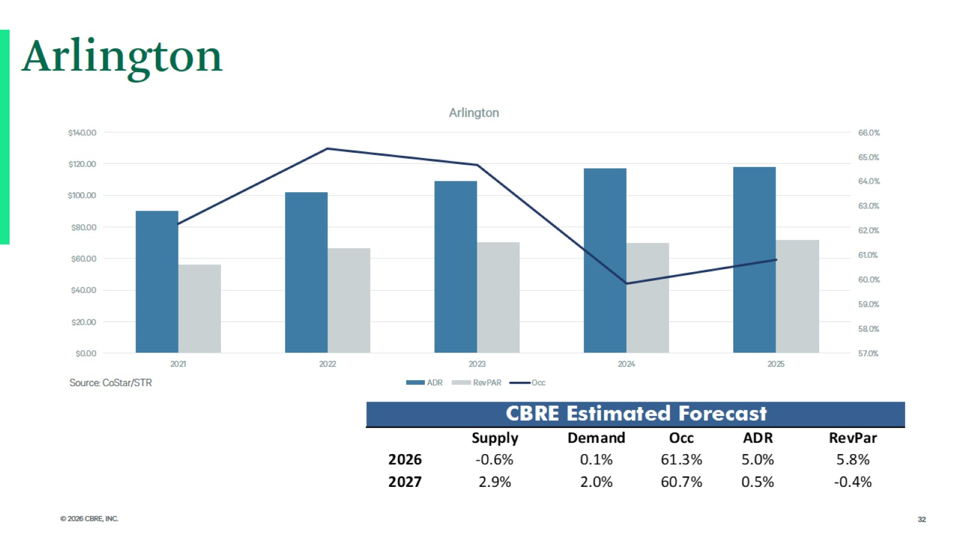
Arlington

Slide 33
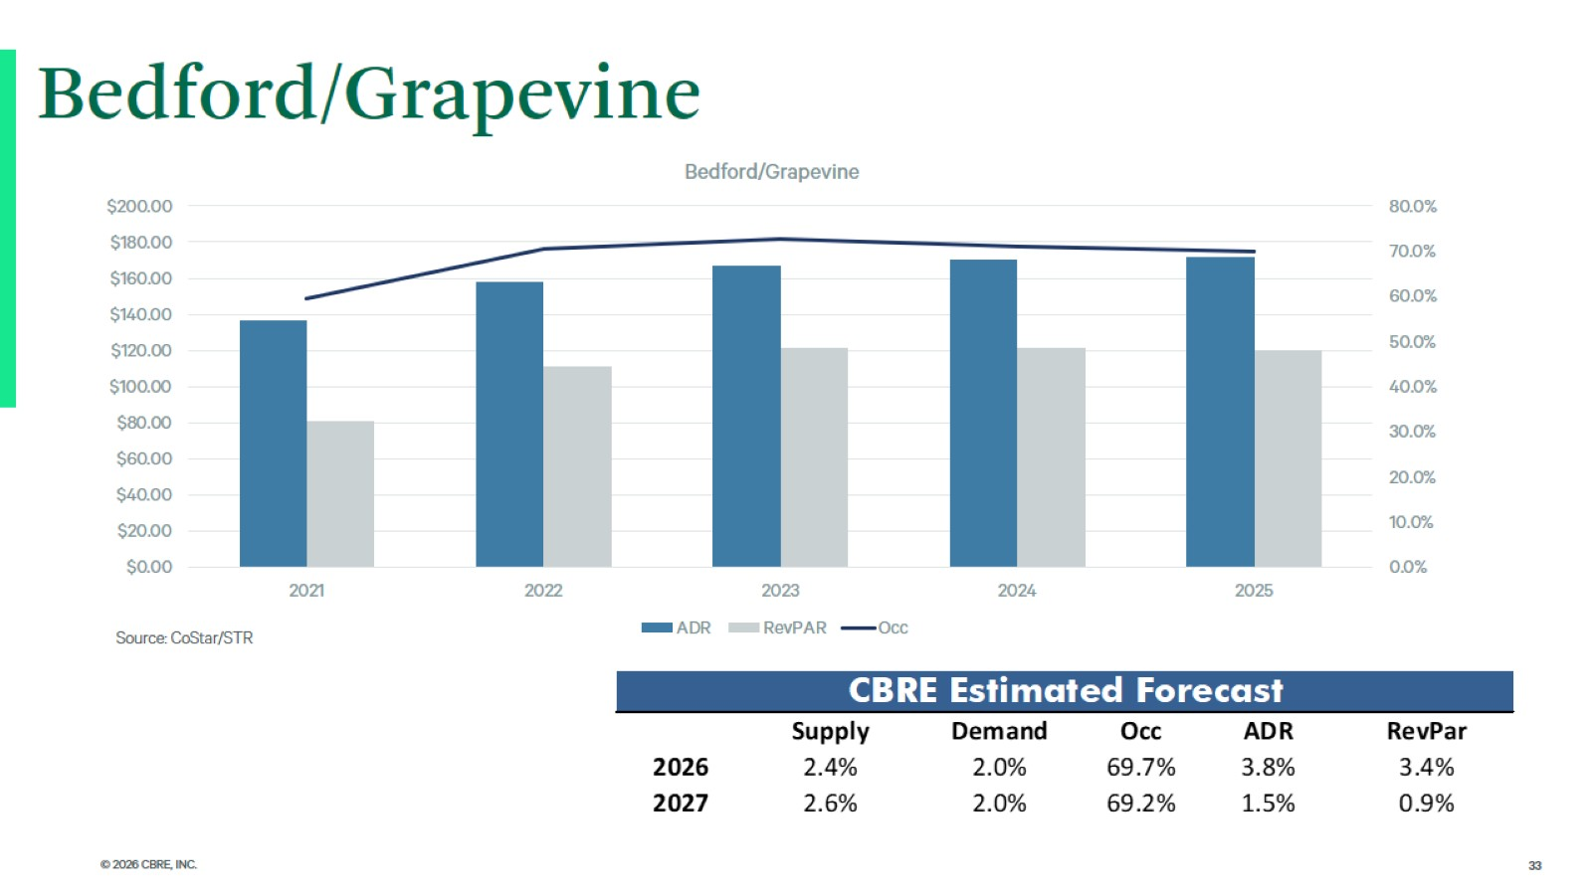
Bedford/Grapevine

Slide 34
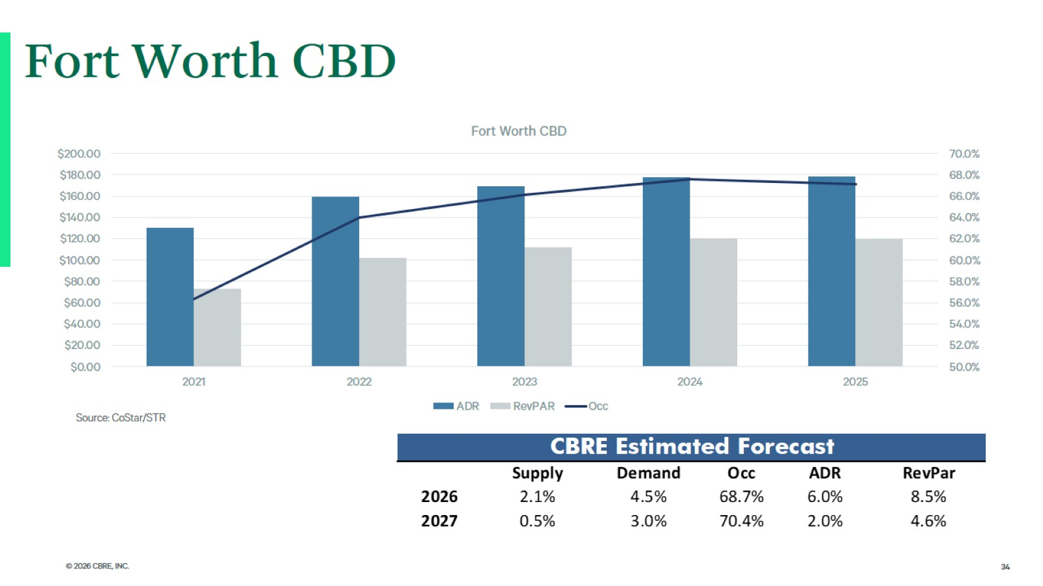
Fort Worth CBD

Slide 35
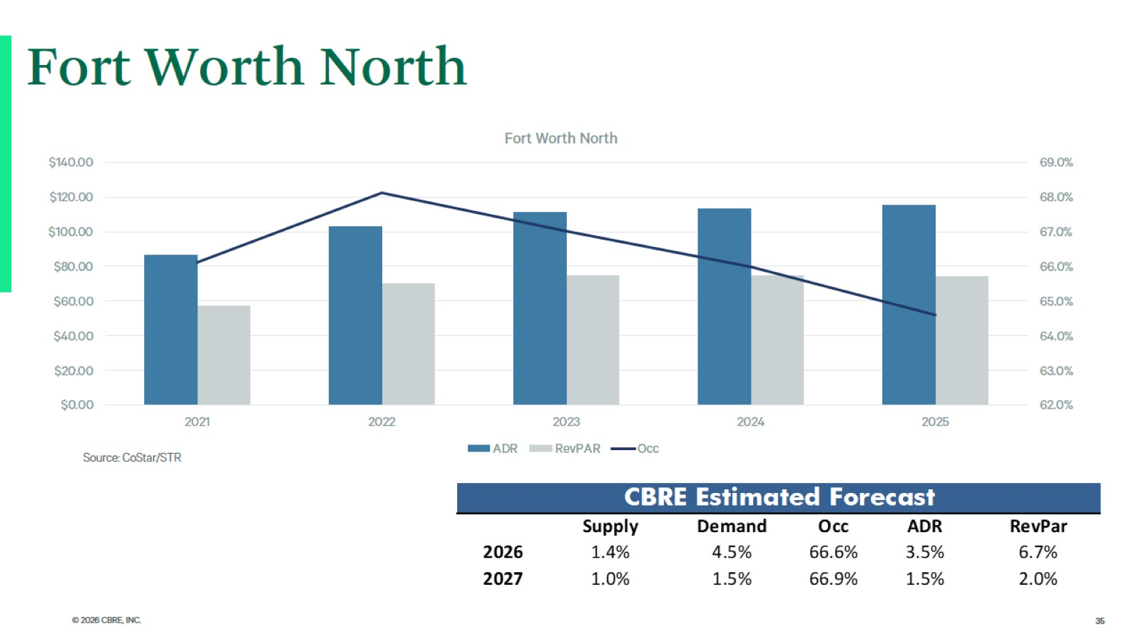
Fort Worth North

Slide 36
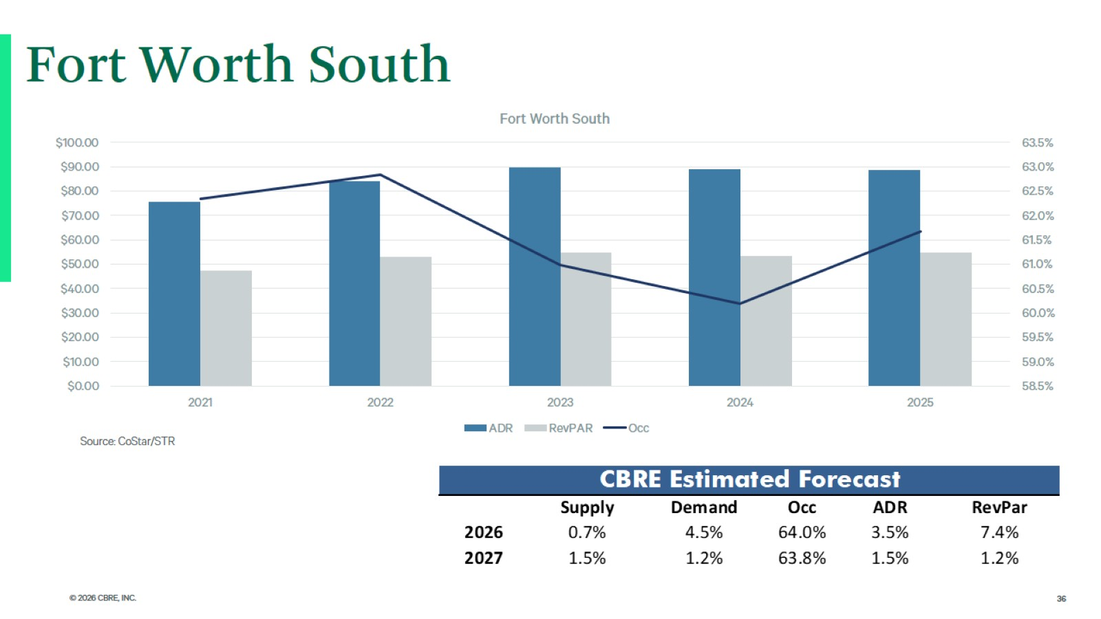
Fort Worth South

Slide 37
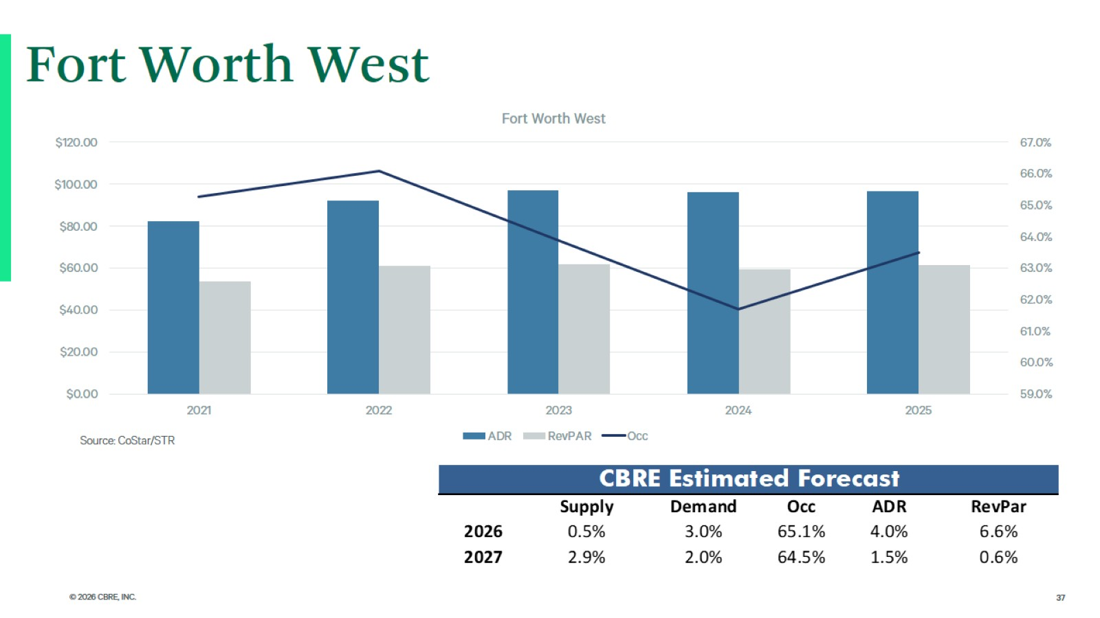
Fort Worth West

Slide 38
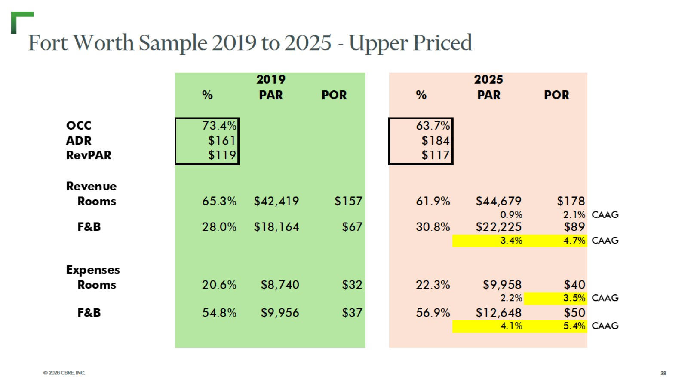
Fort Worth Sample 2019 to 2025 - Upper Priced

Slide 39
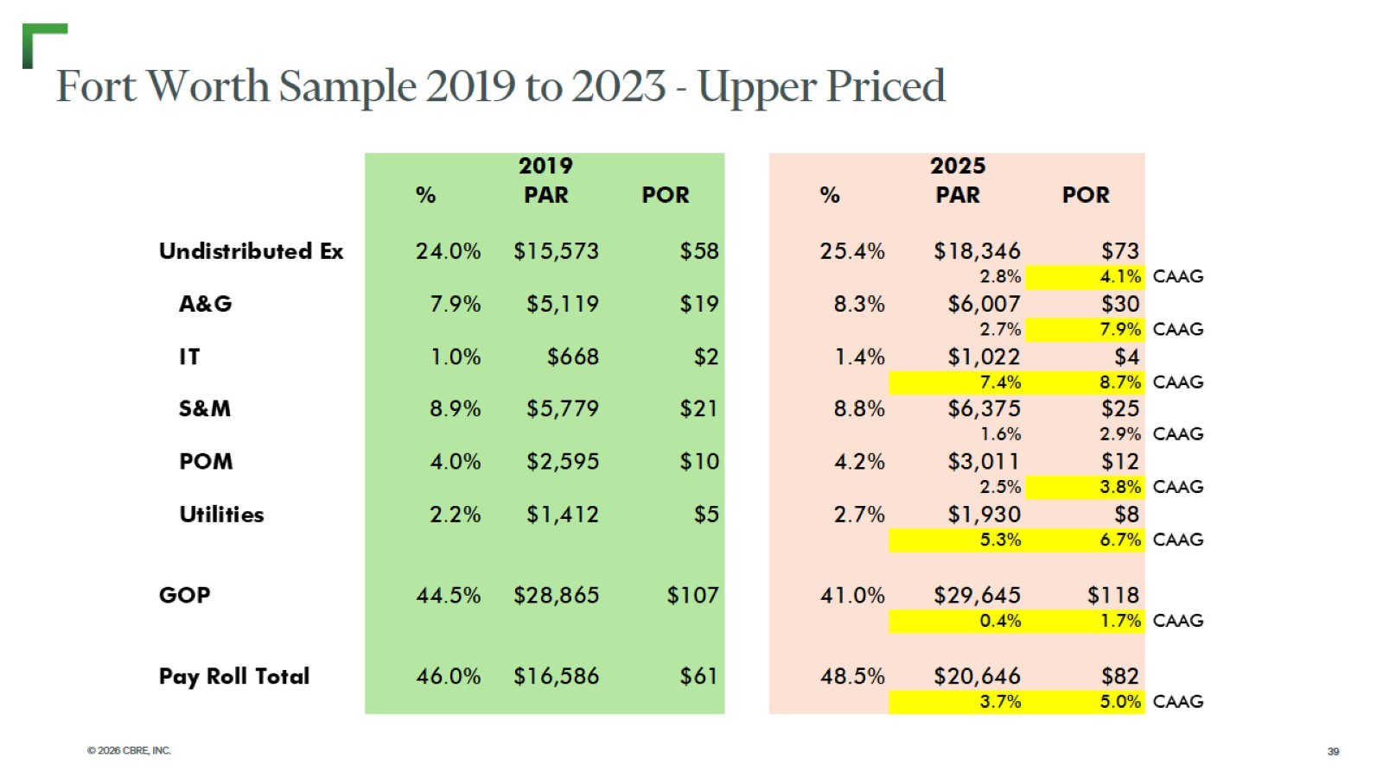
Fort Worth Sample 2019 to 2023 - Upper Priced

Slide 40
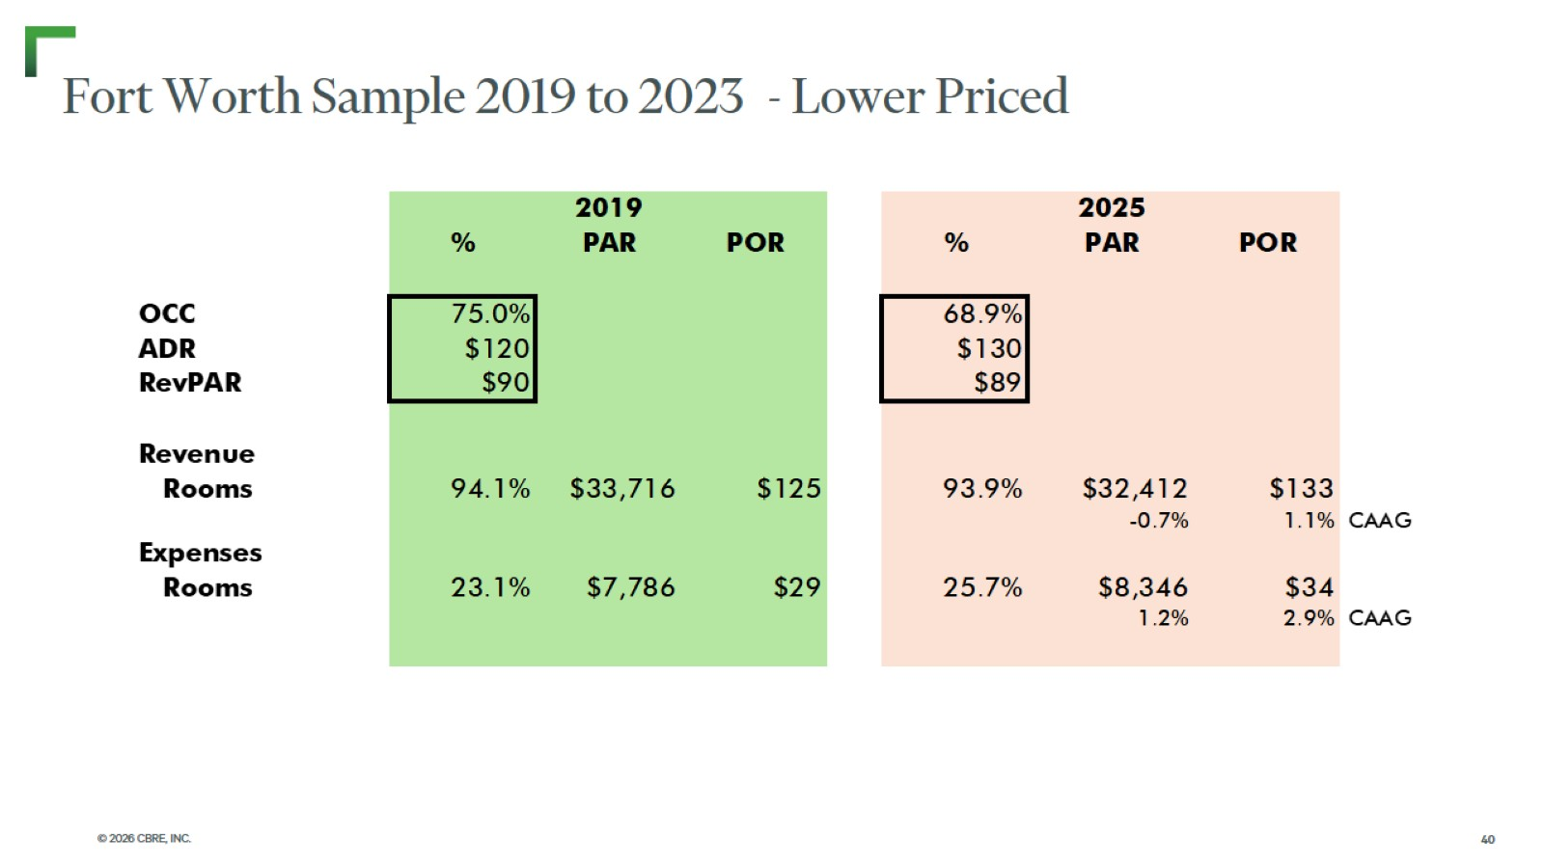
Fort Worth Sample 2019 to 2023 - Lower Priced

Slide 41
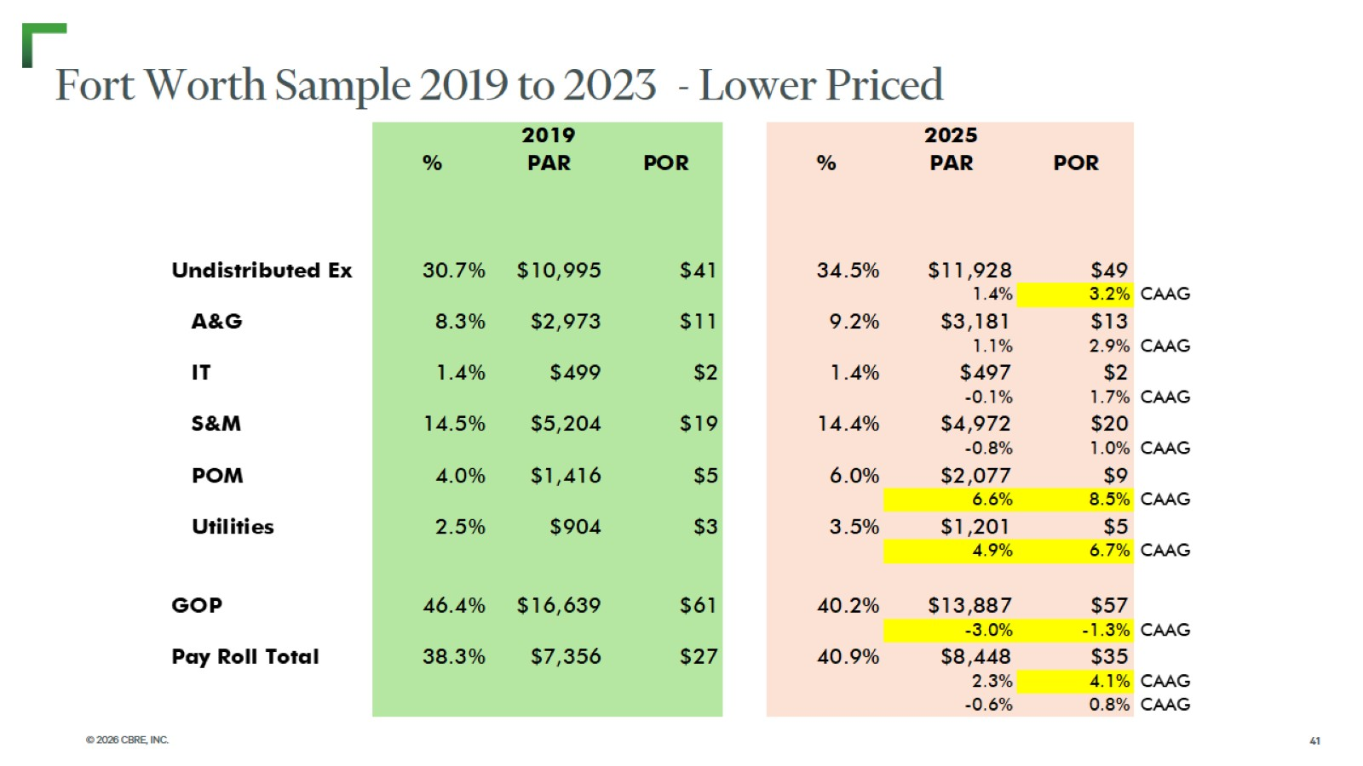
Fort Worth Sample 2019 to 2023 - Lower Priced

Slide 42

Addenda

Slide 43
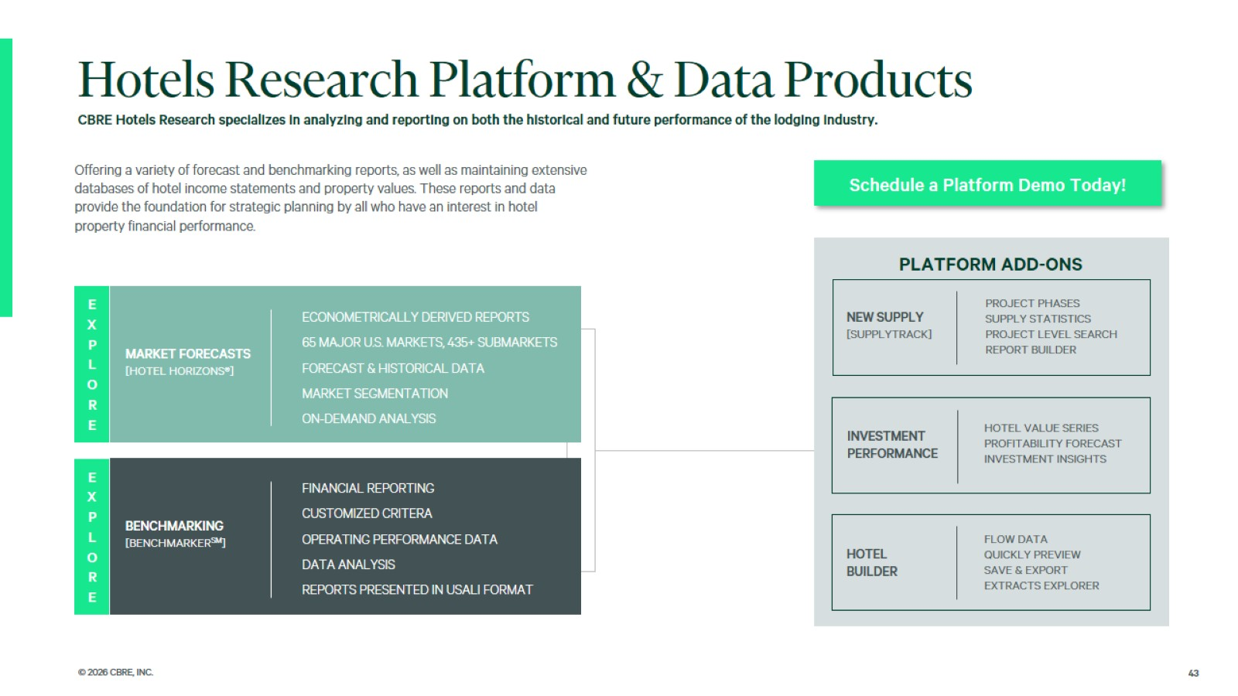

Slide 44

CBRE Hotels
Advisory
Capabilities

Slide 45

Insight. Integration.
Results.

Slide 46
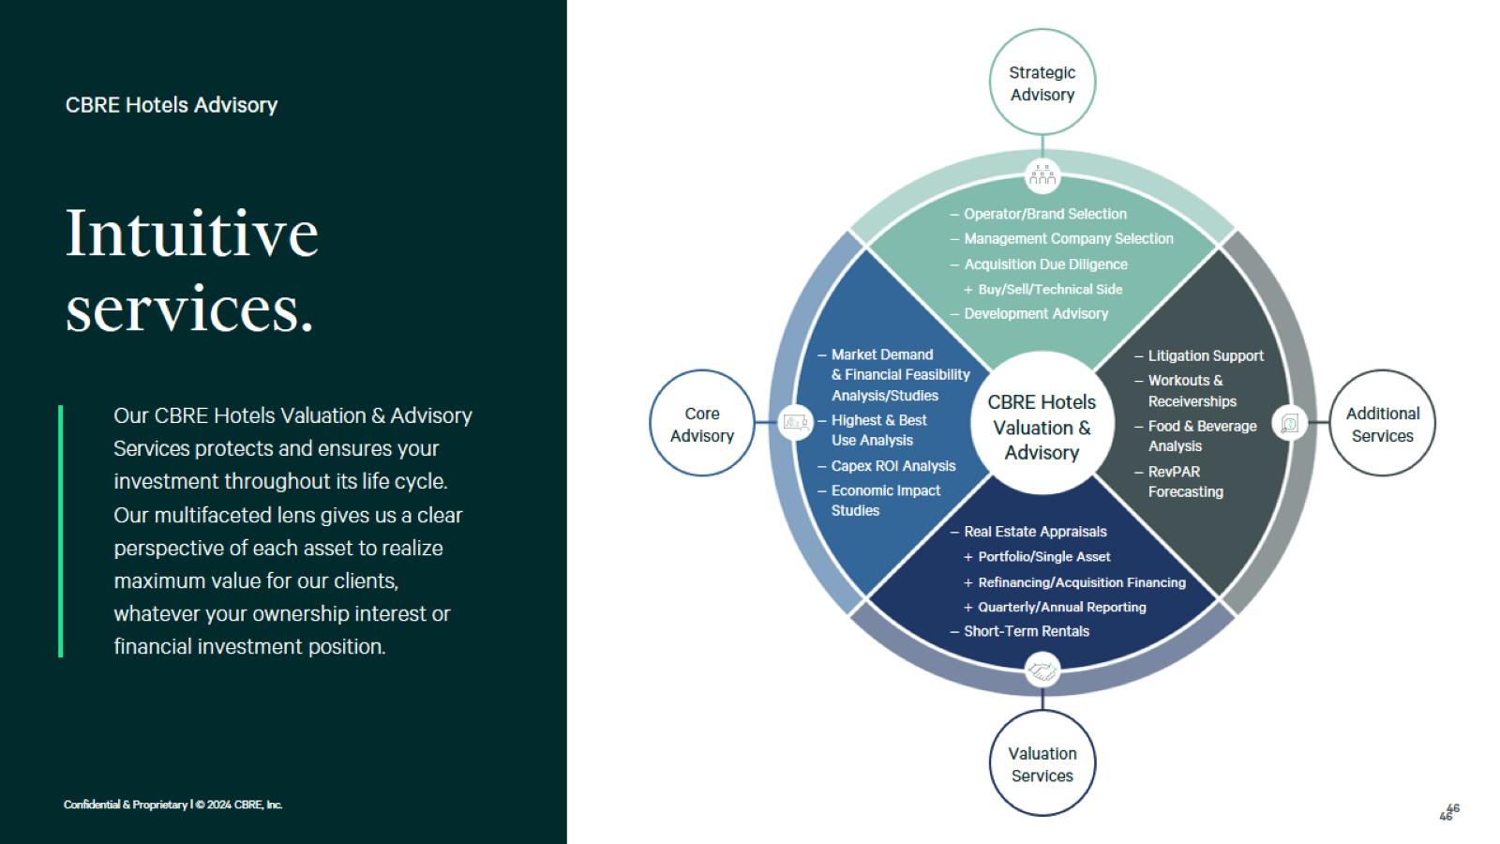

Slide 47
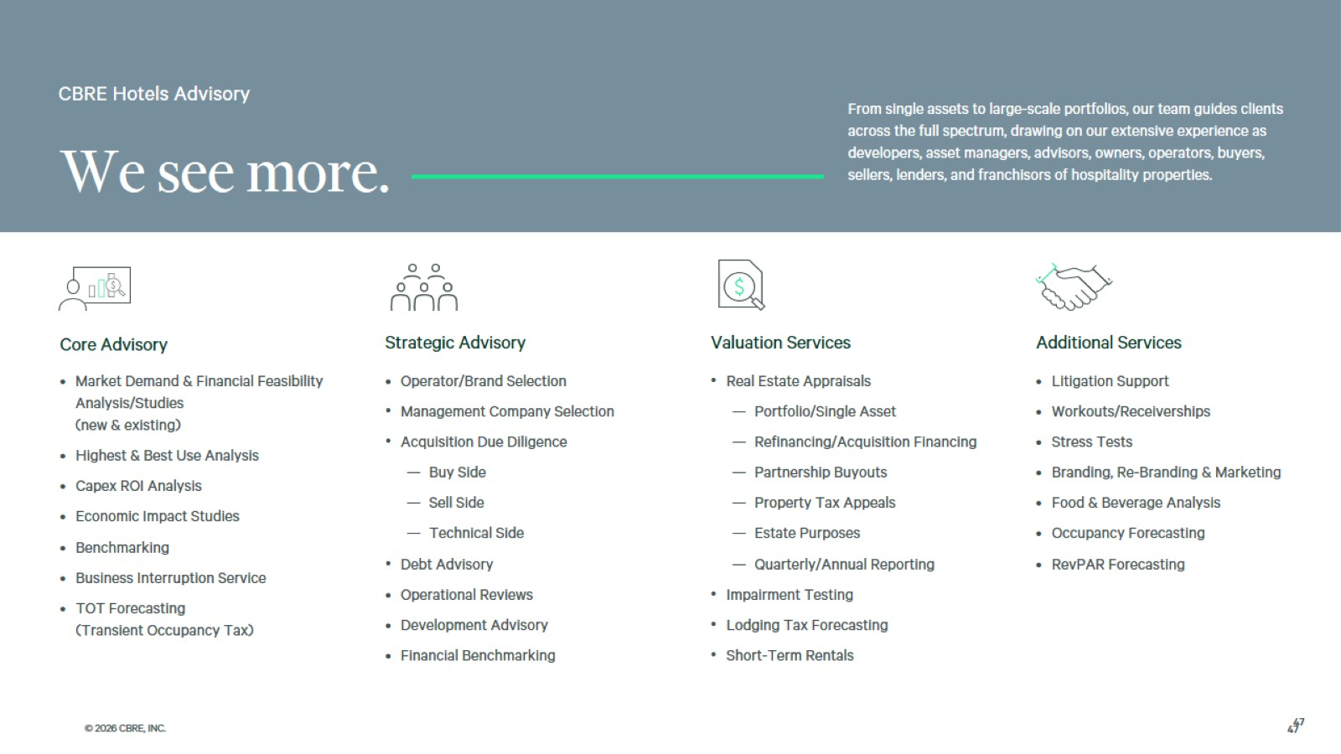

Slide 48
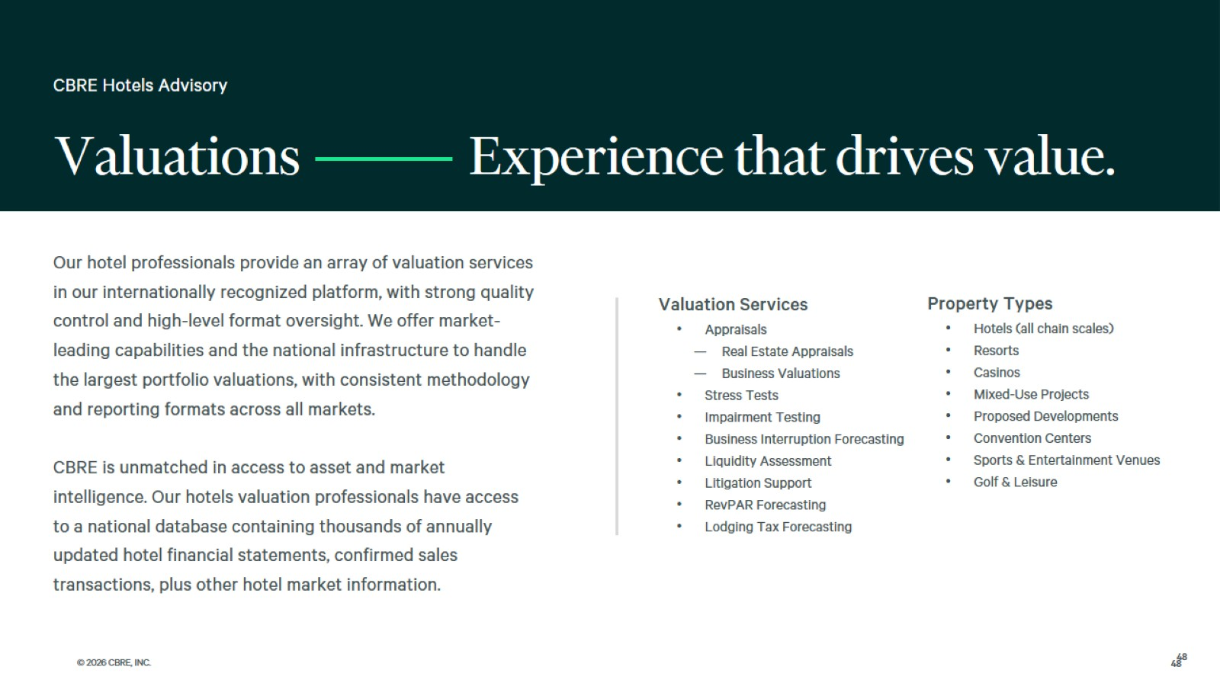
Experience that drives value.

Slide 49
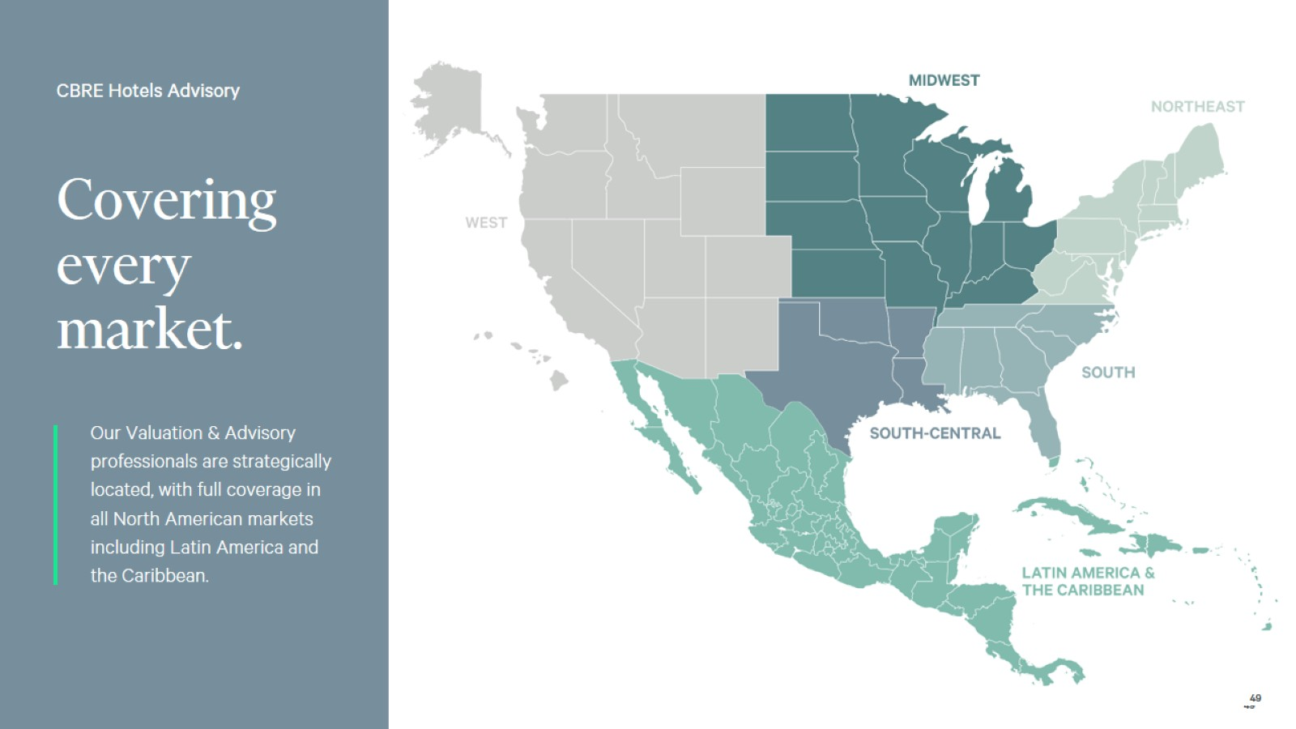
Covering every market.

Slide 50
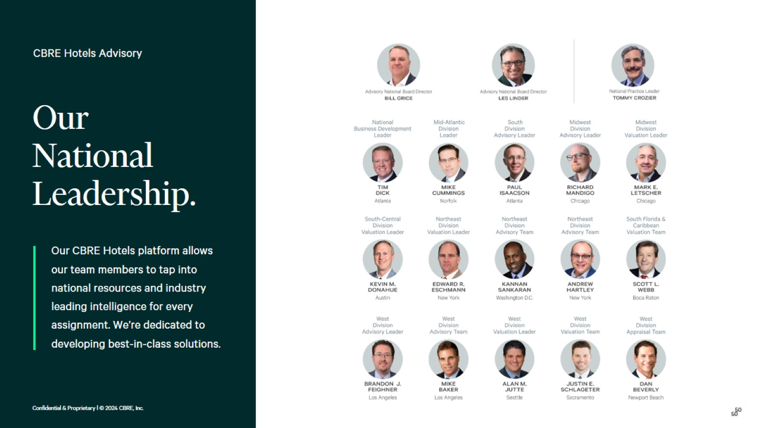
Our
National Leadership.

Slide 51
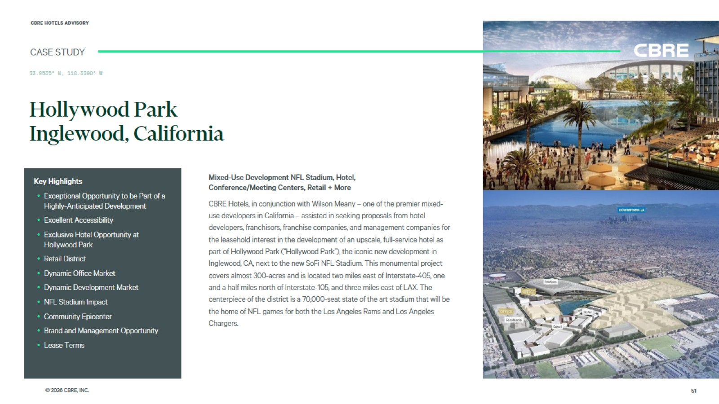
Hollywood Park
Inglewood, California

Slide 52
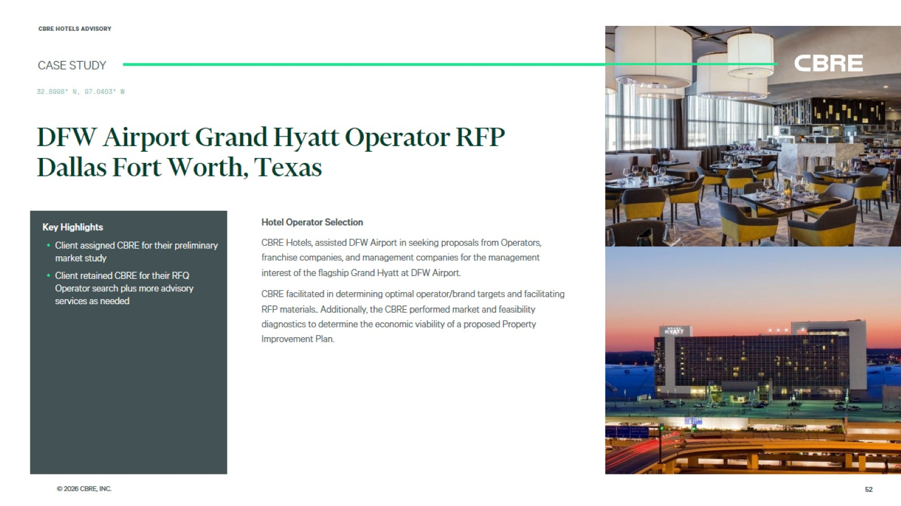
DFW Airport Grand Hyatt Operator RFP
Dallas Fort Worth, Texas

Slide 53
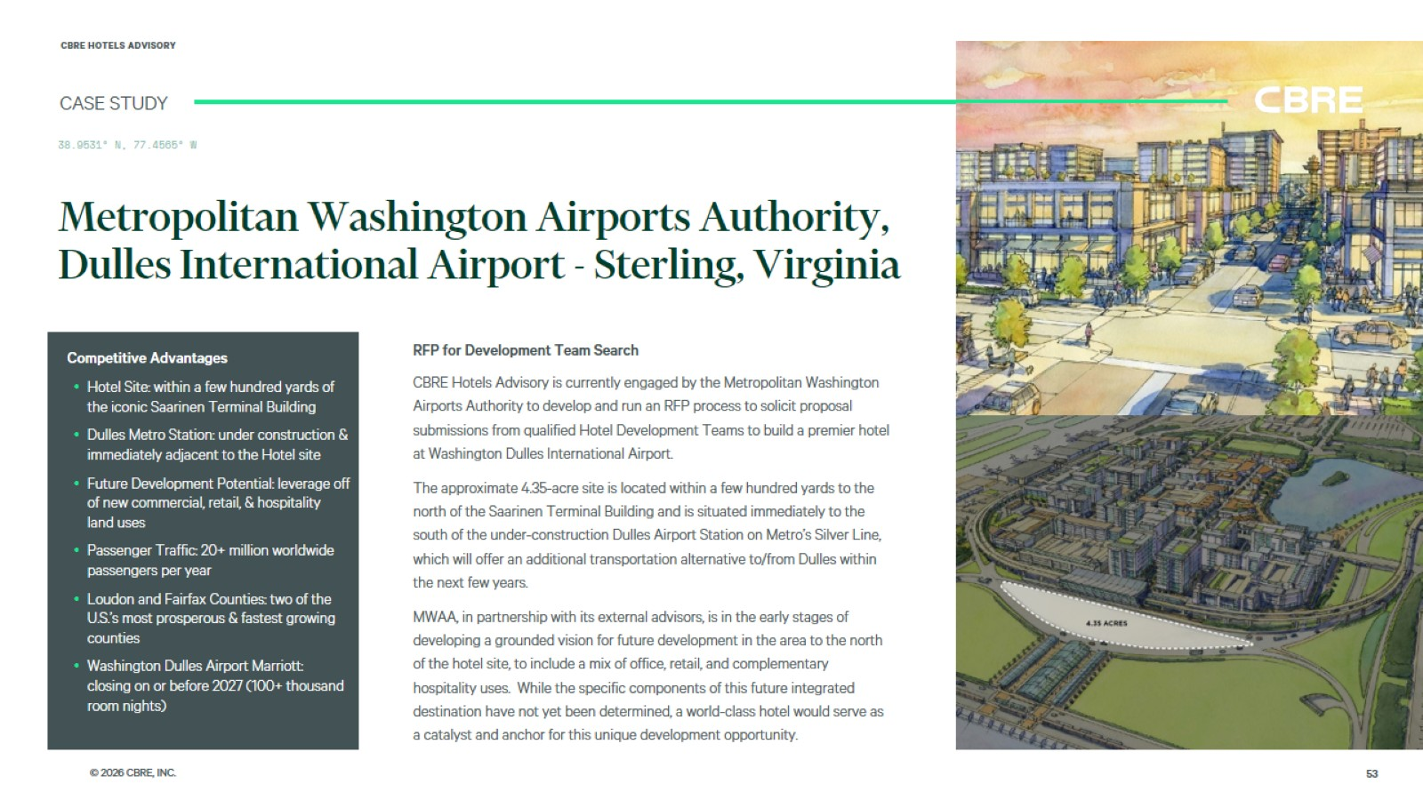
Metropolitan Washington Airports Authority, Dulles International Airport - Sterling, Virginia

Slide 54
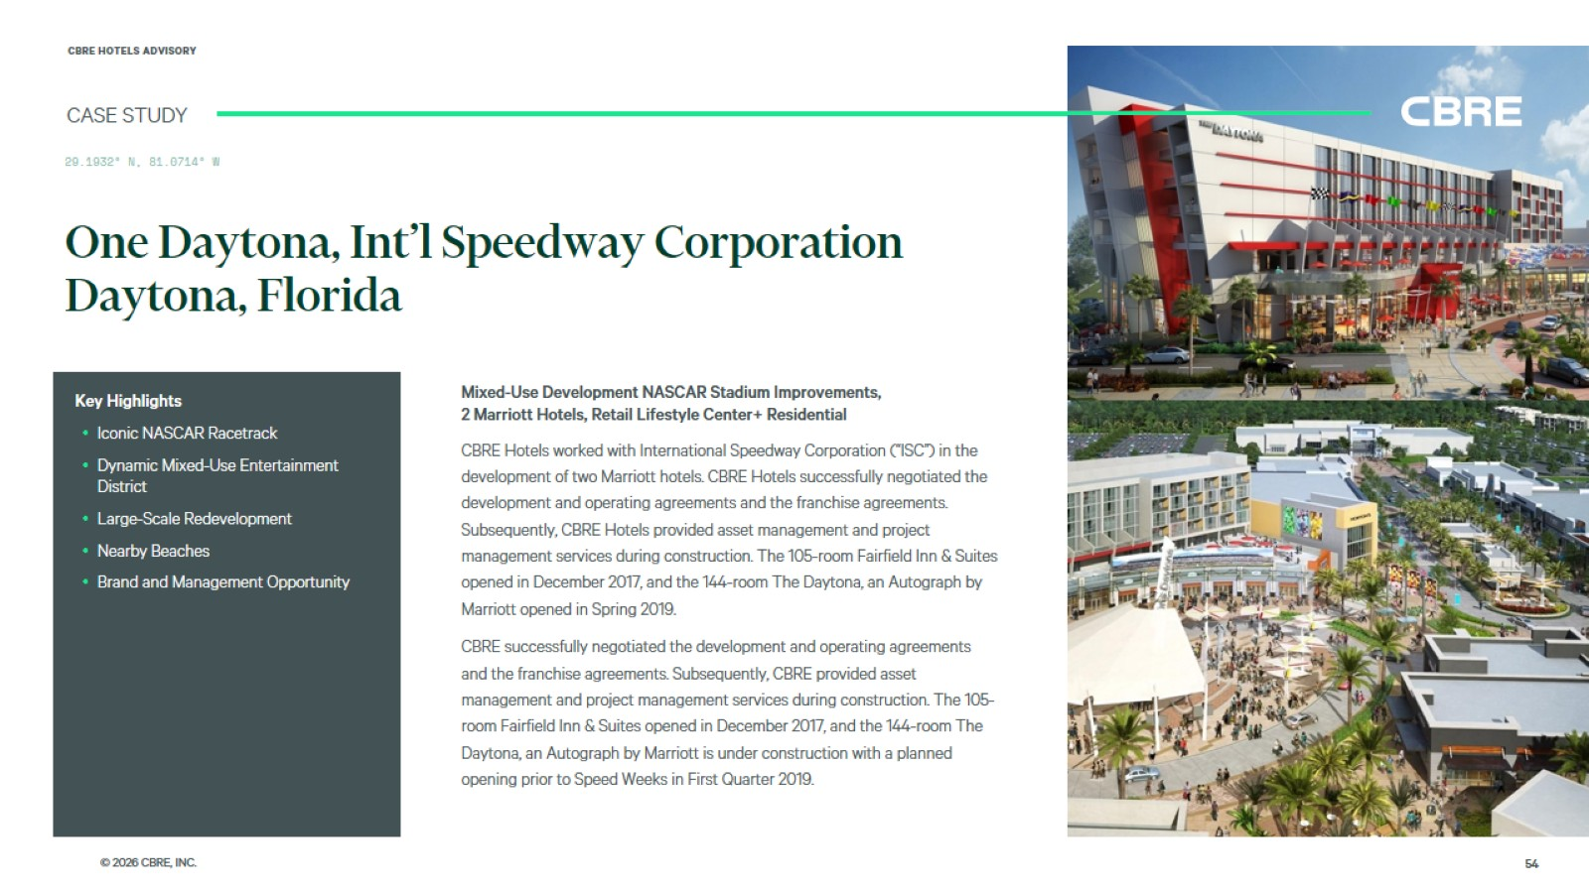
One Daytona, Int’l Speedway Corporation
Daytona, Florida

Slide 55
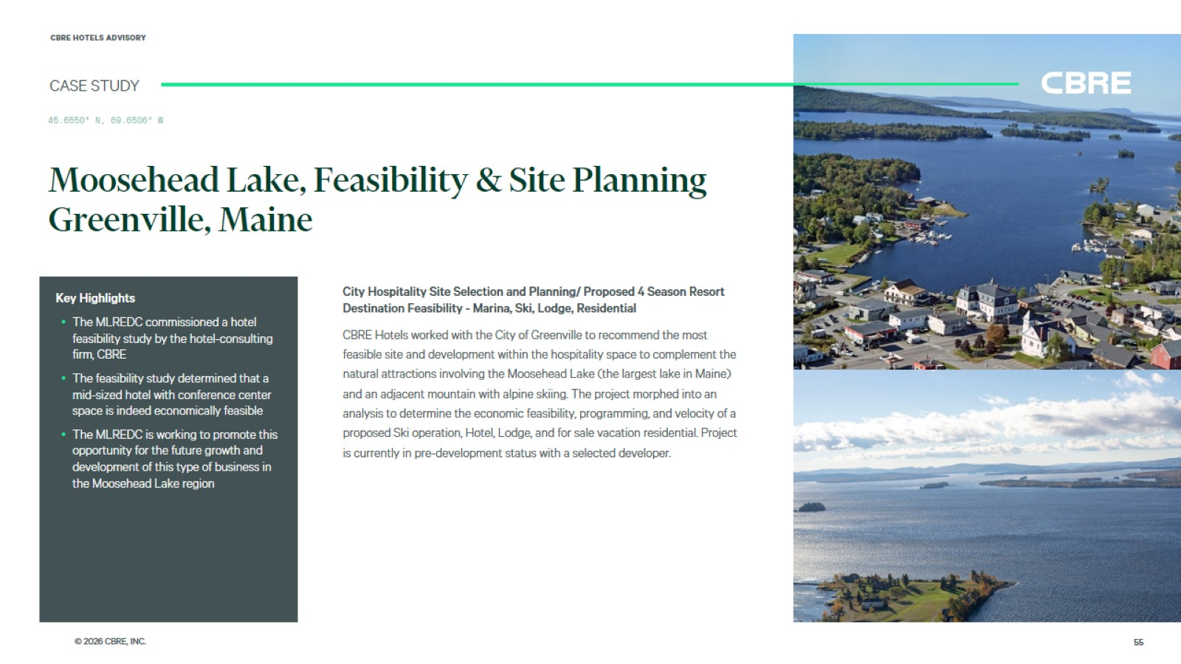
Moosehead Lake, Feasibility & Site Planning
Greenville, Maine

Slide 56
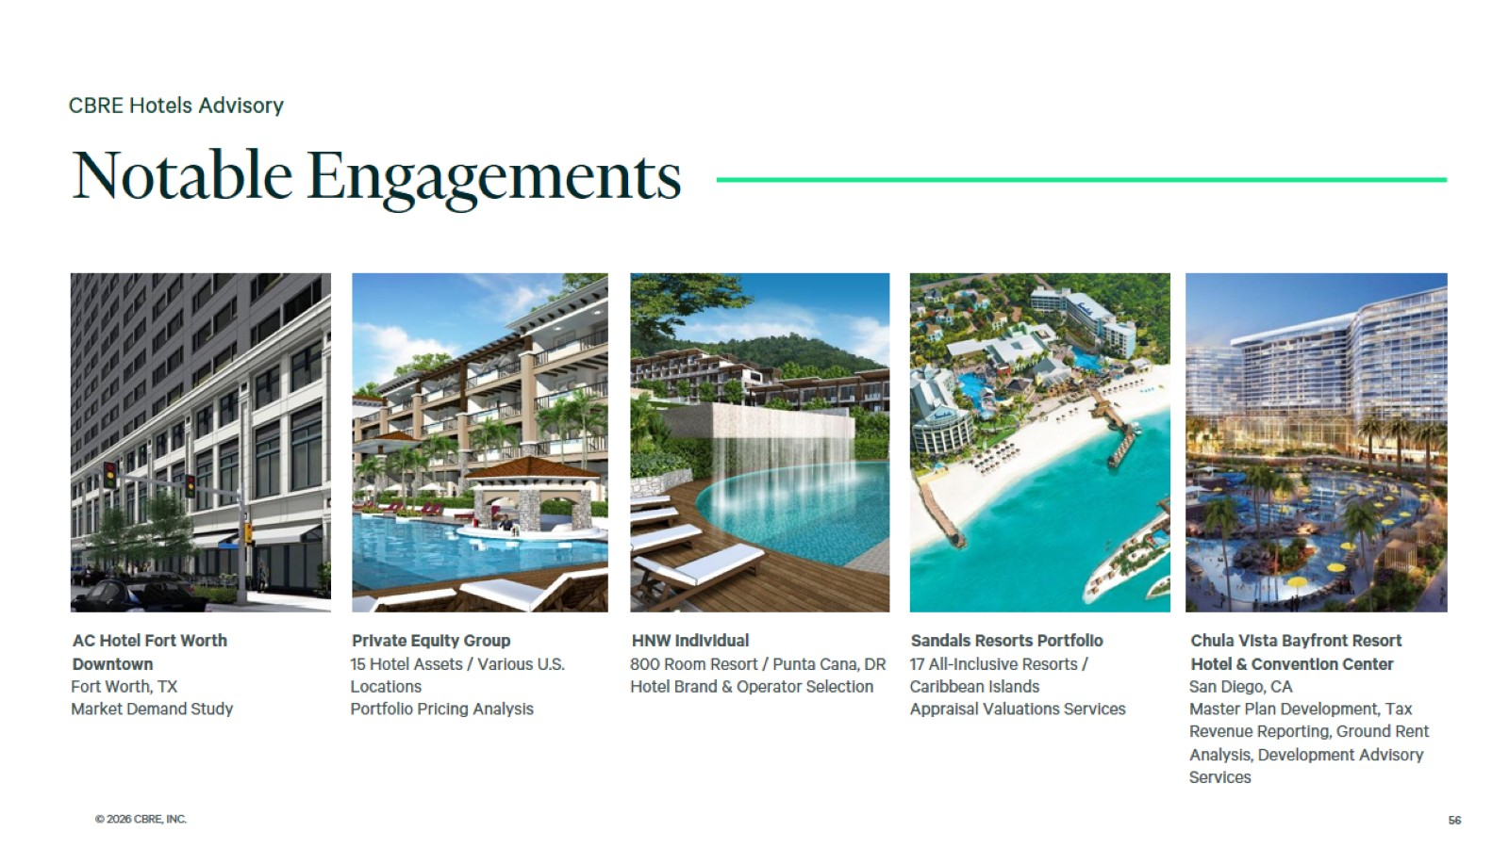

Slide 57
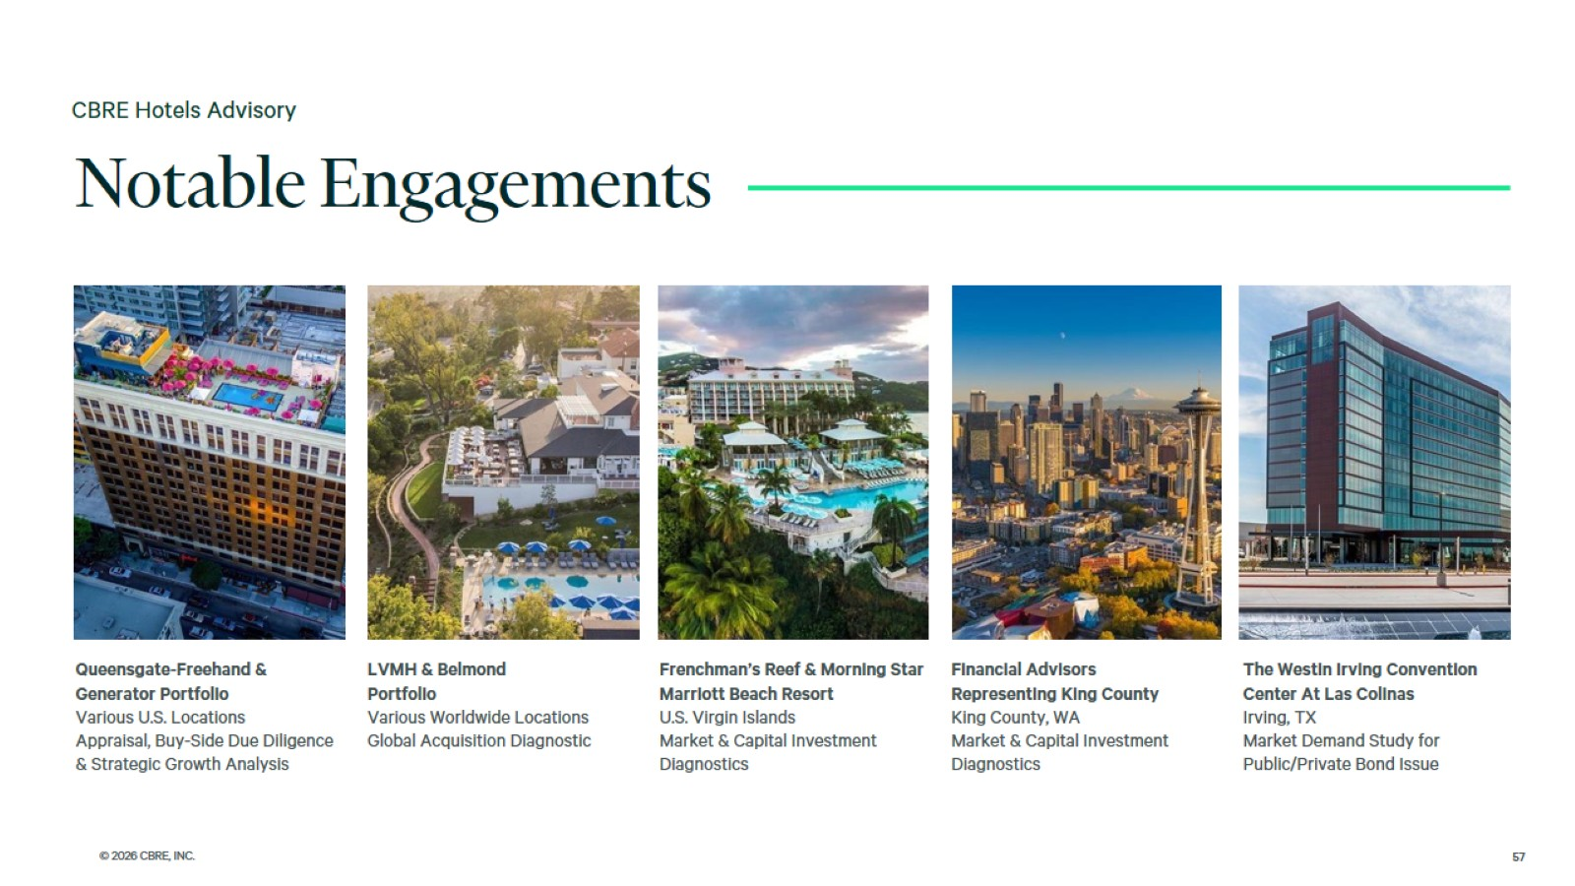

Slide 58
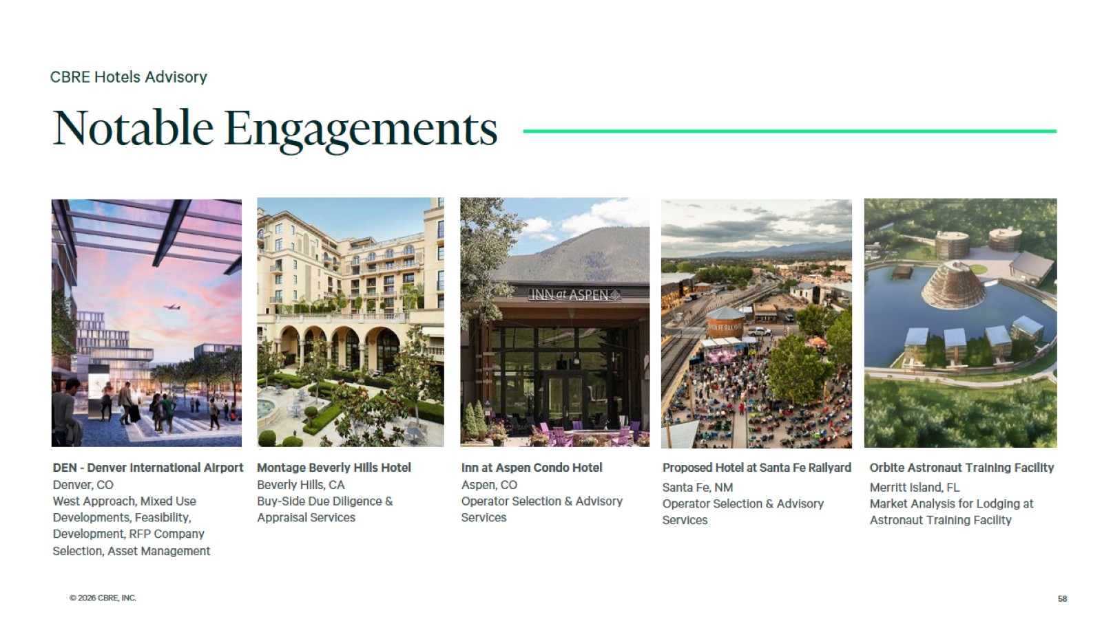

Slide 59


